Slide 1
TYPE OF HYDROGEN STORAGE SYSTEM
Liquid (cryogenic) hydrogen
Hydrogenated liquid organic hydrogen carrier
Compressed gaseous hydrogen
Ammonia

Slide 2
Low density at gaseous state
Low volumetric density
ISSUES OF STORAGE HYDROGEN

Slide 4
WHY Compressed Gas
However, compressed gas has been chosen due to the approximate with current technologies used in offshore by oil and gas industry , Moreover , similarities with natural gas process . Although , the liquid hydrogen can be considered a better option due to their high density as reported by Krishna el 2012 , it seems that the challenge with temperature is considered costly option . Furthermore , the hydrogen at this system boils in -253 C which means it is necessary to maintain the temperature in balance or it may boil away . In addition , designers of cryogenic liquid hydrogen storage and supply systems should be familiar with all the hazards of gaseous hydrogen as well as those of liquid hydrogen .

Slide 5
Materials suitable for hydrogen high pressure vessels
The risk of hydrogen embrittlement of the steel.
carbon fibers can be used for composite tanks wrapping.
Carbon steel .

Slide 6
Hydrogen Storage system offshore
Compressed Gas

Slide 7
Number of the tanks
Total of the weight system
Quantity of storage H2

Slide 8
COMPRESSED HYDROGEN STORAGE
The following 4 types of high pressure vessels are classified
Type I: pressure vessel made of metal
Type II: pressure vessel made of a thick metallic liner hoop wrapped with a fiber-resin composite.
Type III: pressure vessel made of a metallic liner fully-wrapped with a fiber-resin composite.
Type IV: pressure vessel made of polymeric liner fully-wrapped with a fiber-resin composite.
The port is metallic and integrated in the structure (boss).

Slide 9
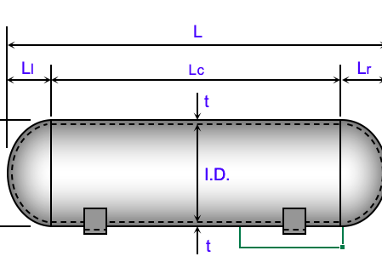
Thickness of Tank
t = $\frac{PR°}{2SE+0.4P}$
Thickness circumferential Stress Calculations per Paragraph UG-27 internal radius.
t = $\frac{PR}{2SE+0.4P}$ ,
t = $\frac{PR}{2SE+0.4P}$
Thickness Longitudinal Stress Calculations
t = $\frac{P∗R}{SE−0.6∗P}+CA$ ,wall thickness.
P = $\frac{2SEt}{D+0.2t}$ , Allowable Max. pressure

