Slide 1
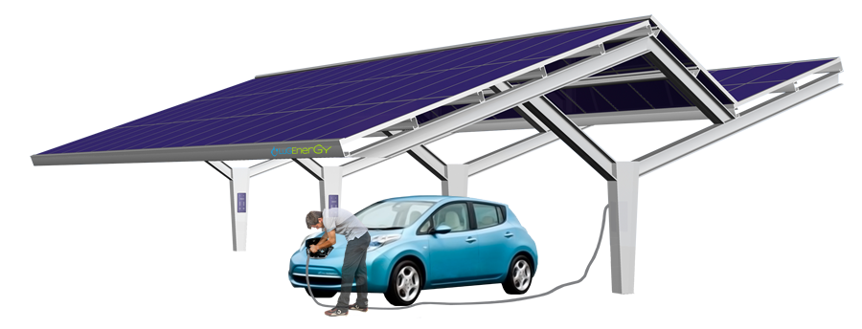
Feasibility study into the use of clean urban energy resources to make a contribution to electric vehicle (EV) demand
Source:LuGEnerGY
MSc Sustainable Engineering: Renewable Energy Systems and the Environment

Slide 2
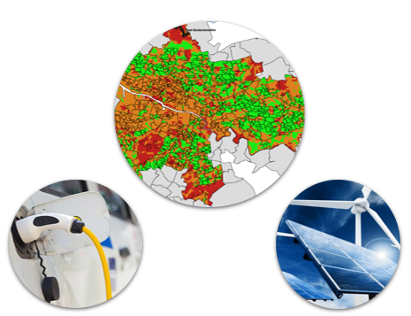
PROJECT AIM & METHOD
Project aim & method
Deliverables
Assessment of EV demand
Assessment of resources
Land identification
Results
AIM: To carry out a quantitative assessment of contribution of urban renewable energy to meet different electric vehicle demands depending on land availability
To carry out a quantitative assessment of contribution of urban renewable energy to meet different electric vehicle demands depending on land availability
Land identification
Electric vehicle demand estimation
Renewable supply estimation

Slide 3
DELIVERABLES
Project aim & method
Deliverables
Assessment of EV demand
Assessment of resources
Land identification
Results
To carry out a quantitative assessment of contribution of urban renewable energy to meet different electric vehicle demands depending on land availability
Decision support tool
To carry out a quantitative assessment of contribution of urban renewable energy to meet different electric vehicle demands depending on land availability
Land identification
Electric vehicle demand estimation
Renewable supply estimation

Slide 4
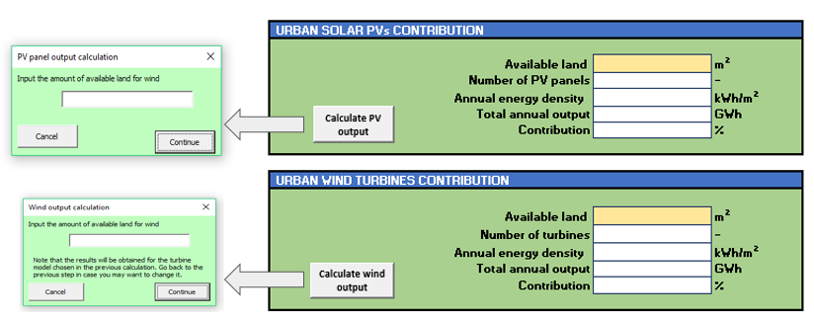
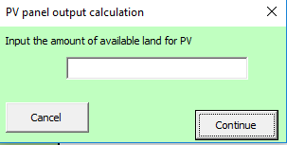
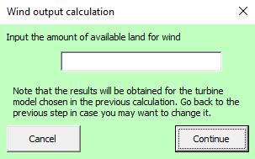
DELIVERABLES
DECISION SUPPORT TOOL

Slide 5
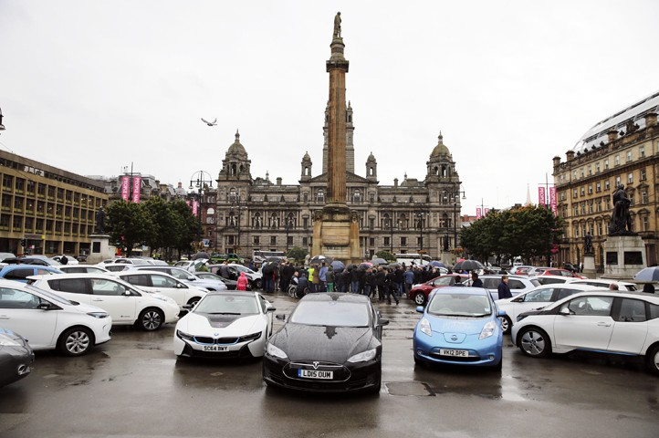
ASSESSMENT OF ELECTRIC VEHICLE DEMAND
Project aim & method
Assessment of EV demand
Assessment of resources
Land identification
Results
Deliverables
Three scenarios
Our example: Glasgow

Slide 6
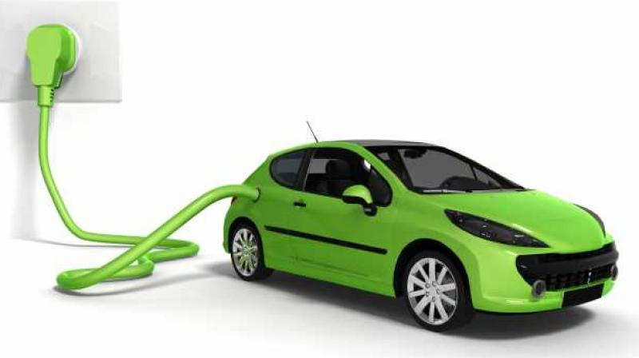
ASSESSMENT OF ELECTRIC VEHICLE DEMAND
EV roll-out short-term scenario
SCENARIO 2024:
Glasgow City Council target
25,000 EVs → 10% of private car fleet
Source: electtricomagazine.it
Notes:
SCENARIO 1:It only refers to cars, and represents the Target established by the Glasgow City Council for 2024, which expects to have 25000 electric cars in the streets of Glasgow. This would mean that a 10% of the current car fleet would be transformed into electric.
SCENARIO 2: encloses scenario 1, plus the Scottish Government Target for 2030, expecting to tranform at least 50% of the bus fleet in Scotland into electric. Therefore, this scenairo was developed by asuming that 10% of the current private car fleet and 50% of the bus fleet in Glasgow would be electric.
SCENARIO 3. It is the most futuristic scenario, and represents the energy requirements that would arise from a completely electric car and bus fleet in Glasgow. An inclusion of individual modes of tranport, such as electric bikes or scootes was considered as well, and therefore, it was predicted that the number of private cars would declined.

Slide 7
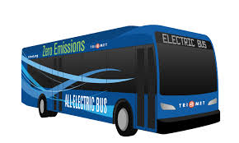
ASSESSMENT OF ELECTRIC VEHICLE DEMAND
EV roll-out medium-term scenario
SCENARIO 2030:
Scenario 2024 + Scottish Government target
25,000 EVs → 10% of private car fleet
486 electric buses → 50% of bus fleet
Source:trimet.org
Notes:
SCENARIO 1:It only refers to cars, and represents the Target established by the Glasgow City Council for 2024, which expects to have 25000 electric cars in the streets of Glasgow. This would mean that a 10% of the current car fleet would be transformed into electric.
SCENARIO 2: encloses scenario 1, plus the Scottish Government Target for 2030, expecting to tranform at least 50% of the bus fleet in Scotland into electric. Therefore, this scenairo was developed by asuming that 10% of the current private car fleet and 50% of the bus fleet in Glasgow would be electric.
SCENARIO 3. It is the most futuristic scenario, and represents the energy requirements that would arise from a completely electric car and bus fleet in Glasgow. An inclusion of individual modes of tranport, such as electric bikes or scootes was considered as well, and therefore, it was predicted that the number of private cars would declined.

Slide 8
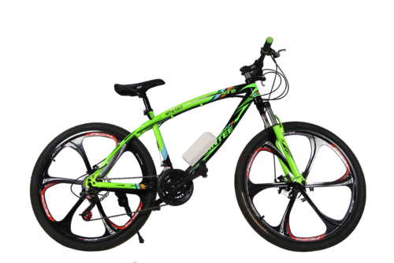
ASSESSMENT OF ELECTRIC VEHICLE DEMAND
EV roll-out long-term scenario
SCENARIO 2050: Complete electrification of transport
217,463 EVs → 100% of private car fleet
971 electric buses → 100 % of bus fleet
1 personal mode of transport per 10 cars
Source: Scott cycles
Notes:
SCENARIO 1:It only refers to cars, and represents the Target established by the Glasgow City Council for 2024, which expects to have 25000 electric cars in the streets of Glasgow. This would mean that a 10% of the current car fleet would be transformed into electric.
SCENARIO 2: encloses scenario 1, plus the Scottish Government Target for 2030, expecting to tranform at least 50% of the bus fleet in Scotland into electric. Therefore, this scenairo was developed by asuming that 10% of the current private car fleet and 50% of the bus fleet in Glasgow would be electric.
SCENARIO 3. It is the most futuristic scenario, and represents the energy requirements that would arise from a completely electric car and bus fleet in Glasgow. An inclusion of individual modes of tranport, such as electric bikes or scootes was considered as well, and therefore, it was predicted that the number of private cars would declined.

Slide 9
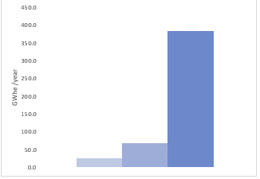
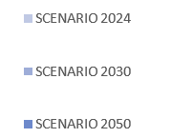
ASSESSMENT OF ELECTRIC VEHICLE DEMAND
Electrical energy requirements for Glasgow scenarios
Notes:
- Ability to transform a EV scenario into energy
- Scenarios based on Governmental plans
- EXPLAIN ALL THE SCENARIOS → TARGETS
-
Explain what we got
What is running
the results we obtain for this analysis.--> PUT THEM IN CONTEXT

Slide 10
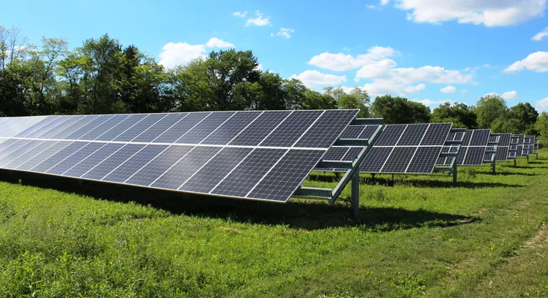
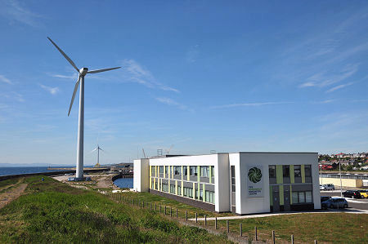
ASSESSMENT OF URBAN RENEWABLE ENERGY RESOURCES
Project aim & method
Assessment of EV demand
Assessment of resources
Land identification
Results
Deliverables
Assessment of resources
Solar PV calculation tool
Wind turbine calculation tool
Source:WMUK.org
Source: Fife Renewables Innovation Centre
Notes:
Explanation about the context of the project:
Government’s legislation to push forward RE deployment
Boosting cleaner cities
Many companes interested in investing money on projects like this
Quantitative evaluation looking into the future, carrying out a feasibility study of the contribution of clean urban energy resources to the implementation of EVs
We are not looking, charge control, supply-matching problems → “We understand those are really important problems behind this project. However, we are not looking into that in this project.”

Slide 11
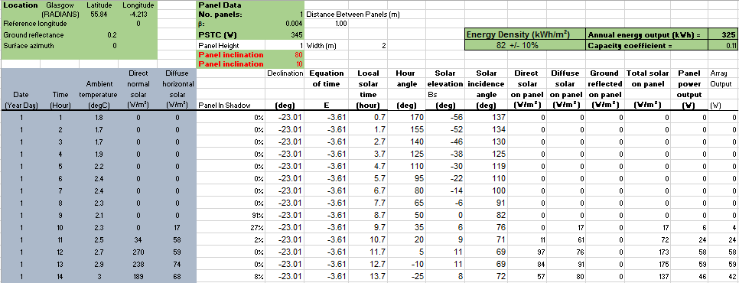
ASSESSMENT OF URBAN RENEWABLE ENERGY RESOURCES
Solar PV calculation tool
Notes:
Explanation about the context of the project:
Government’s legislation to push forward RE deployment
Boosting cleaner cities
Many companes interested in investing money on projects like this
Quantitative evaluation looking into the future, carrying out a feasibility study of the contribution of clean urban energy resources to the implementation of EVs
We are not looking, charge control, supply-matching problems → “We understand those are really important problems behind this project. However, we are not looking into that in this project.”

Slide 12
ASSESSMENT OF URBAN RENEWABLE ENERGY RESOURCES
Solar PV calculation tool
Notes:
Explanation about the context of the project:
Government’s legislation to push forward RE deployment
Boosting cleaner cities
Many companes interested in investing money on projects like this
Quantitative evaluation looking into the future, carrying out a feasibility study of the contribution of clean urban energy resources to the implementation of EVs
We are not looking, charge control, supply-matching problems → “We understand those are really important problems behind this project. However, we are not looking into that in this project.”

Slide 13
ASSESSMENT OF URBAN RENEWABLE ENERGY RESOURCES
Solar PV calculation tool
Notes:
Explanation about the context of the project:
Government’s legislation to push forward RE deployment
Boosting cleaner cities
Many companes interested in investing money on projects like this
Quantitative evaluation looking into the future, carrying out a feasibility study of the contribution of clean urban energy resources to the implementation of EVs
We are not looking, charge control, supply-matching problems → “We understand those are really important problems behind this project. However, we are not looking into that in this project.”

Slide 14
ASSESSMENT OF URBAN RENEWABLE ENERGY RESOURCES
Solar PV calculation tool
Notes:
Explanation about the context of the project:
Government’s legislation to push forward RE deployment
Boosting cleaner cities
Many companes interested in investing money on projects like this
Quantitative evaluation looking into the future, carrying out a feasibility study of the contribution of clean urban energy resources to the implementation of EVs
We are not looking, charge control, supply-matching problems → “We understand those are really important problems behind this project. However, we are not looking into that in this project.”

Slide 15
ASSESSMENT OF URBAN RENEWABLE ENERGY RESOURCES
Solar PV calculation tool
Notes:
Explanation about the context of the project:
Government’s legislation to push forward RE deployment
Boosting cleaner cities
Many companes interested in investing money on projects like this
Quantitative evaluation looking into the future, carrying out a feasibility study of the contribution of clean urban energy resources to the implementation of EVs
We are not looking, charge control, supply-matching problems → “We understand those are really important problems behind this project. However, we are not looking into that in this project.”

Slide 16
ASSESSMENT OF URBAN RENEWABLE ENERGY RESOURCES
Solar PV calculation tool
Notes:
Explanation about the context of the project:
Government’s legislation to push forward RE deployment
Boosting cleaner cities
Many companes interested in investing money on projects like this
Quantitative evaluation looking into the future, carrying out a feasibility study of the contribution of clean urban energy resources to the implementation of EVs
We are not looking, charge control, supply-matching problems → “We understand those are really important problems behind this project. However, we are not looking into that in this project.”

Slide 17
ASSESSMENT OF URBAN RENEWABLE ENERGY RESOURCES
Optimum angle of inclination
$$β_{f}$$
$$P_{W}$$
$$P_{h}$$
$$P_{th}$$
f
f
s
$$A_{p}$$
Source: http://www.greenrhinoenergy.com/solar/performance/shading.php

Slide 18
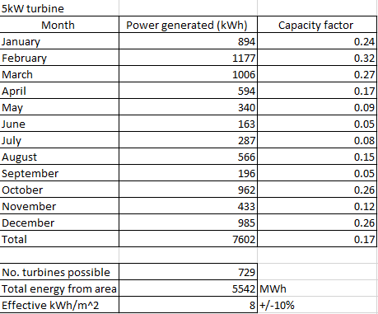
ASSESSMENT OF URBAN RENEWABLE ENERGY RESOURCES
Wind power calculation tool

Slide 19
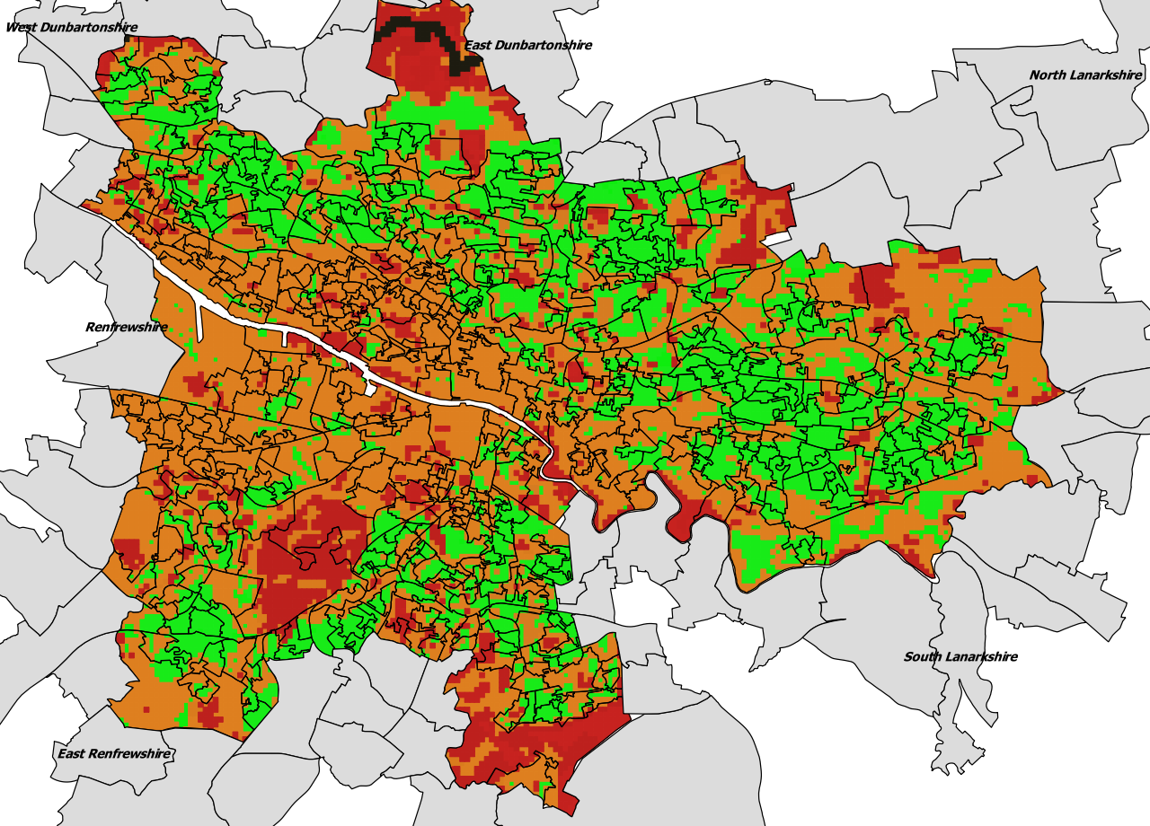
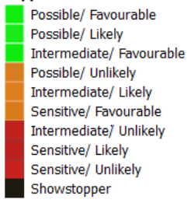
LAND IDENTIFICATION
Project aim & method
Assessment of EV demand
Assessment of resources
Land identification
Results
Deliverables
Policy/Technical
Notes:
We began to search for available land which would be available for use as a site for clean energy generation.
For this, we used a piece of GIS software which operates on a resolution of 20m x 20m blocks. It then applies all technical constraints and active policies across the city and scores each block based upon the likelihood of obtaining planning permission.

Slide 20
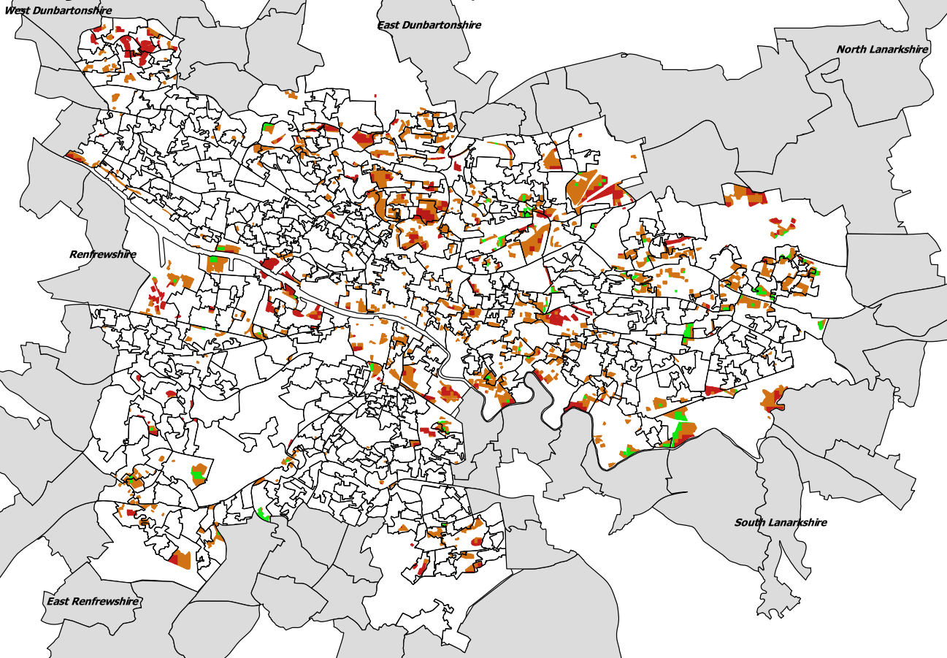
LAND IDENTIFICATION
Vacant & Derelict Land
Green = 0.8 km²

Slide 21
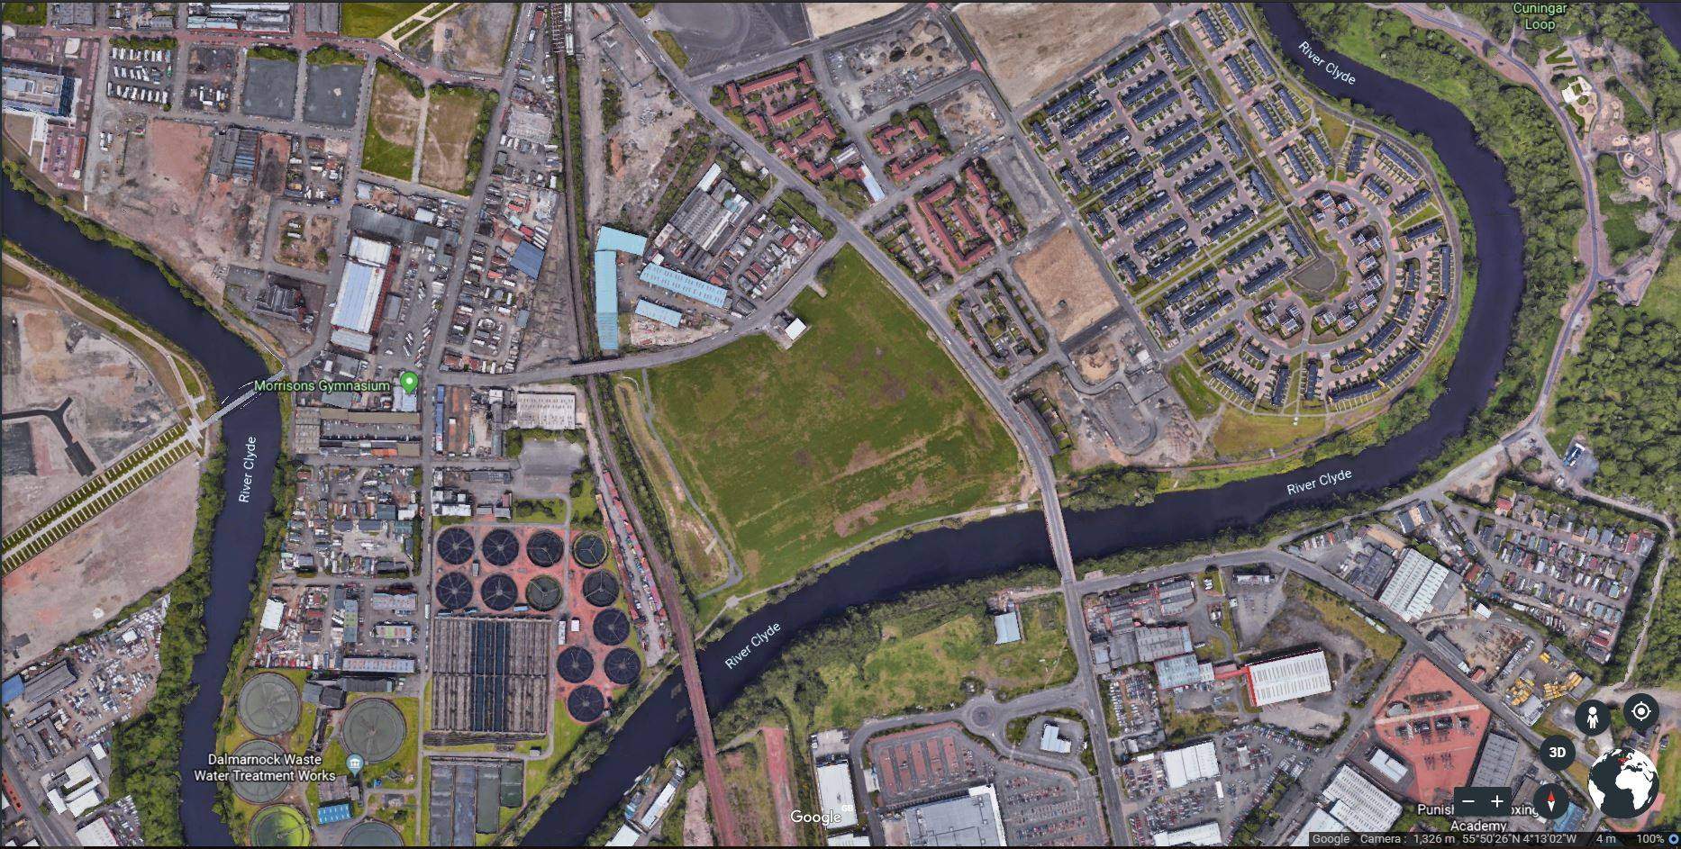

Slide 22
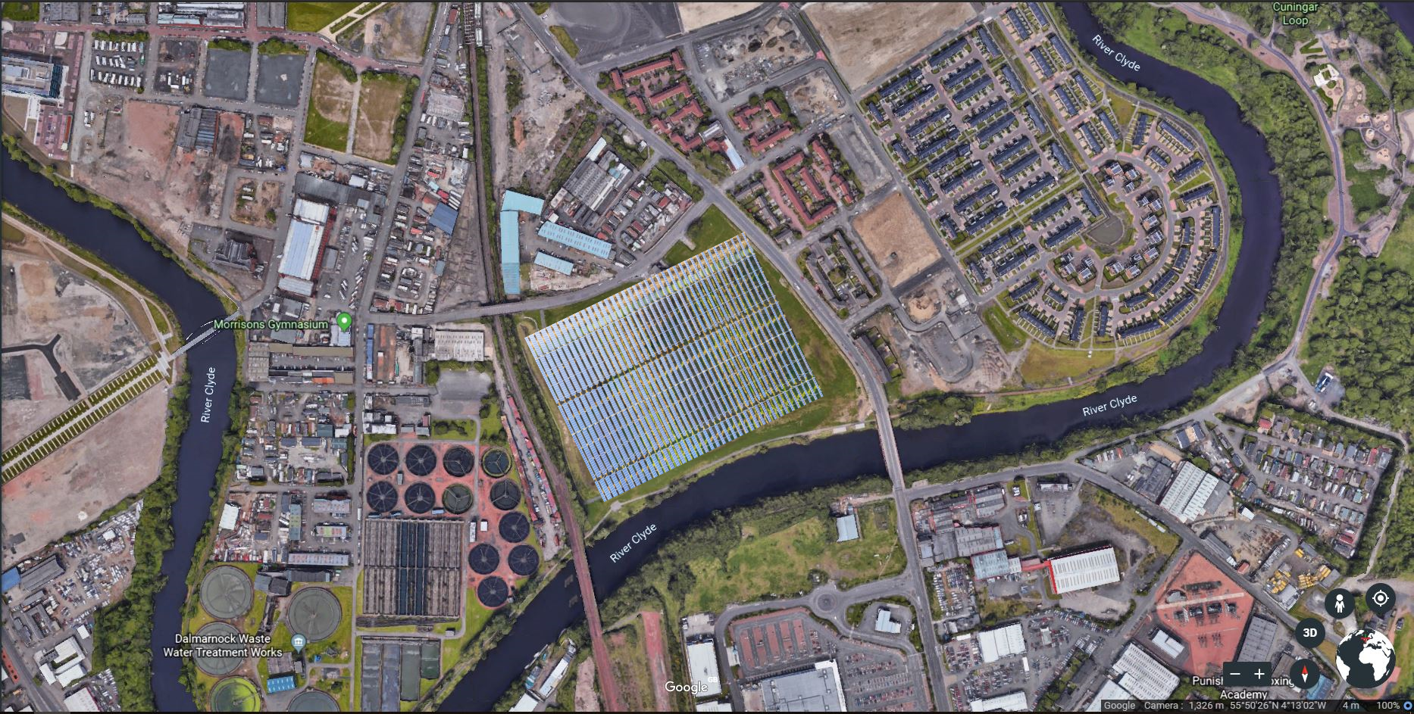

Slide 23
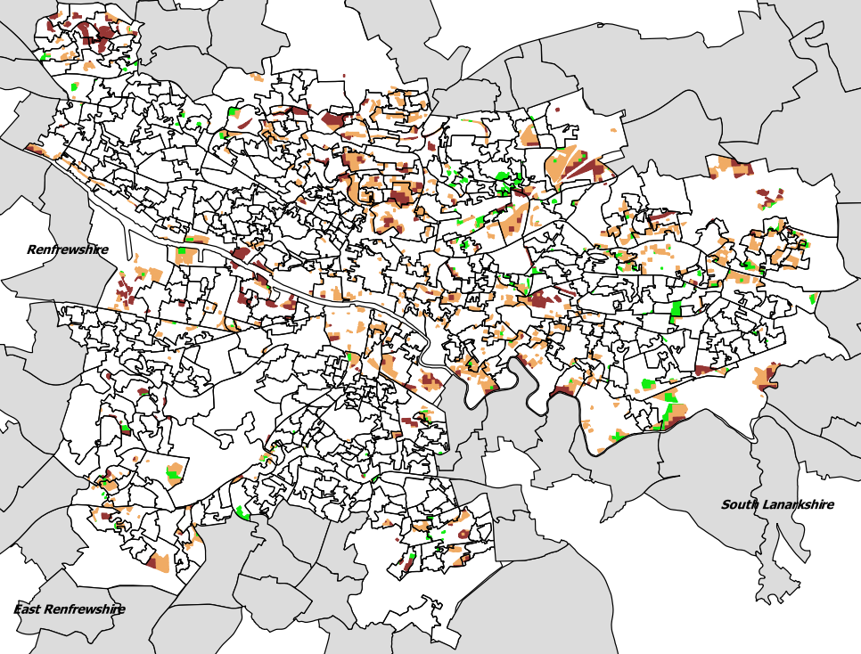
LAND IDENTIFICATION
Vacant & Derelict Land
Orange = ~3 km²
Notes:
We began to search for available land which would be available for use as a site for clean energy generation.
For this, we used a piece of GIS software which operates on a resolution of 20m x 20m blocks. It then applies all technical constraints and active policies across the city and scores each block based upon the likelihood of obtaining planning permission.

Slide 24
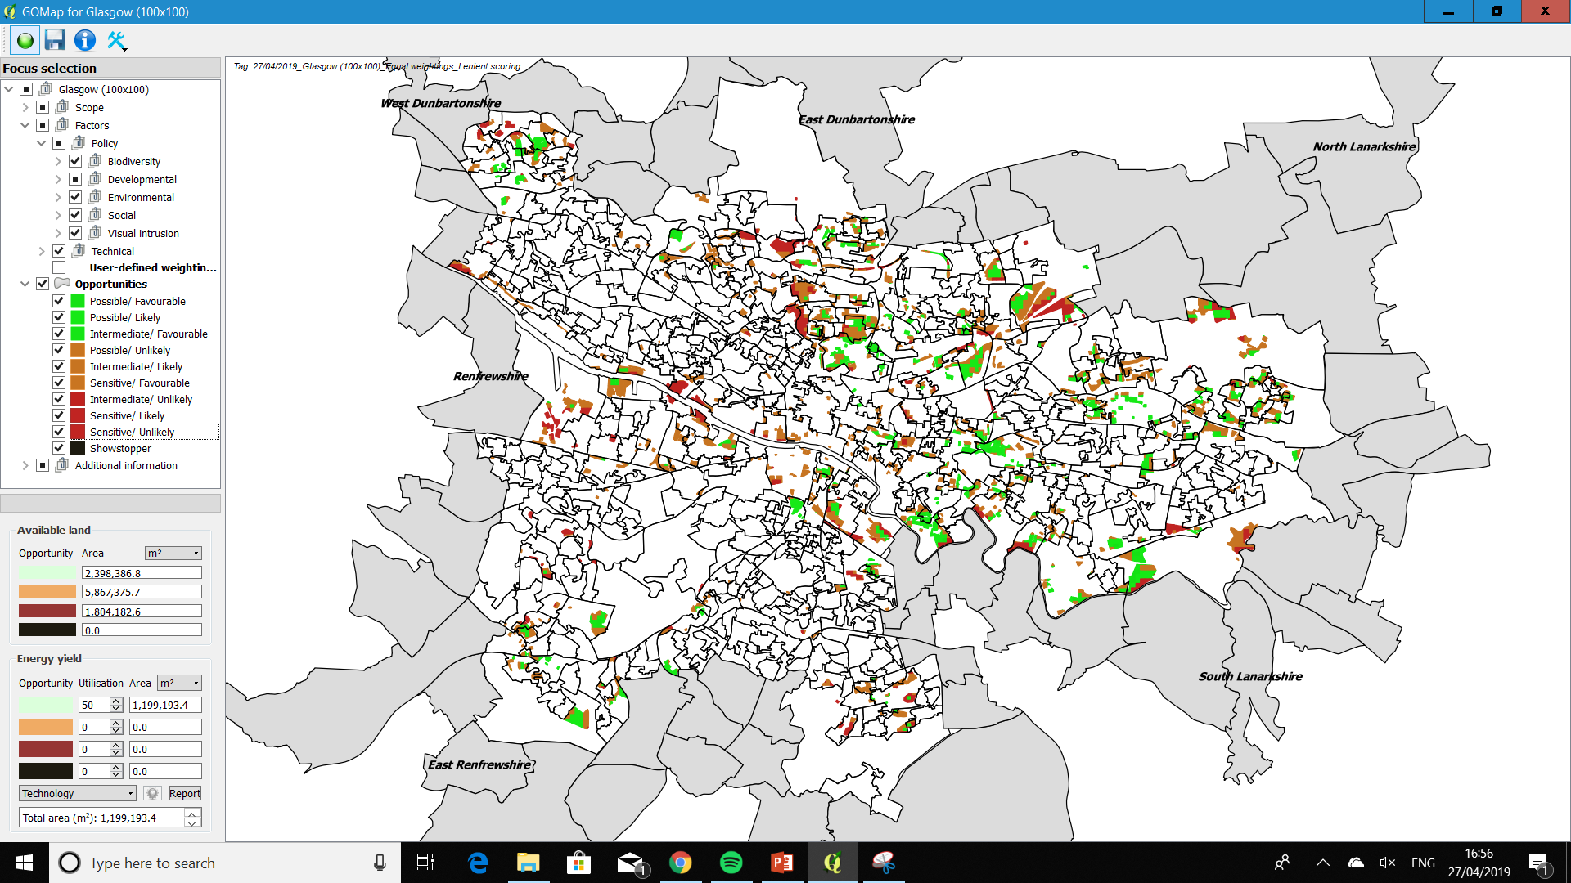

Slide 25
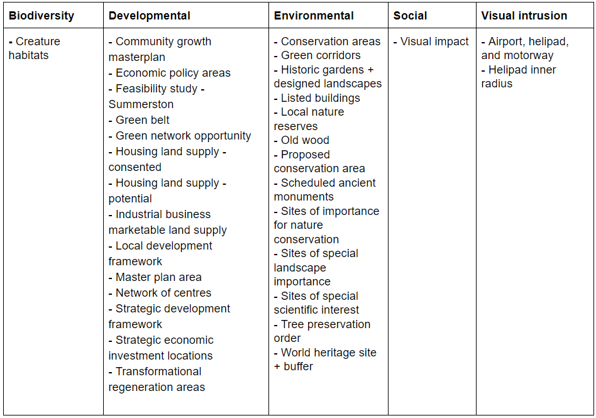
Active policies

Slide 26
Active policies

Slide 27
LAND IDENTIFICATION
Policy feature | Coverage within orange areas (km² ) | Increase in green areas due to relaxation (km² )
Strategic development framework | 2 | 0.46
Green network opportunity areas | 0.48 | 0.023
Economic policy areas | 0.98 | 0.38
Local development framework | 0.41 | 0.069
Visual impact | 1.4 | 0.44

Slide 28
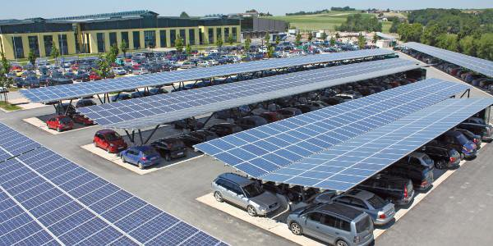
LAND IDENTIFICATION
Car Parks fitted with PV Canopies
All car parks > 1000m²
= 1.3 km²
Source: Greenpeace
Source: Solarbranche.de
Notes:
So moving forward, we carried out a directed search for all V&D land, as these areas currently serve little to no purpose and would be easier to obtain planning permission than currently developed land.
We then implemented a stringent scoring policy in our GIS software to obtain a more realistic view of the available land. This simply ranks the overall score of each block at that of the highest scored policy or constraint in that area.
The breakdown of the areas is shown here, but crucially the area of land that is likely to be available for development at present is around 0.73 sqr km.

Slide 29
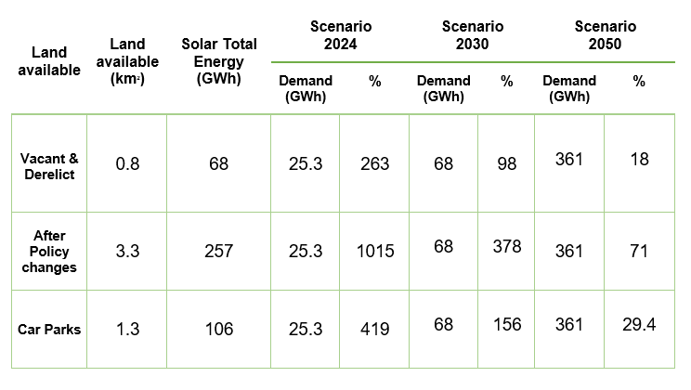
RESULTS
Project aim & method
Assessment of EV demand
Assessment of resources
Land identification
Results
Deliverables

Slide 30
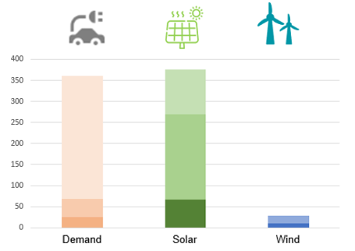
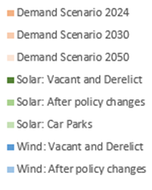
RESULTS
RE contribution in Glasgow for Scenario 2024

Slide 31
RESULTS
RE contribution in Glasgow for Scenario 2024
Vacant and derelict

Slide 32
RESULTS
RE contribution in Glasgow for Scenario 2030

Slide 33
RESULTS
RE contribution in Glasgow for Scenario 2030
Vacant and derelict

Slide 34
RESULTS
RE contribution in Glasgow for Scenario 2050

Slide 35
RESULTS
RE contribution in Glasgow for Scenario 2050
Vacant and derelict

Slide 36
RESULTS
RE contribution in Glasgow for Scenario 2050

Slide 37
RESULTS
RE contribution in Glasgow for Scenario 2050

Slide 38
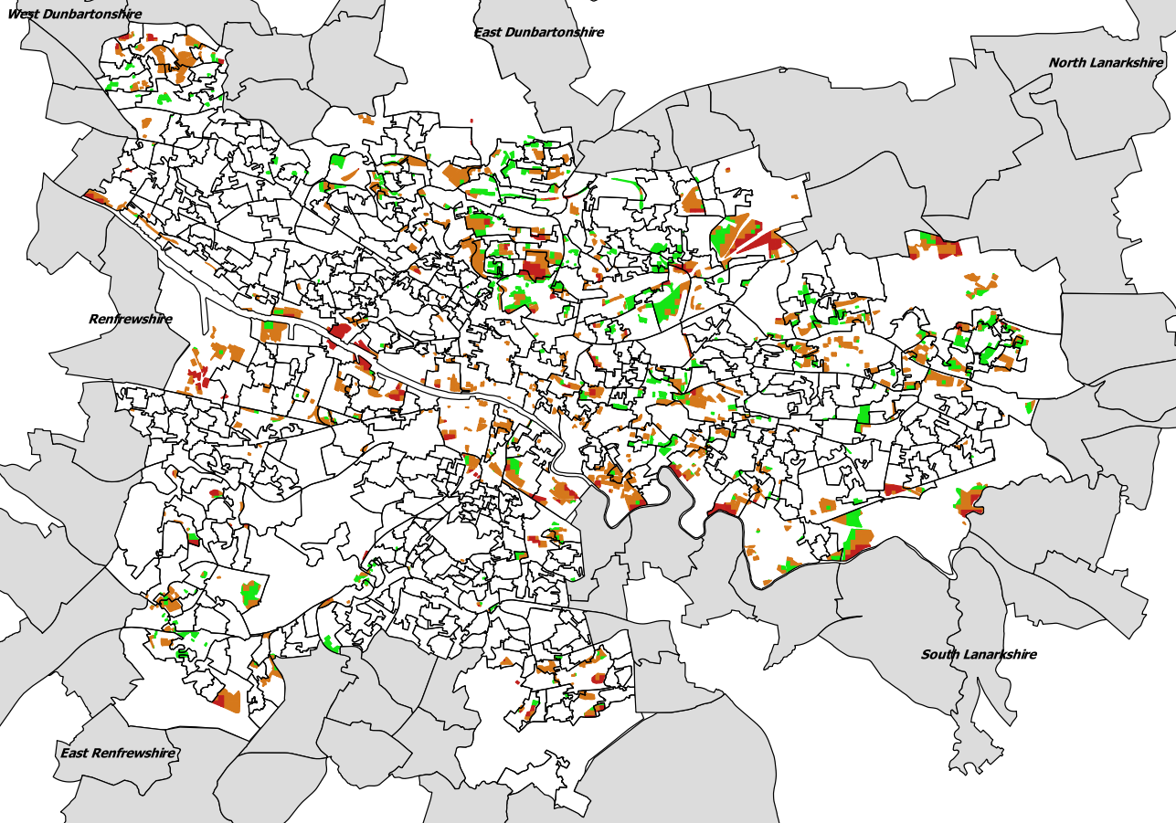
Charge point location

Slide 39
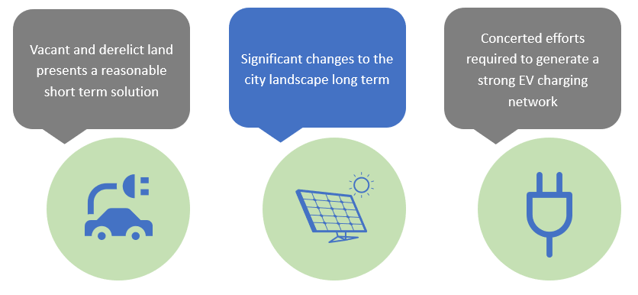
CONCLUSIONS

Slide 40
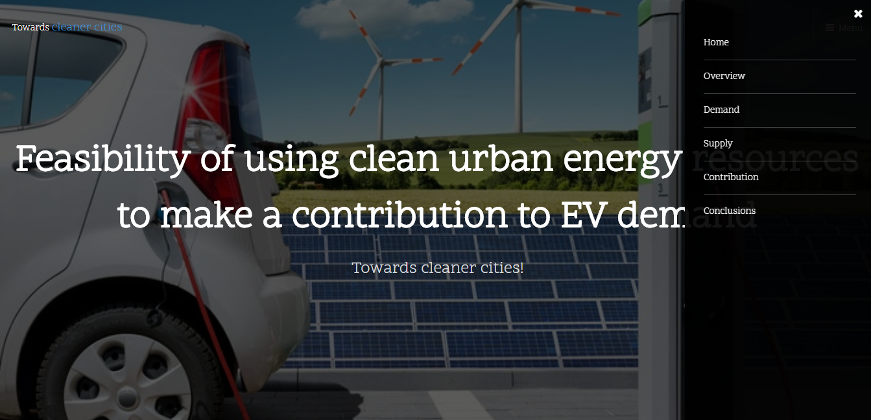
-All available on our website
-URL
Notes:
The very core
Giving more empahises
Land
Numbers
Available
Here i show a couple of frames about the tool
z

