Slide 1
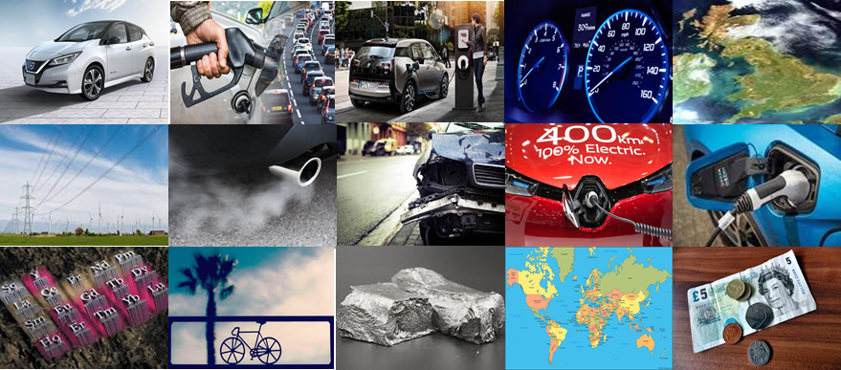
Electric Vehicle
Paradigm Shift
Assessment of the implications for Great Britain
Alex Aristotelous – Louise Comrie – Carlos Cortes – Josh Findlay – Guru Shete

Slide 2
Problem Description
Aims & Intended Outputs
Technical
Economic
Practical
Overall EV Transition Assessment
What ‘fuels’ the EV transition?
Cleaner cities
Reduce oil dependency
Government Interventions
Establishing targets & goals
i.e. 2040 ICE ban
Government Interventions
Establishing targets & goals
i.e. 2040 ICE ban
Problem
Lack of research & evidence
Implications unknown
Problem
Lack of research & evidence
Implications unknown
Aims & Objectives
Identify the implications and quantify
Technical
Economic
Practical
Sustainable
Intended Outputs
Develop different EV scenarios
Interactive tool
Assessment of overall sustainability
Help the public in understanding the effects of an EV transition

Slide 3
Presentation Structure
Business as Usual Scenario
ELECTRIC VEHICLE SCENARIOS
Conservative Scenario
Most Aggressive Scenario
TECHNICAL IMPLICATIONS
ECONOMIC IMPLICATIONS
SUSTAINABILITY
Electricity Demand
Fuel Tax
Revenue Lost
Lithium Resources
OVERALL ELECTRIC VEHICLE TRANSITION ASSESSMENT
Grid Infrastructure
$${CO}_{2} \&{ NO}_{X} tailpipe emissions$$
Public Charging Infrastructure
Assessment of sustainability
OVERALL ELECTRIC VEHICLE TRANSITION ASSESSMENT

Slide 4
Scenario Matrix
Three scenarios to present today |  | EV Projections
 |  | Business as usual | Intermediate | High EVs
Number of Cars Projections* | Business as usual
 | Dep. Of Transport
Business as Usual Scenario
Most Aggressive Scenario
Conservative Scenario
*We have modelled three other scenarios with National Grid's projection of total cars to 25 million

Slide 5
Presentation Structure
ELECTRIC VEHICLE SCENARIOS
Business as Usual Scenario
Business as Usual Scenario
Conservative Scenario
Most Aggressive Scenario

Slide 6
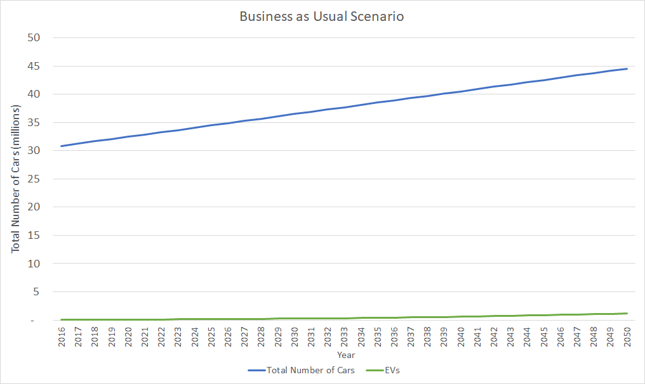
Business as Usual Scenario
Car Projections
Total Cars 2050:
44.5 million
EV 2050:
1.4 million
EV 2016:
33,860

Slide 7
Presentation Structure
ELECTRIC VEHICLE SCENARIOS
Business as Usual Scenario
Conservative Scenario
Conservative Scenario
Most Aggressive Scenario
TECHNICAL IMPLICATIONS
What is the Conservative Scenario?
Electricity Demand
Modelling techniques for the Technical Implications
Grid Infrastructure
Results of these models for the Conservative Scenario
Charging Infrastructure
Electric Vehicle Paradigm Shift

Slide 8
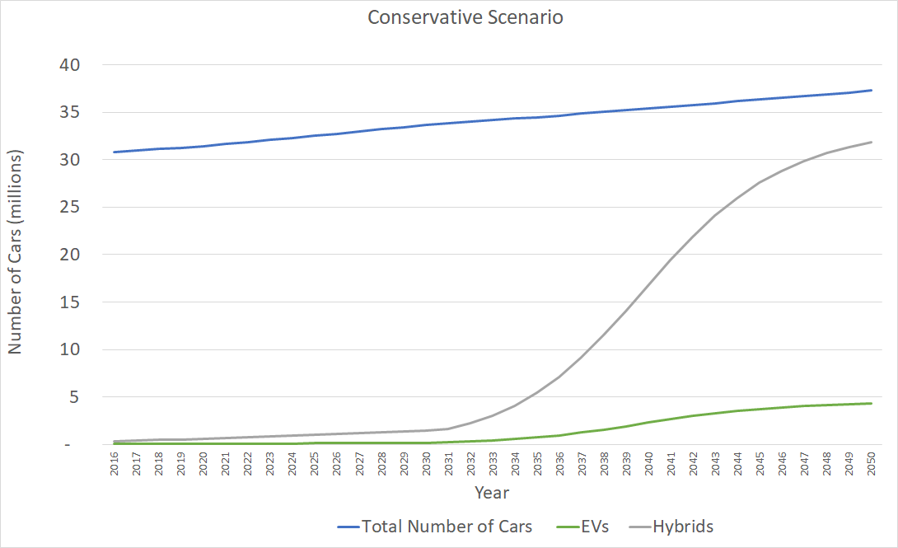
Conservative Scenario
Car Projections
Total Cars 2050:
37.2 million
Hybrids* 2050:
31.9 million
EV 2050:
4.3 million
EV 2016:
33,860
*Hybrids include both plug-in and non-plug-in

Slide 9
Electrical Demand
2127.51kWh/EV*
Business as Usual
Conservative
EV 2050: 1.4 million
EV 2050: 4.3 million
2.98TWh
9.15TWh
EV's Annual Electrical Demand
0.98%
3.01%
*Annual Distance Covered/EV = 12713km

Slide 10
Grid Infrastructure
Low Voltage Limitations
Thermal violation – demand growth
Voltage violation – embedded generation growth
LV Network
230V | 11kV
LV Network
11kV | 230V
LV Network
230V | 11kV
11kV | 33kV
Transmission Network*
33kV | 11kV
LV Network
230V | 11kV
MV Network
LV Network
11kV | 230V
MV Network
LV Network
HV Network
LV Network
230V | 11kV
11kV | 230V
Distribution Network
33kV | 132kV
Grid Supply Point
Distribution Network
230V | 11kV
11kV | 33kV
LV Network
LV Network
MV Network
LV Network
230V | 11kV
11kV | 230V
LV Network
11kV | 33kV
33kV | 11kV
LV Network
230V | 11kV
MV Network
11kV | 230V
MV Network
LV Network
LV Network
230V | 11kV
230V | 11kV
LV Network
11kV | 230V
*132kV networks in Scotland are managed by the System Operator and included in the transmission network

Slide 11
Public Charging Infrastructure
Conservative Scenario
Aggressive Scenario
Business as Usual = 241,000
Public Charging Points
1:5
Ability to domestically charge?
PUBLIC CHARGING
CURRENT RATIO
1:5
Conservative = 740,000 Public Charging Points
Is it profitable?
By 2040 ratio is 1:4
12/05/2018
Electric Vehicle Paradigm Shift
11

Slide 12
Presentation Structure
ELECTRIC VEHICLE SCENARIOS
Business as Usual Scenario
Conservative Scenario
Most Aggressive Scenario
Most Aggressive Scenario
TECHNICAL IMPLICATIONS
What is the Aggressive Scenario?
Electricity Demand
Results of the Technical Implications for the Aggressive Scenario
Grid Infrastructure
Charging Infrastructure
Impacts of these Results

Slide 13
Aggressive Scenario
Upper Penetration Rate
- 100% of new sales EV by 2040
- 100%(approx.) of market EV by 2050
Department for Transport Car Projection
- 44.5 Million Cars in 2050

Slide 14
Aggressive Scenario
Car Projections
EV 2050:
43.2 Million
EV 2016:
33,860

Slide 15
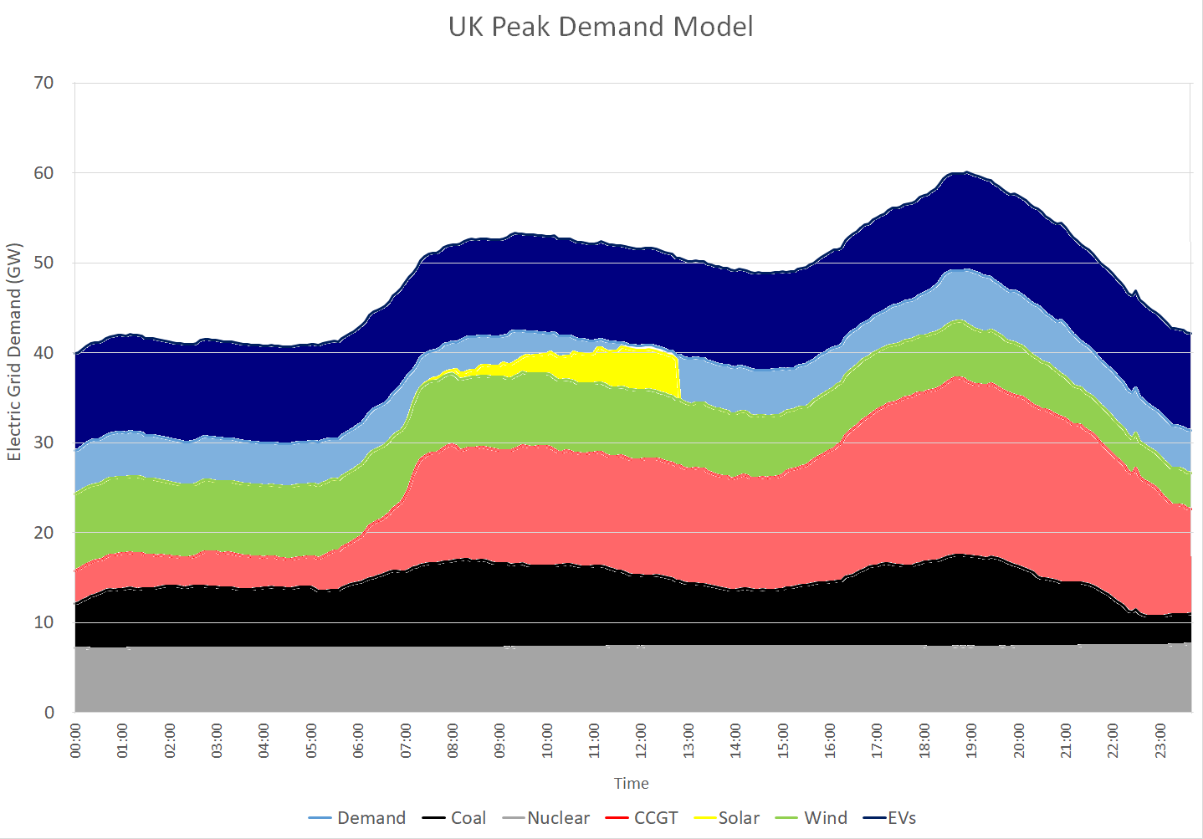
Electricity Demand
In 2050 92.01TWh extra electricity required
Annual consumption of electricity in UK in 2016 was 304TWh
26%

Slide 16
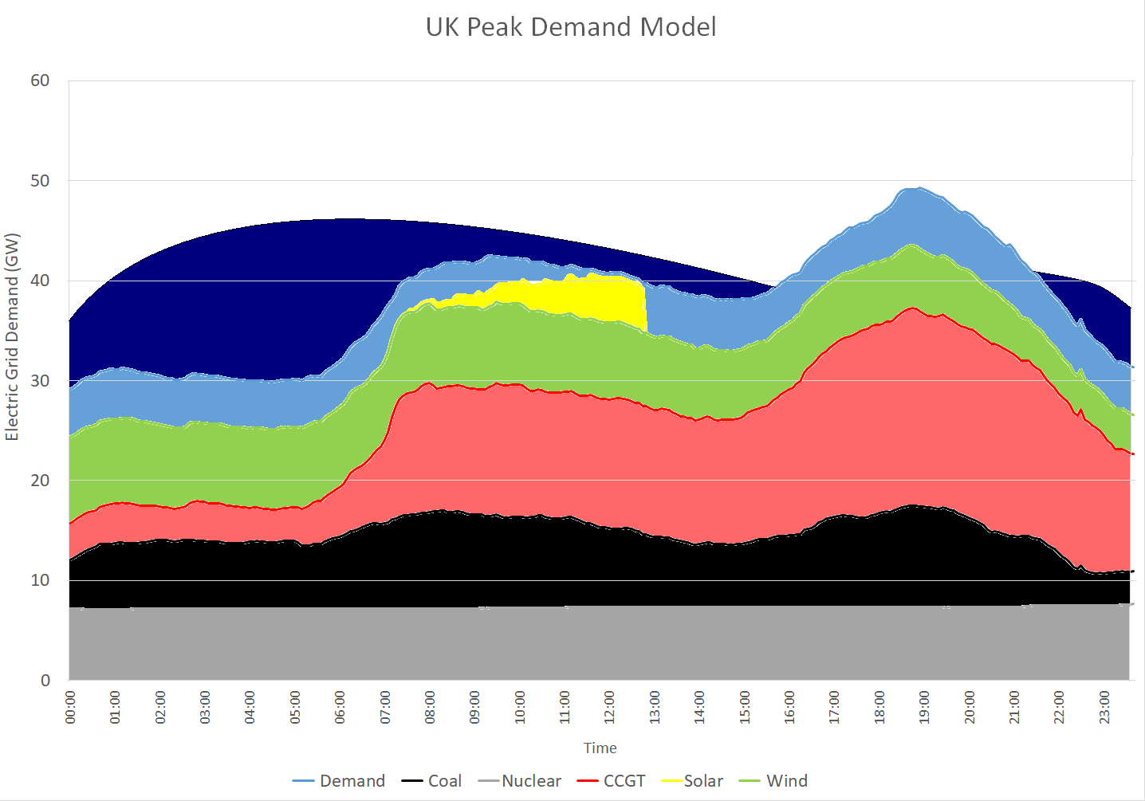
Electricity Demand

Slide 17
Electricity Demand
20% EVs 8.3 Million EVs 7kW Chargers
Additional 60GW
Current 74GW

Slide 18
Grid Infrastructure
Upgrade Required due to
exceeding limitations
Current Grid
Low Voltage Network
408,000km
<1kV
Low Voltage Network
32%
130,000 km
Total Distribution Networks
800,000km
<132kV*
Total Distribution Network
Impacts of LV upgrade
High and Extra High Voltage Networks
25,000km
>132kV
£4.4 Billion**
High and Extra High Voltage Networks
Cost
Time of Upgrade
*132kV networks in Scotland managed by System Operator and included in transmission network
** Price reflects cost for upgrade of cables and transformers but not labour and maintenance

Slide 19
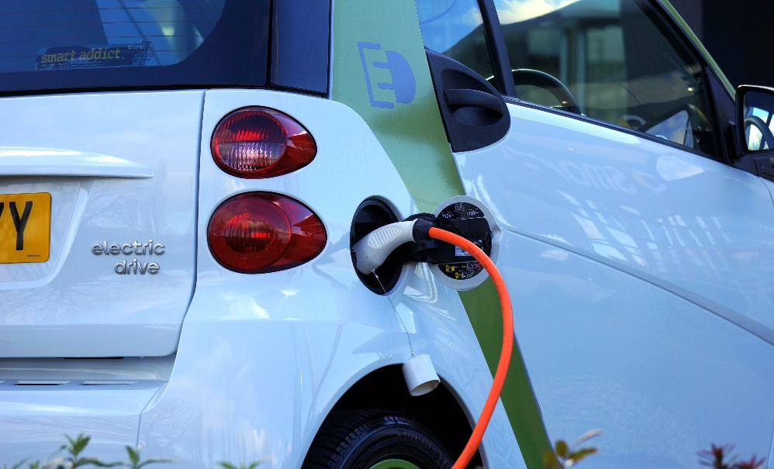
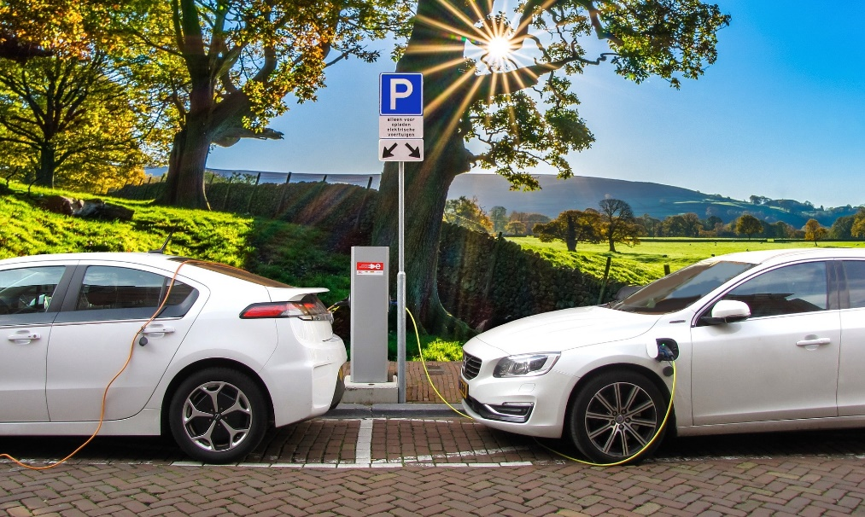
Public Charging Infrastructure
Business as Usual:241,000
Publicly accessible charging points
8,649,000
Publicly accessible charging points
Impacts
Cost of Infrastructure
Management
Location
Speed
Grid
Time to Build Infrastructure
916times more
100km² of parking space

Slide 20
Economic Implications
SCENARIOS
£
THE BUSINESS AS USUAL
CONSERVATIVE
FUEL TAX
REVENUE LOST
MOST AGGRESSIVE

Slide 21
Fuel Tax Revenue Lost
How could the Goverment recover this lost revenue?
PETROL
Fuel tax revenue
£664
2016
2050
UK Petrol and Diesel Cars Consumption
UK Number of Cars
Business as Usual Scenario
Most Aggressive Scenario
Annual
Fuel tax revenue
£732
Per ICE Car
33,000
EVs
Annual
Fuel tax loss
£732
Per EV
Conservative Scenario
Change in Charging Electricity Price
£ 30 Million
DIESEL
Fuel tax revenue
£800
£3 Billion
£32 BILLION!
£1 Billion
UK Electricity Prices in 2017
How this would change
The electricity bill?
14 p/kWh
Unit price
£72
Standing charge cost per year
&
Electric Vehicle
Tax Component
Changes in
Electricity Charging Price
43 million EVs
X 3.5
OR
X 10
35 pence
per kWh
33,000
EVs
49 p/kWh
Unit price
£730
Standing charge cost per year

Slide 22
Assessment of Sustainability
SCENARIOS
Lithium
$${CO}_{2}$$
〖𝐶𝑂〗_2
$${NO}_{x}$$
〖𝑁𝑂〗_𝑥
Sustainable?
THE BUSINESS AS USUAL
CONSERVATIVE
MOST AGGRESSIVE

Slide 23
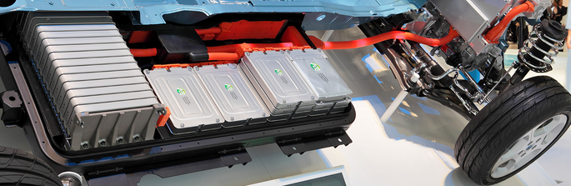
Lithium Resources
4 kg
Lithium*
Dependency on New Strategic Commodities
Reserves Location
RISKS
Battery Capacity
40 kWh
No Lithium Extraction in Europe
Security of Supply
GB
2050
Lithium Consumed during EV Transition
0.035
2050
2050
EV Lithium Consumed
USA
3.2
UK Consumption equal to
1.5 %
Global Lithium Reserves
CHINA
Global Lithium
Reserves
16 Mt
Human and Water Ecotoxicity
Most Aggressive Scenario
Business as Usual Scenario
Conservative Scenario
Most Aggressive Scenario
Recovery and Recycling
ENVIRONMENTAL PROBLEMS
0.048
7.5
BRAZIL
0.023
Eutrophication
No Global Large Scale Recovery
2.7
CHILE
ZIM
2
AUS
6,000 t
26,000 t
226,000 t
ARG
226,000 t
Map units are in Mt
*Average value taken

Slide 24
CO₂ Tailpipe Emissions
CO_{2 EMISSIONS}
2050
UK Car & Taxis
Business as Usual Scenario
48 Mt
IF Electricity produced with CLEAN SOURCES
2015
> 55 % Reduction
Conservative Scenario
> 15 % Reduction
UK Car & Taxis
24 Mt
68 Mt
Most Aggressive Scenario
2 Mt
Total Domestic CO₂ Transport Emissions
Total UK CO₂ Emissions

Slide 25
NO_{x} Tailpipe Emissions
NO_{x EMISSIONS}
2050
UK Car & Taxis
Business as Usual Scenario
42 kt
IF Electricity produced with CLEAN SOURCES
2015
> 35 % Reduction
Conservative Scenario
> 15 % Reduction
UK Car & Taxis
12 kt
148 kt
Most Aggressive Scenario
2 kt
Total Domestic NO_{x} Transport Emissions
Total UK NO_{x} Emissions

Slide 26
Assessment of Sustainability
IMPROVEMENT OF
AIR QUALITY
LITHIUM RESOURCES
DEPENDENCY
NO_{x EMISSIONS}
CLIMATE
CHANGE
BENEFITS DEPEND ON GENERATION SOURCE
CO_{2 EMISSIONS}

Slide 27
Overall Assessment
EV Transition
Lithium environmental issues
Increase Air Quality
Social inequalities Charging access
Business opportunities & Boost Car Industry
Investments in grid upgrade & new power plants
Meet 2050 UK
Carbon Targets
Fuel Tax
Revenue Lost
Oil Dependency Reduction

Slide 28
Is this Sustainable?
NOT WITHOUT…
LIMITED UPGRADE GRID DISTRIBUTION NETWORK
BALANCE
TAX REVENUE LOST
LITHIUM RECYCLING
SMART CHARGING
LOW CARBON ELECTRICITY GENERATION
PUBLIC ADOPTION OF EVs
…

Slide 29
Thank you for coming!
Notes:
Results for Lithium ion:
Total lithium required till 2050 = 1.5 Million tonnes.
Impacts: With lithium demand expected to increase globally due to uptake of EV’s UK Government knows how pivotal this element is and has invested 1Million GBP for mining lithium. Cornish Lithium Ltd is expected to serve lithium for the whole UK (and probably Europe as well. What amount of Lithium reserves exist in Cornwall is not known.). Amazing fact about exploring lithium in Cornwall is that the team is trying to detect the reserves by imaging vegetation and minerals on the ground using satellite technology. The best part is UK and Europe have reliable battery collection and recycling techniques.(But currently the recycling rate is very low below 1%). Add a bit about Josh’s work of recycling batteries.
Reasons to worry: Finite lithium sources available globally.

