Slide 1
HAPI
Combined Wind and Hydro Power Generation in the Nile
THET THIN ZAR LWIN NIKOLAOS NTAVARINOS ZLATINA PASEVA GERASIMOS PETRATOS

Slide 2
Contents
1
Introduction of HAPI concept
2
Location
3
Technical insight
4
Financial analysis
5
Conclusions and future work

Slide 3
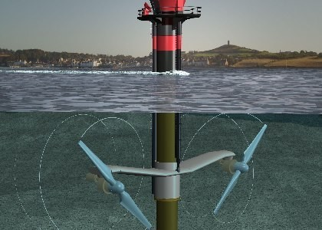
Introduction of HAPI concept
Hybrid system of wind and current turbines
Floating structure in the river
[windpowerengineering.com]
[alternative-energy-news.info]
Introduction of HAPI Location Technical insight Financial analysis Conclusions and future work
3

Slide 4
Aims and objectives
Aims
Investigation of the feasibility of HAPI
Objectives
Selection of appropriate location
System configuration
Hydrostatic analysis
Calculation of dynamic loads
Grid connection
Financial analysis
Introduction of HAPI Location Technical insight Financial analysis Conclusions and future work
4
4

Slide 5
Location
Breakdown of selection factors
1
Hydrographical factors
Water depth, river width
Adequate conditions
2
-Water stream velocity
-Wind speed
3
Favorable spatial characteristics
Navigable channel, human activities
Introduction of HAPI Location Technical insight Financial analysis Conclusions and future work
5
5

Slide 6
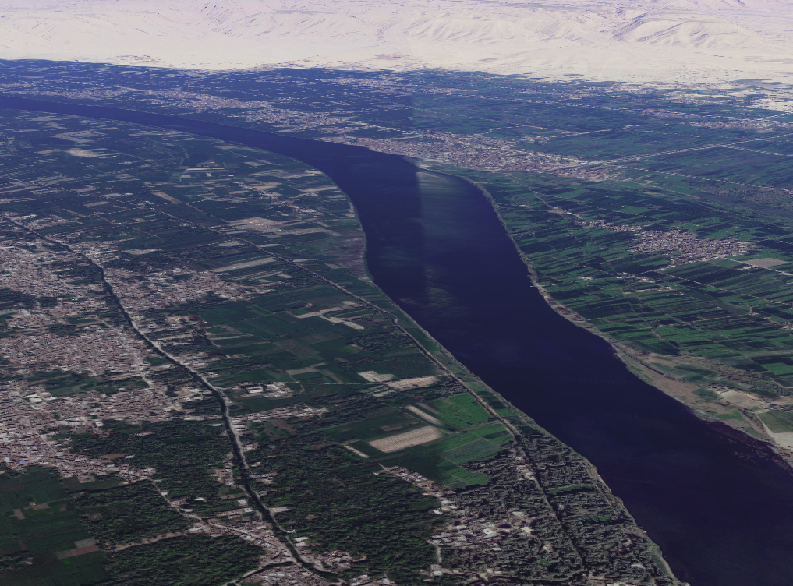
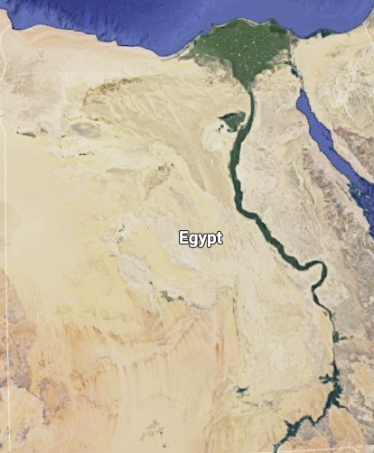
Location
Selected location: River Nile, Egypt
Al Balyana
HAPI platform
Introduction of HAPI Location Technical insight Financial analysis Conclusions and future work
6
6

Slide 7
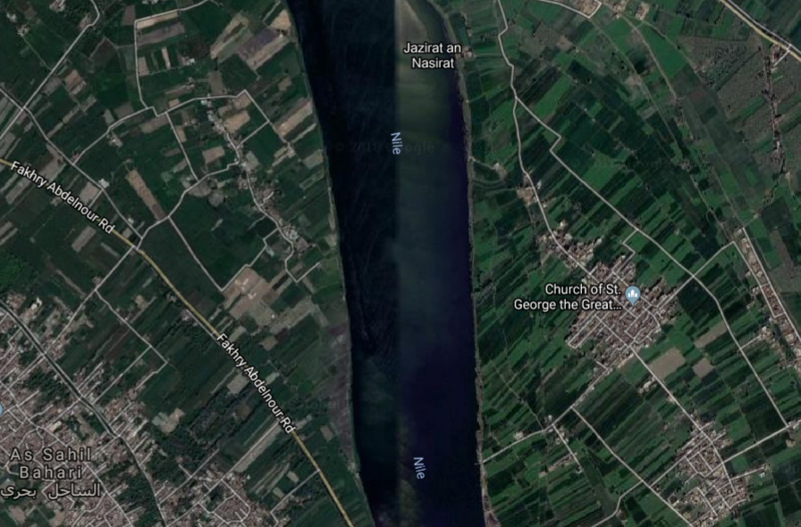
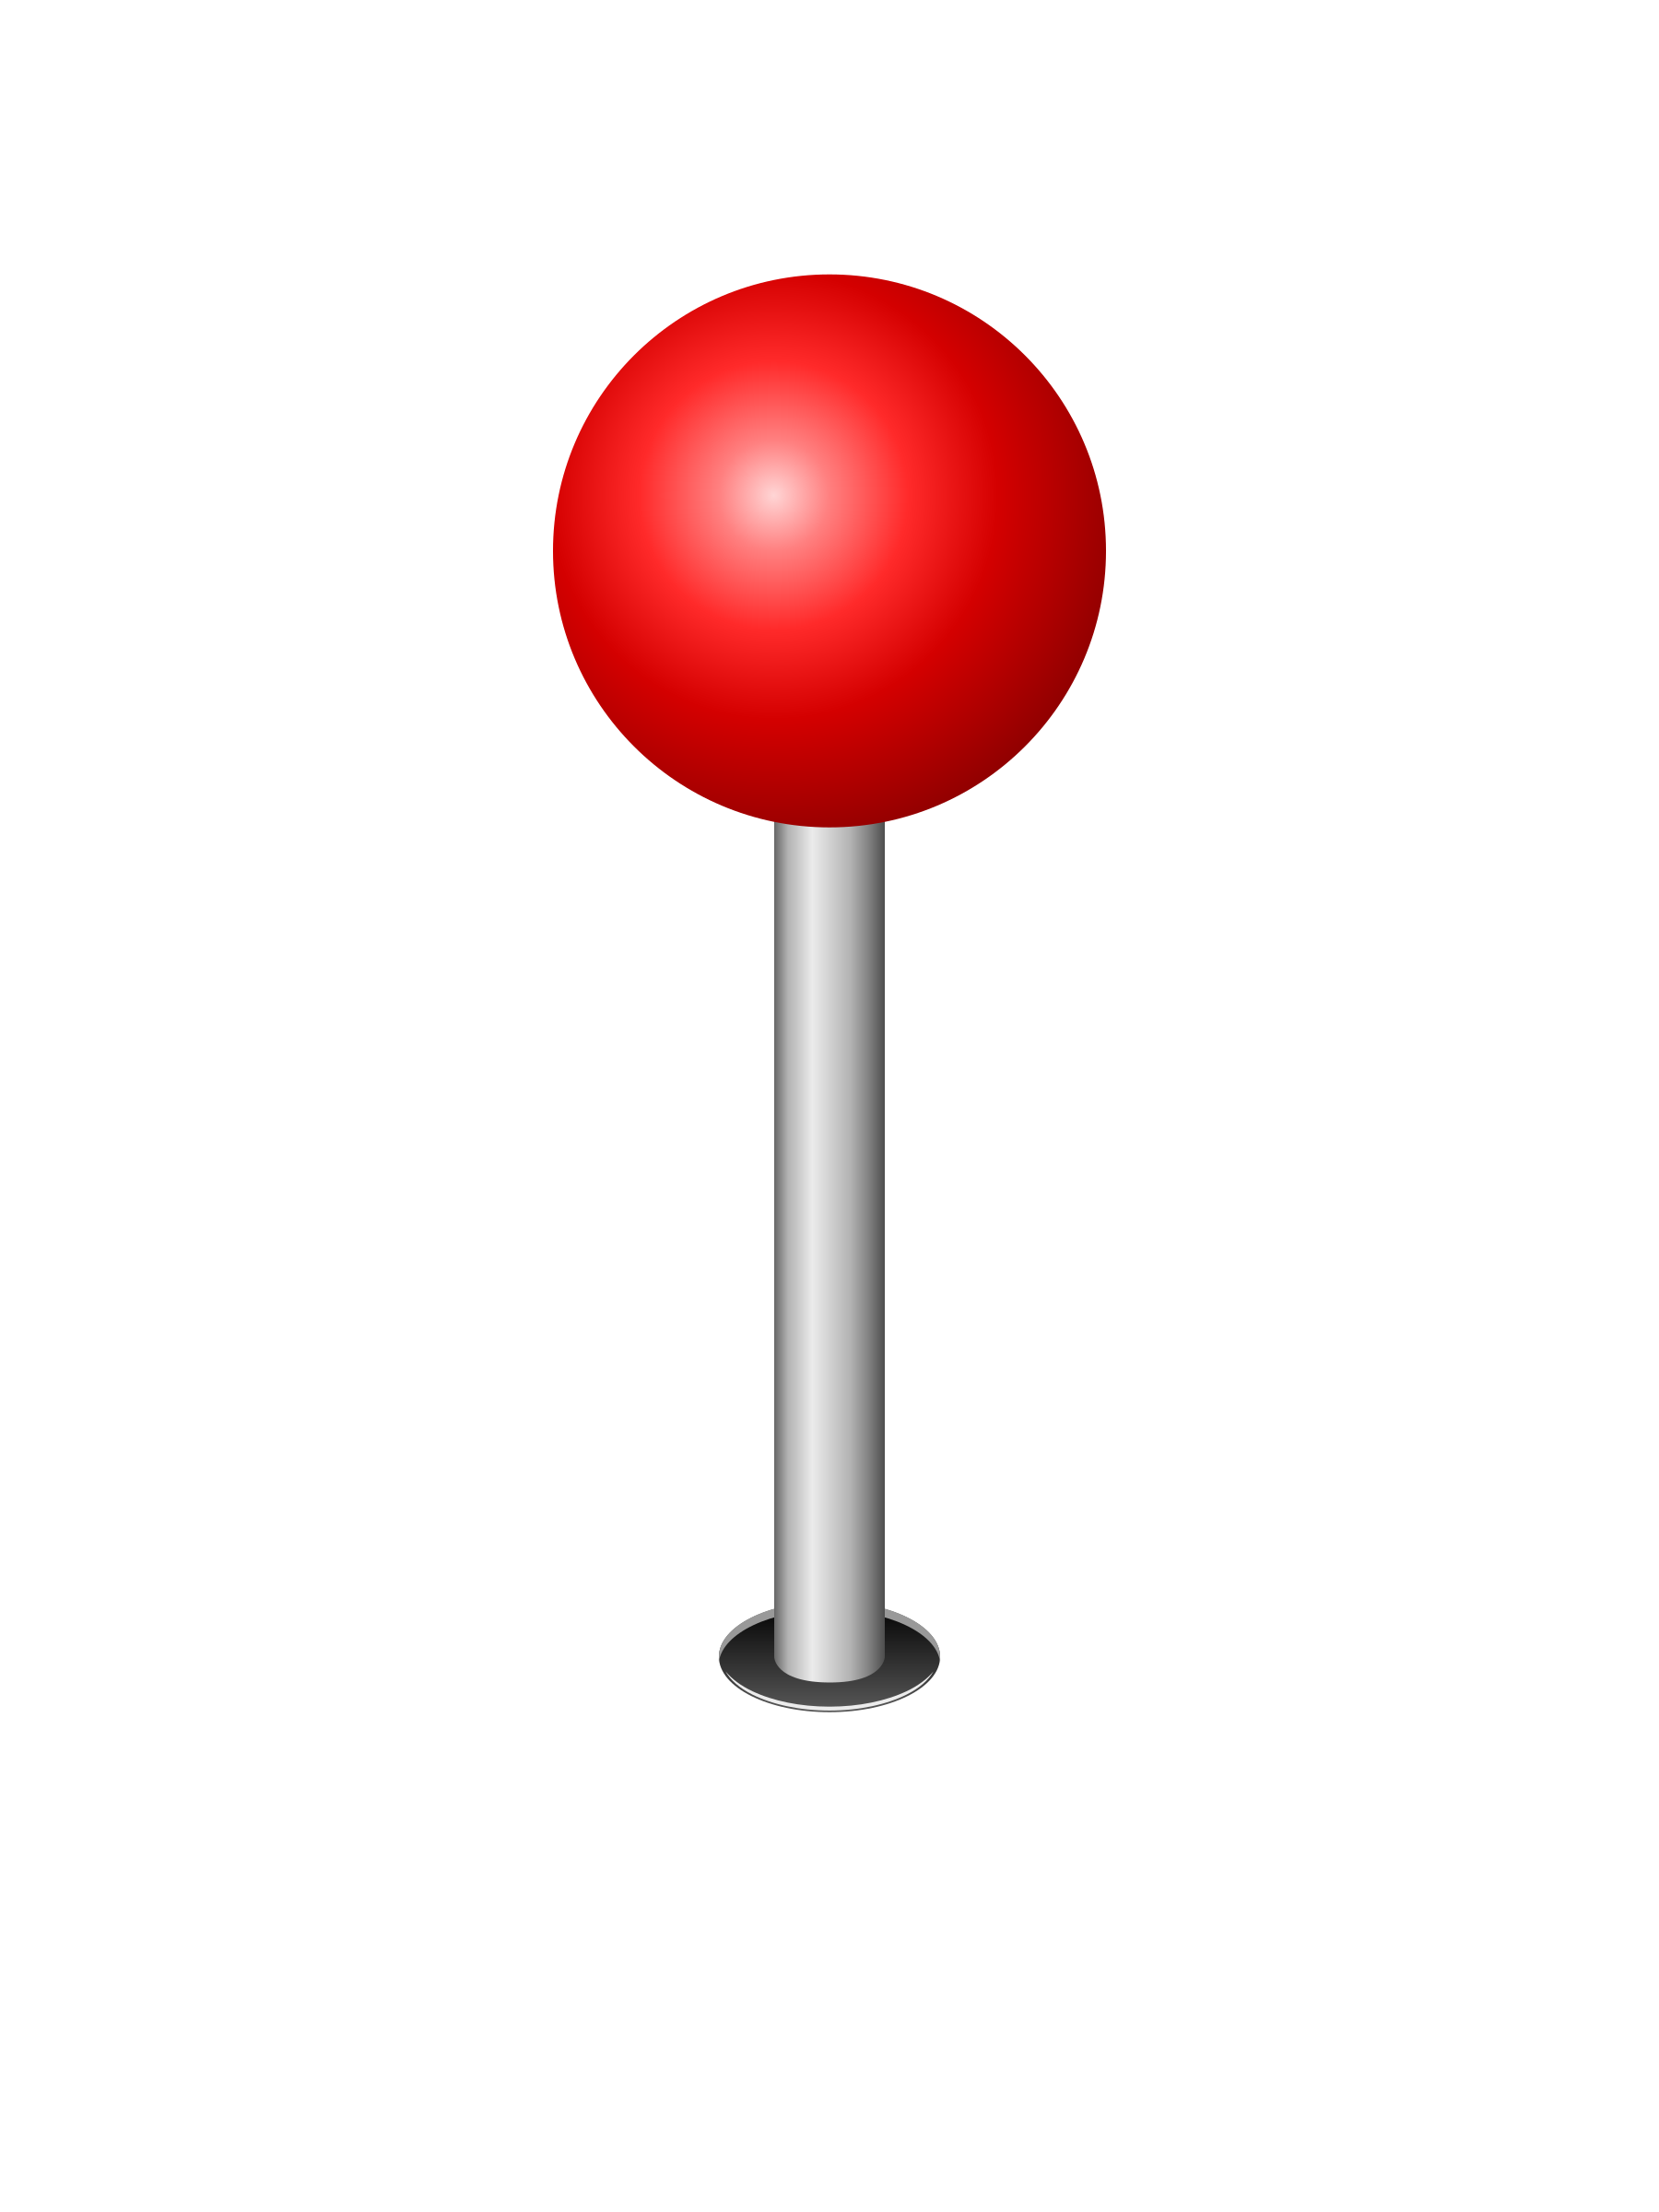
Location
Enough width
Depth: 10m
Depth = 10m
Navigation Channel: 100m
450 m
Introduction of HAPI Location Technical insight Financial analysis Conclusions and future work

Slide 8
Challenges
1
Shallow waters
2
Low stream velocity
5
Legislation
3
Optimise power output
4
Maximize power output
3
Shallow waters
4
System layout
Introduction of HAPI Location Technical insight Financial analysis Conclusions and future work
8
8

Slide 9
System configuration
HAWT
100kW
Position: centre of the platform
4 x 5kW . Distance to each other: 18m
Bottom clearance: 4-5m
Wind turbine
River Current Turbines
Introduction of HAPI Location Technical insight Financial analysis Conclusions and future work
9
9

Slide 10
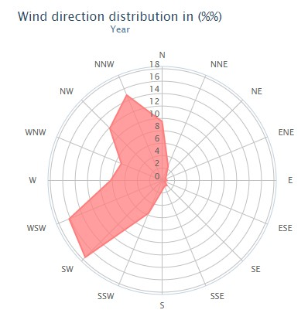
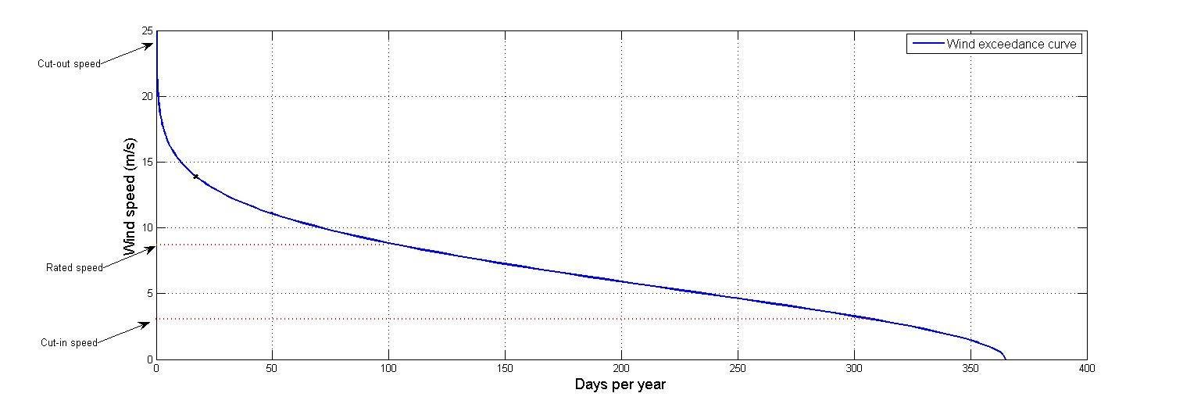
Energy Output
Wind profile
Wind direction distribution throughout a year
Wind exceedance curve
360 MWh/year
Mean wind speed: 6.6 m/s
CF = 41%
[Windfinder.com]
Introduction of HAPI Location Technical insight Financial analysis Conclusions and future work
10
10
Notes:
satisfaction of local communities needs

Slide 11
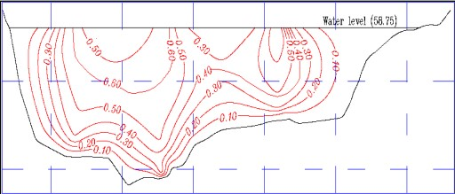
Energy Output
River current profile
Mean current speed: 0.8m/s
60 MWh/year
CF = 35%
Contour of stream velocity in a cross-section
[ N.M. Eshra, 2014]
Introduction of HAPI Location Technical insight Financial analysis Conclusions and future work
11
11
Notes:
satisfaction of local communities needs

Slide 12
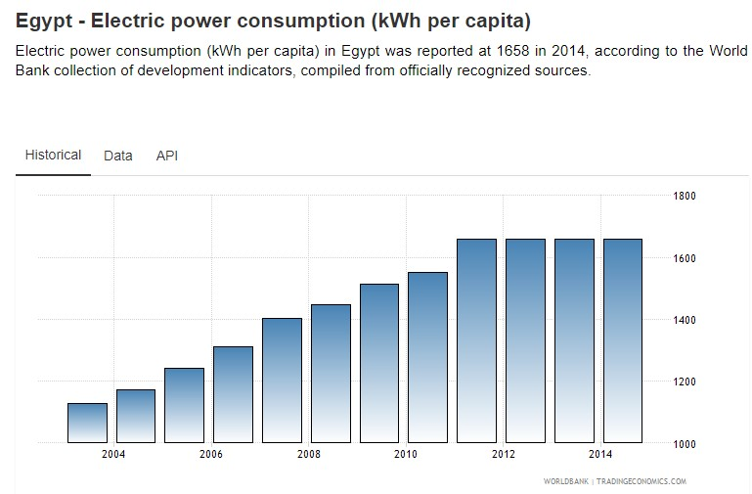
Energy Output
Total energy output
100 typical households
360+60 = 420 MWh/year
Egypt- Electric Power consumption – kWh per capita
Introduction of HAPI Location Technical insight Financial analysis Conclusions and future work
12
12
Notes:
satisfaction of local communities needs

Slide 13
Mooring lines
Spread mooring system
Catenary shape
Nominal diameter: 50mm
Break load = 2,700 kN
Normal operation
Fairlead
Depth = 10m
Touchdown point
Anchored
end
23m
Suspended line length
Line tension ≈ 40 kN
riverbed
7m
Introduction of HAPI Location Technical insight Financial analysis Conclusions and future work
13

Slide 14
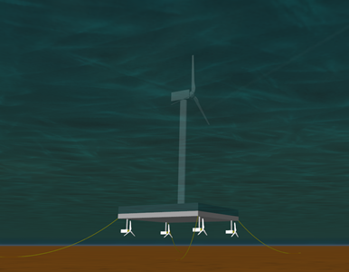
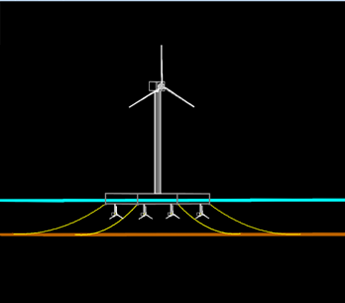
Mooring lines
Introduction of HAPI Location Technical insight Financial analysis Conclusions and future work
14

Slide 15
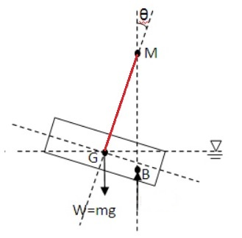
Hydrostatic Analysis
Stable Equilibrium: Total Weight = Buoyancy
W- Total weight of the structure Fb- Buoyancy force
The most important Parameters for Stability:
Heel (Starboard Port)
Trim (Fore Aft)
Draught
GM - Metacentric Height
GZ curve
Introduction of HAPI Location Technical insight Financial analysis Conclusions and future work
15
15

Slide 16
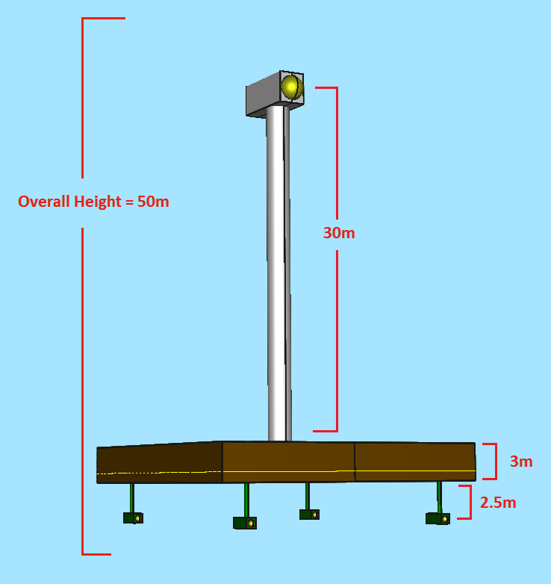
Hydrostatic analysis
Added Ballast
Total Number of Tanks | 8
Material | Concrete (2080 kg/m3)
Tank Length | 5 m
Tank Beam | 11.5 m
Tank Height | 0.2 m
Quantity | 99%
Operational Draught | 1.16 m
Platform Dimensions
Length | 23 m
Beam | 23 m
Height | 3 m
Design Draught | 0.8 m
Introduction of HAPI Location Technical insight Financial analysis Conclusions and future work
16
16

Slide 17
Hydrostatic analysis
Results
Draft Amidships | 1.17m
Freeboard | 1.83m
Heel | 0.0°
Trim (+ve by stern) | 0.003m
Trim angle (+ve by stern) | 0.0064°
GMt corrected | 53.789m
GML | 53.789m
IMO and DNV regulations for floating
pontoons/ barge:
Initial GM has to be greater than 0.35m
Freeboard not less than 0.3m
Trim angle to not exceed 10°
Introduction of HAPI Location Technical insight Financial analysis Conclusions and future work
17
17

Slide 18
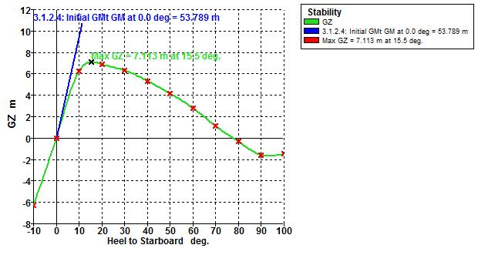
Hydrostatic analysis
Initial GMT has to be greater than 0.35m
~54m
GZ curve to vanish after 35°
~80°
Introduction of HAPI Location Technical insight Financial analysis Conclusions and future work
18
18

Slide 19
Loading
Mechanical loads
Dynamic loads
F_{wind}
Wind force = 20kN
Bending moment = 53kN∙m
Current force = 15kN
waterline
F_{current}
Introduction of HAPI Location Technical insight Financial analysis Conclusions and future work
19
19
Notes:
Flap rise at the root of each blade

Slide 20
Introduction of HAPI Location Technical insight Financial analysis Conclusions and future work
20
20

Slide 21
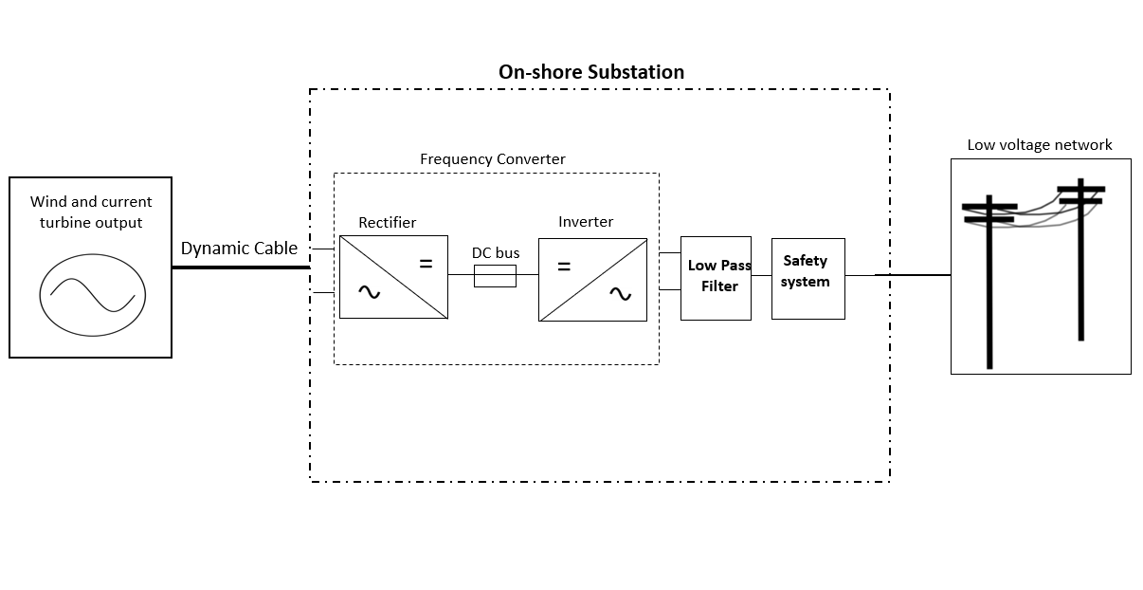
Grid connection
21
Introduction of HAPI Location Technical insight Financial analysis Conclusions and future work
21
21

Slide 22
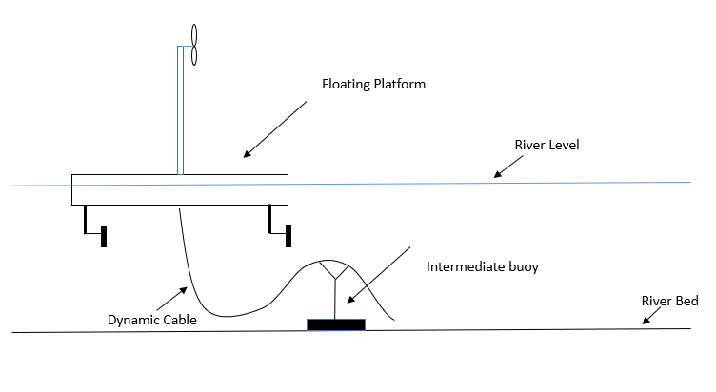
Grid connection
Riverbed Cables
Distance to the shore: 150m
Dynamic cables: Class three-core XLPE, double wire armor
Twisting and bending forces
Repetitive wear from riverbed
Usage of intermediate buoy
Introduction of HAPI Location Technical insight Financial analysis Conclusions and future work
22
22

Slide 23
Grid connection
Weak grid → Frequent interruptions
✔ Steady state voltage
✔ Regulation of flicker values
✔ Harmonics within the limits
Introduction of HAPI Location Technical insight Financial analysis Conclusions and future work
23
23

Slide 24
Financial analysis
Levelised Cost Of Energy (LCOE)
Payback Period
Sensitivity analysis
Introduction of HAPI Location Technical insight Financial analysis Conclusions and future work
24
24

Slide 25
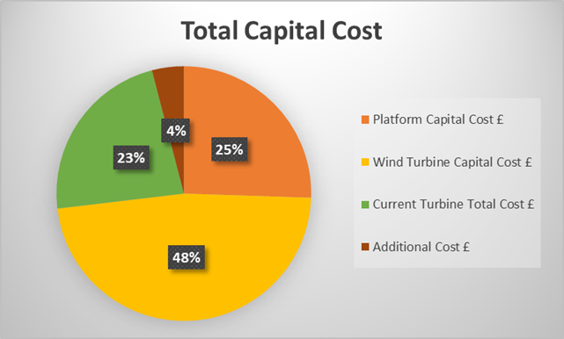
Financial analysis
Annual O&M Cost
Wind Turbine OPEX
Current Turbines OPEX
LCOE ( £/MWh )
Introduction of HAPI Location Technical insight Financial analysis Conclusions and future work
25
25

Slide 26
Financial analysis
20 Years Life-time
LCOE= £0.14 p/kWh
Strike Price= £0.16 p/kWh
Slightly expensive for the Local Egyptian households
2020 Target 20% from Renewable Energy
12% from Wind Power
Government Subsidies
Cooperation with other countries
Introduction of HAPI Location Technical insight Financial analysis Conclusions and future work
26
26

Slide 27
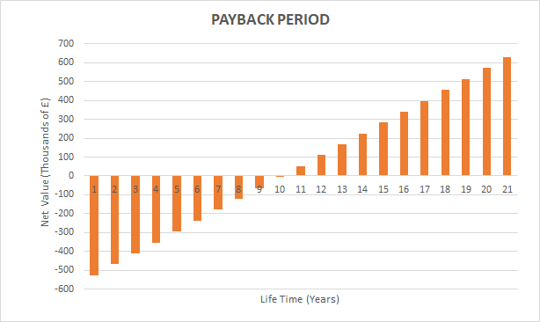
Payback Period
Introduction of HAPI Location Technical insight Financial analysis Conclusions and future work
27
27

Slide 28
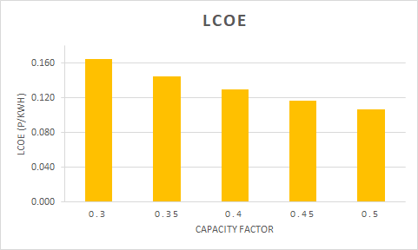
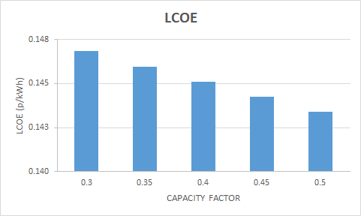
Sensitivity analysis
Wind Turbine Capacity Factor River Current Turbine Capacity Factor
Introduction of HAPI Location Technical insight Financial analysis Conclusions and future work
28
28

Slide 29
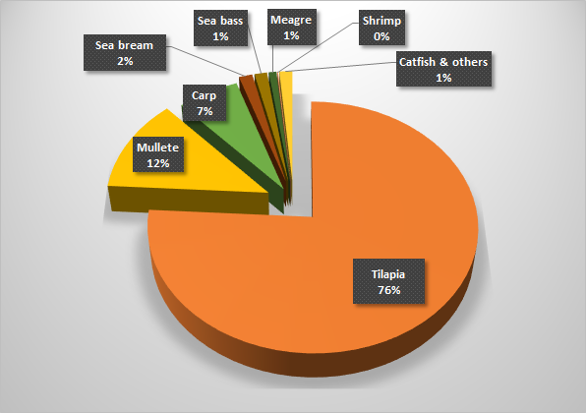
Environmental Impact
Fish farming changes
in areas
behavior and nature of freshwater fish
Figure: Features of aquaculture production
Introduction of HAPI Location Technical insight Financial analysis Conclusions and future work
29
29
Notes:
Production of 1 kg fish needs around 25 m^3 of water or 12 m^2 of land.
Compared with other hydropower station, the effect on water discharges could be negligible.

Slide 30
Environmental Impact
Potential impact
Fish swimming behavior
Stuck with 1.7m in radius
Restrict fish movement
Subsequent effect
Morphological traits
Habitat connectivity
Migration routes
Possible mitigation
Fish-friendly turbine for large array farm
Width of gaps for large fish to pass through
Investigation on rotor avoidance zone
Introduction of HAPI Location Technical insight Financial analysis Conclusions and future work
30
30
Notes:
Morphological traits: swimming style, size and body shape

Slide 31
Conclusions
Feasible design for river applications
Cost-effective with a typical payback period
So, what are the outcomes?
Stable construction under normal operation conditions
Limitation in large scale implementation
Introduction of HAPI Location Technical insight Financial analysis Conclusions and future work
31
31
31

Slide 32
Future Work
Structural analysis
Potential expansion by building arrays
Development of onshore storage techniques
Introduction of HAPI Location Technical insight Financial analysis Conclusions and future work
32
32
32
Notes:
(to get more power)
(to make it dispatchable source)
(technological enhancements + more efficient layout)

Slide 33
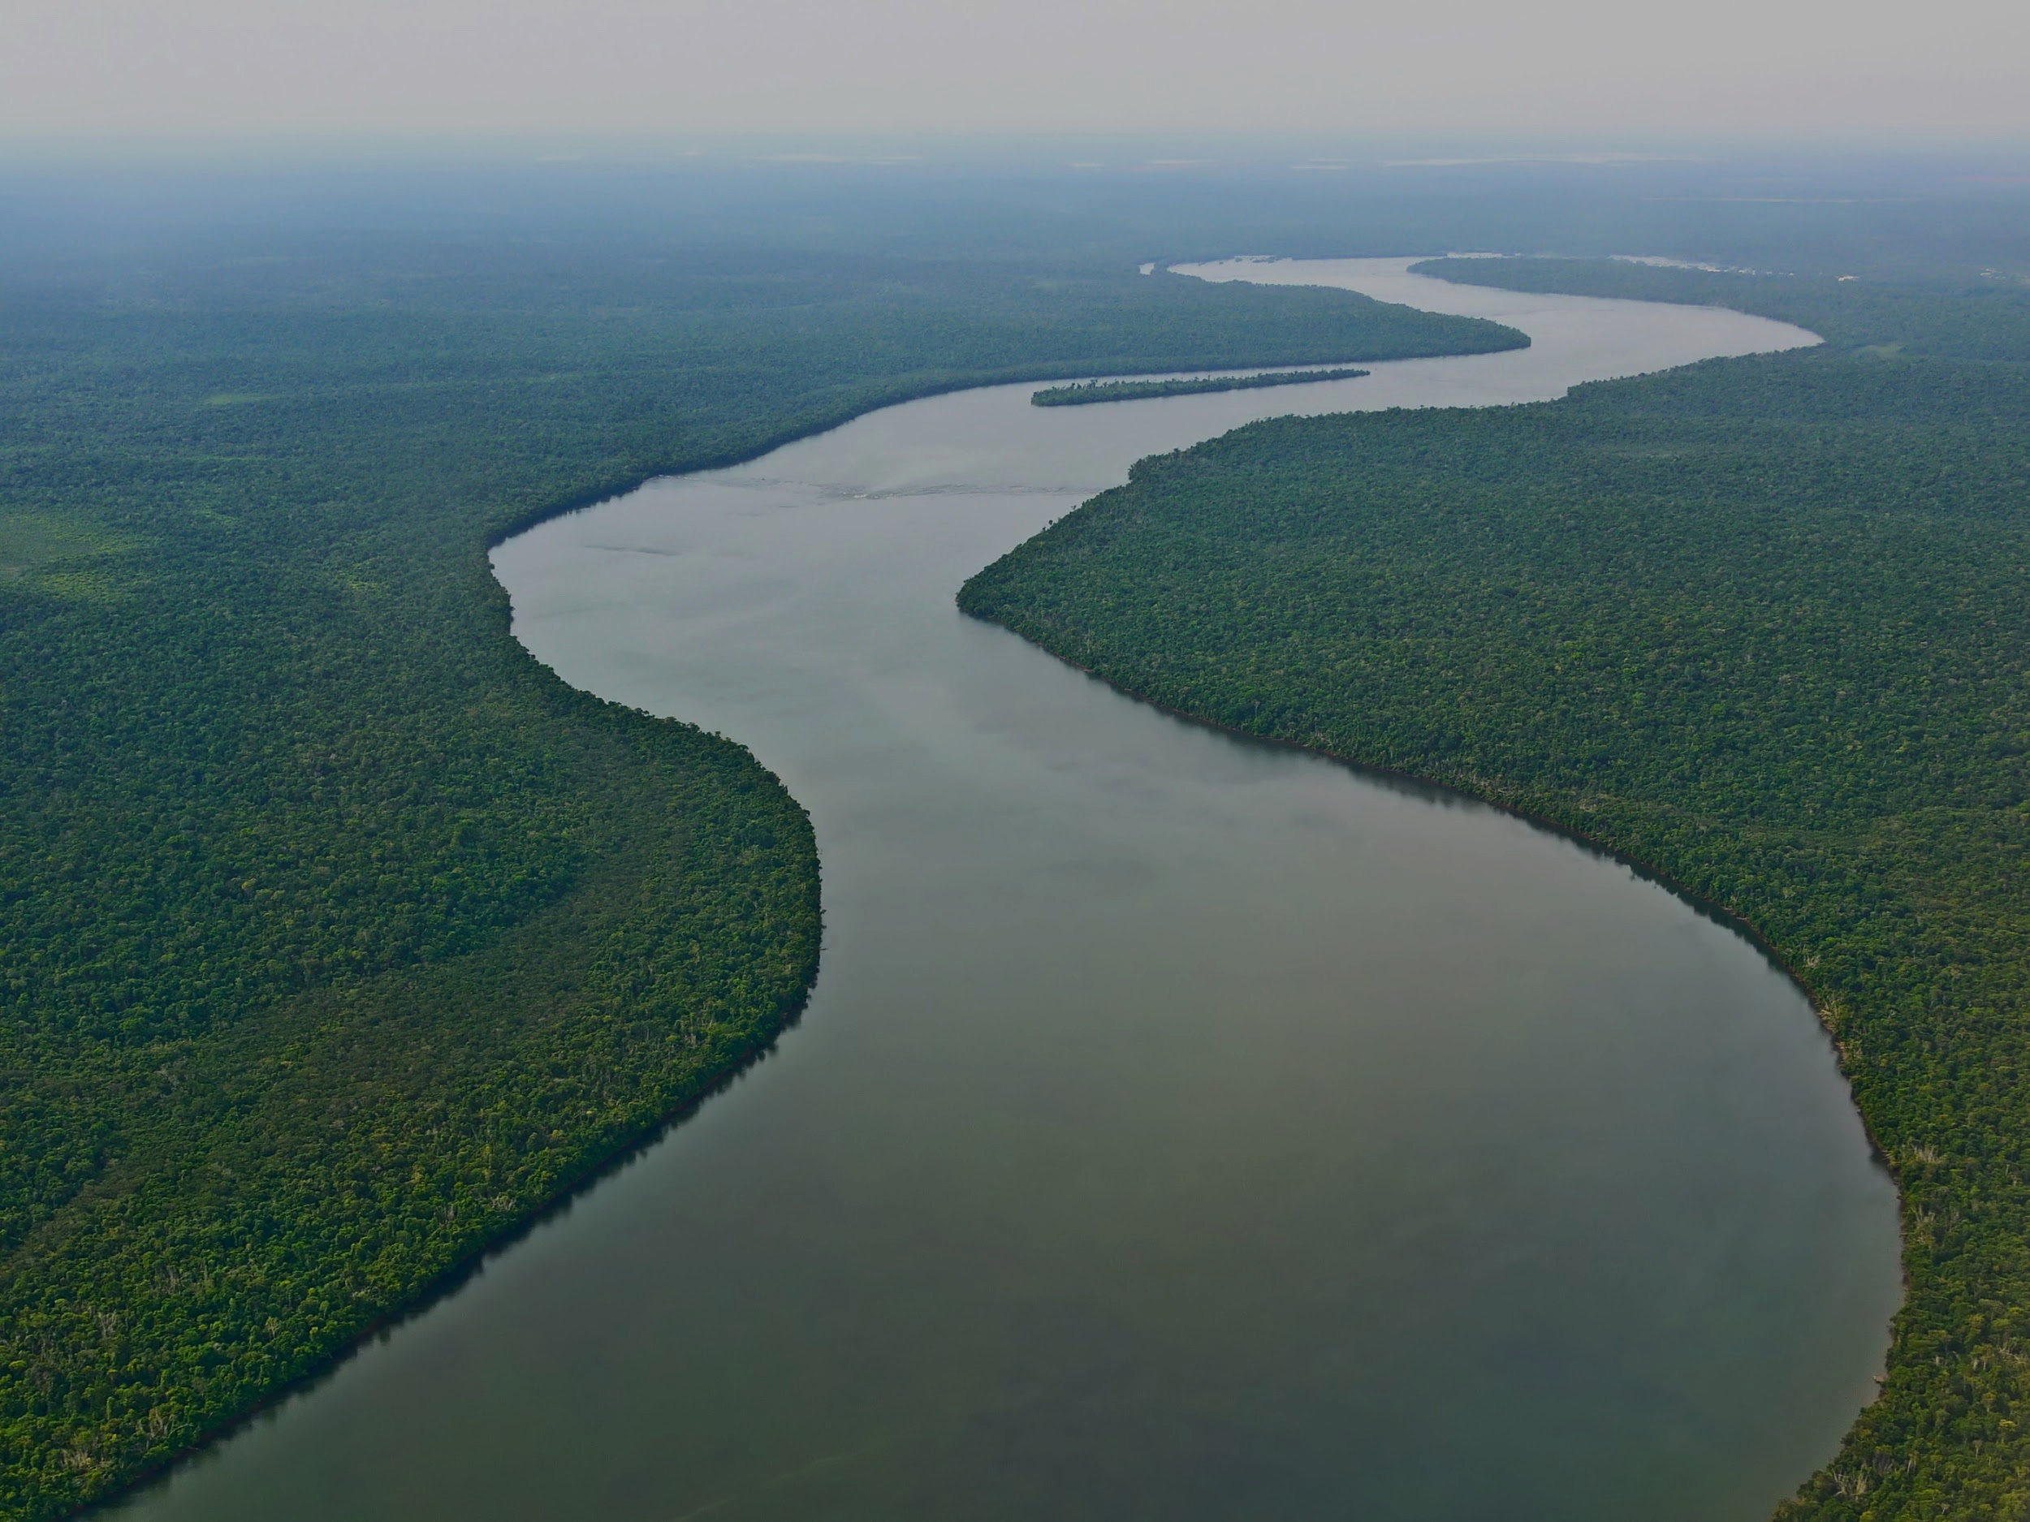
Thank you for your attention!
Any Questions?
Thank you for your attention!
Any questions?

