Slide 1
Andrzej Gruszczynski
Duncan
Hambrey
Emilio
Romero Jiménez
Iain
Sagan
Shahzaib
Sheaikh
Lucia
Urra Viana

Slide 2
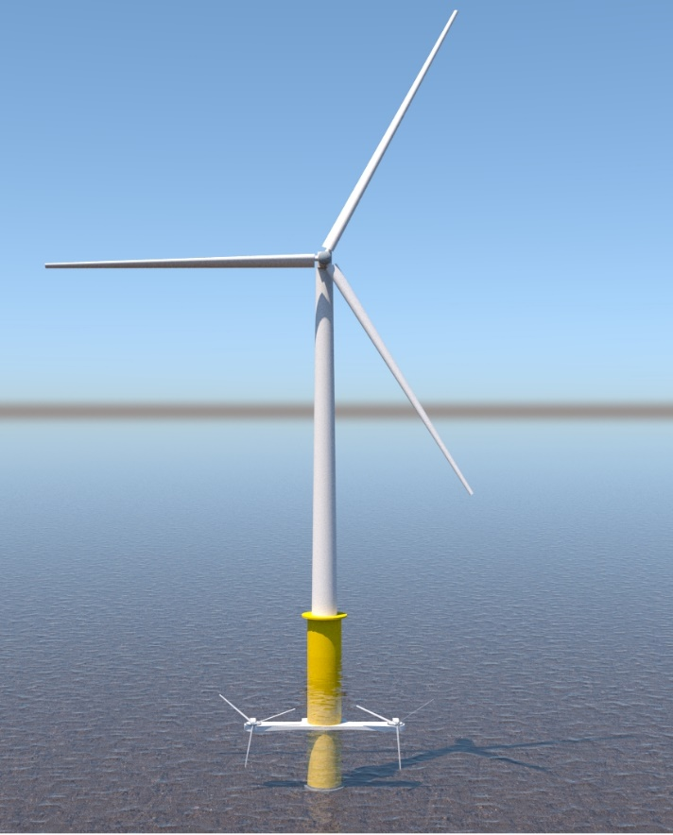
Introducing
HOWaT
The Hybrid Offshore Wind and Tidal System

Slide 3
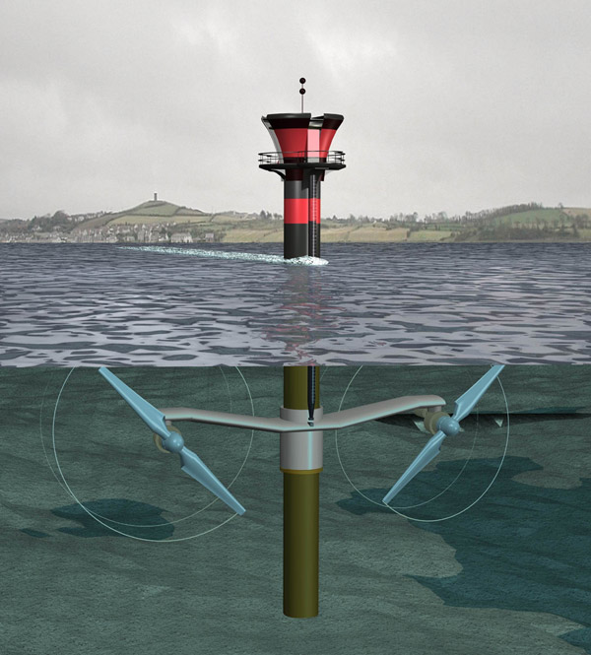
The HOWaT Concept
+
=
?
[alternative-energy-news.info]
[wind-energy-market.com]

Slide 4
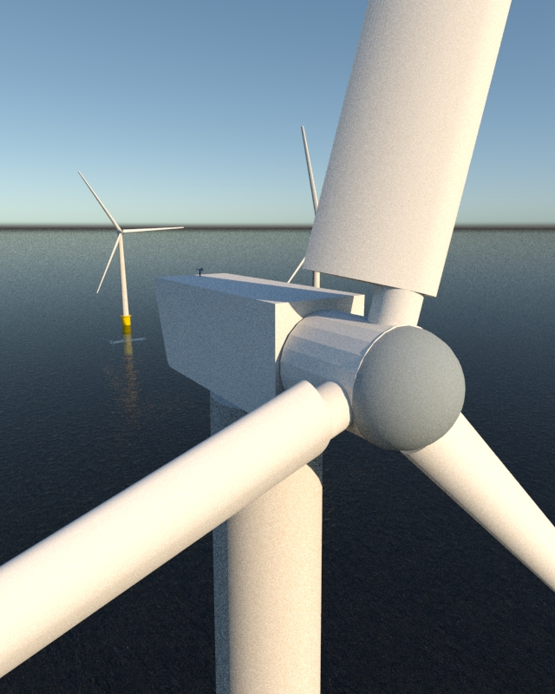
Why?
Predictable Renewable Energy Generation
Increased output from one location
Reduced costs through shared transmission infrastructure and foundations
Shared maintenance costs
Real future potential?

Slide 5
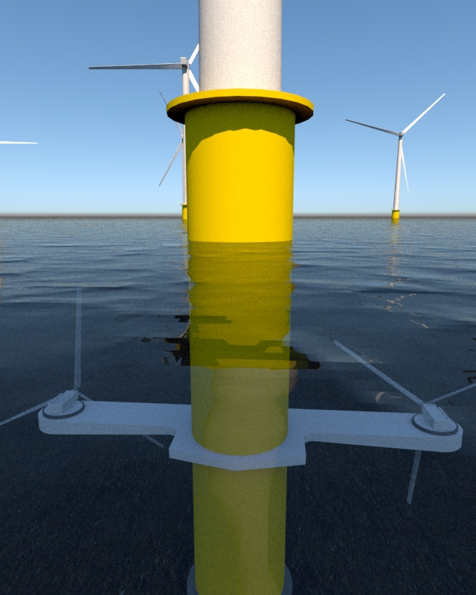
Challenges
Immature technology
Increased structural loads
Vibration
Costs
Future technology?

Slide 6
Aims and Objectives
Aims
Investigate the feasibility of HOWaT
Objectives
Possibility of attachment to existing wind turbines
Suitable location
HOWaT concept
Structural Analysis of foundation
Environmental Impact Assessment
Estimation of costs and energy output

Slide 7
How to design and implement such a system?
1. Create an attachment for existing offshore windfarms
1. Create an attachment for existing offshore windfarms
2. Manufacture the complete hybrid system for new arrays

Slide 8
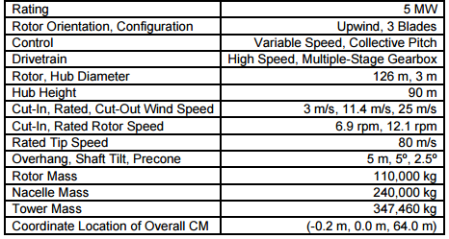
Selected Wind Turbine
NREL’s Baseline 5MW Wind Turbine
8MW Wind Turbine?
Necessary data.
[Senu Sirnivas/NREL]

Slide 9
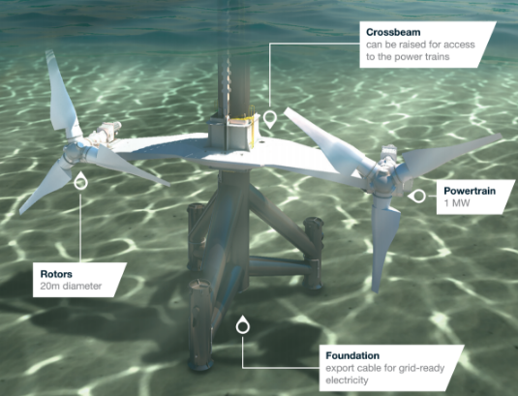
Selected Tidal Stream Turbine
Atlantis’ SeaGen-S 2MW
[Marine Current Turbines]

Slide 10
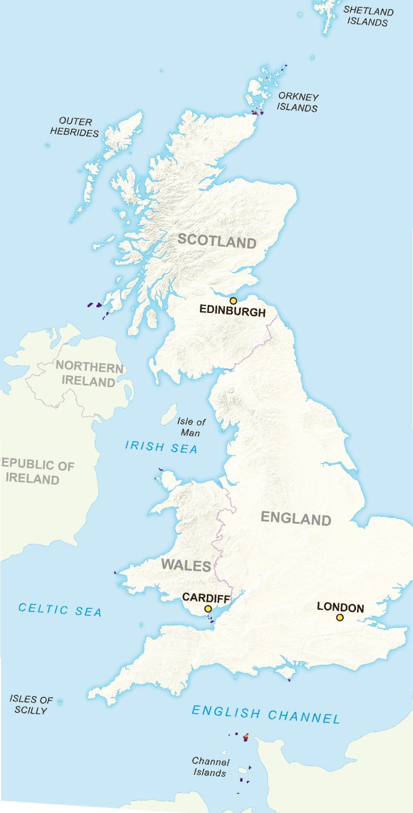
Location
Analysis of existing wind farms
Combination of Wind and Tidal resources, and appropriate depth
Studied with QGIS
Isle of Islay
Planned tidal and wind farms
Better environmental conditions

Slide 11
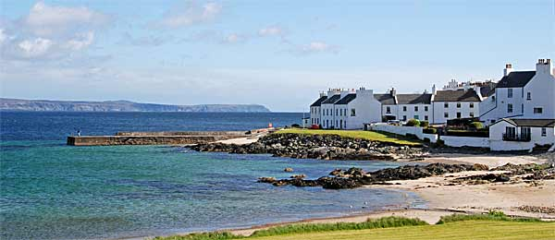
Wind resource
Wind data from Port Ellen
Steps to obtain wind distribution:
Transport data to our location
Fit to a statistical distribution
Calculate generated power and capacity coefficient
[Islayinfo.com]

Slide 12
Wind resource
Cut-in speed | Rated speed | Cut-out speed
3 m/s | 11.4 m/s | 25 m/s
Yearly energy generation | Capacity coefficient
23890 MWh | 54%

Slide 13
Tidal Resource Analysis
Peak Spring Current Speed | 3.05 m/s
Peak Neap Current Speed | 1.69 m/s
Tidal Graph

Slide 14
Tidal Resource Analysis
Seagen –S 2MW chosen to carry out analysis
[Marine Current Turbines]

Slide 15
Tidal Resource Analysis
Lunar Cycle Energy: 521 MWh
Estimated Annual Energy Output: 6.45 GWh
Mean Power Output = 737 kW
Capacity Factor = 36.8%

Slide 16
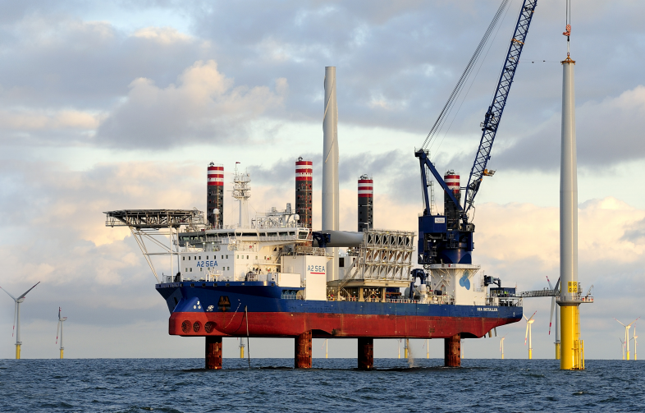
Wind Turbine Installation & Retrieval
A jack up vessel is used for installation.
[Dong Energy, 2017]

Slide 17
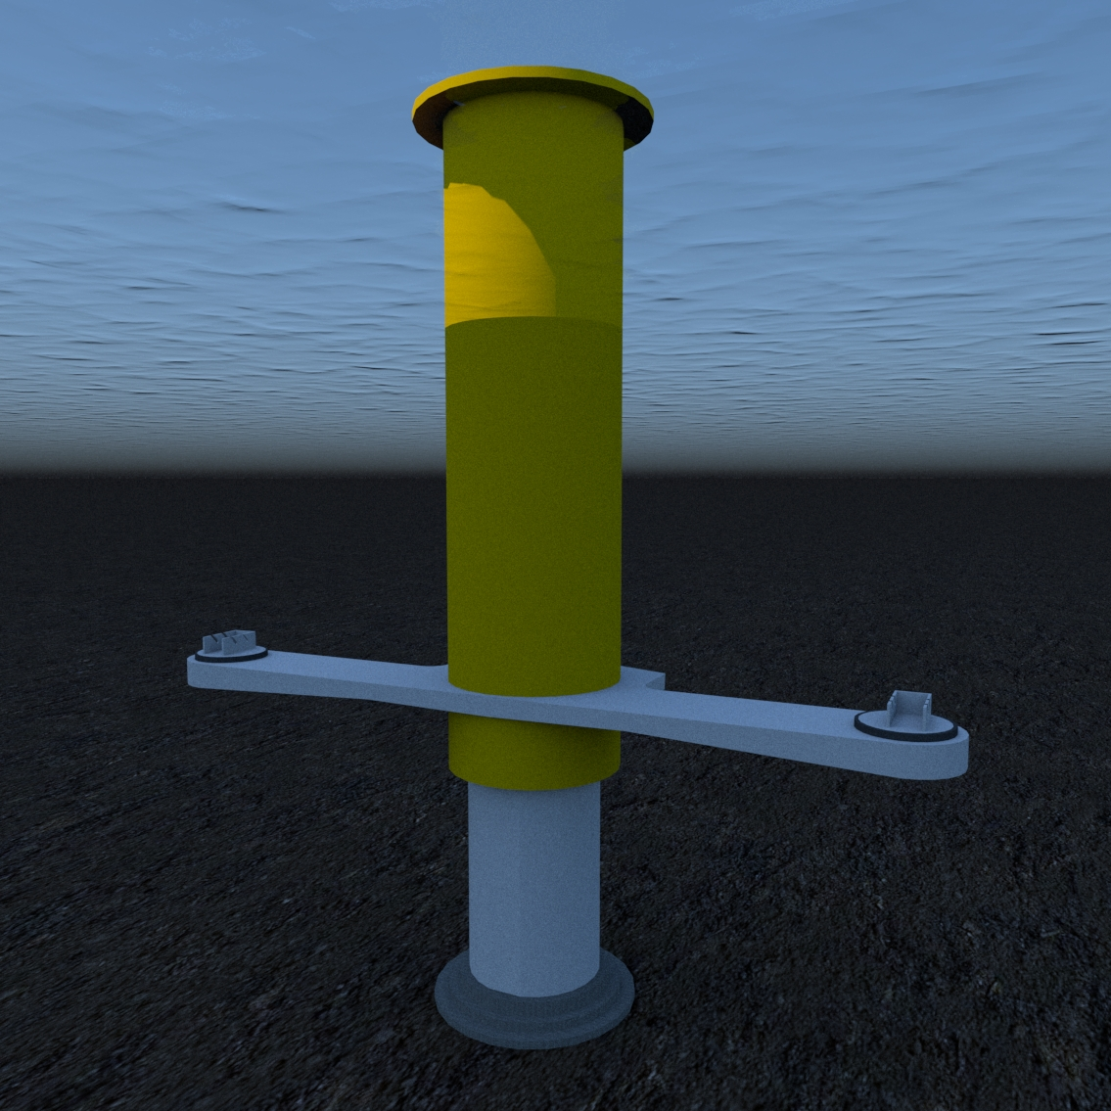
Support Structure
The tidal turbine support structure is welded to the TS
This provides the ease of installation.

Slide 18
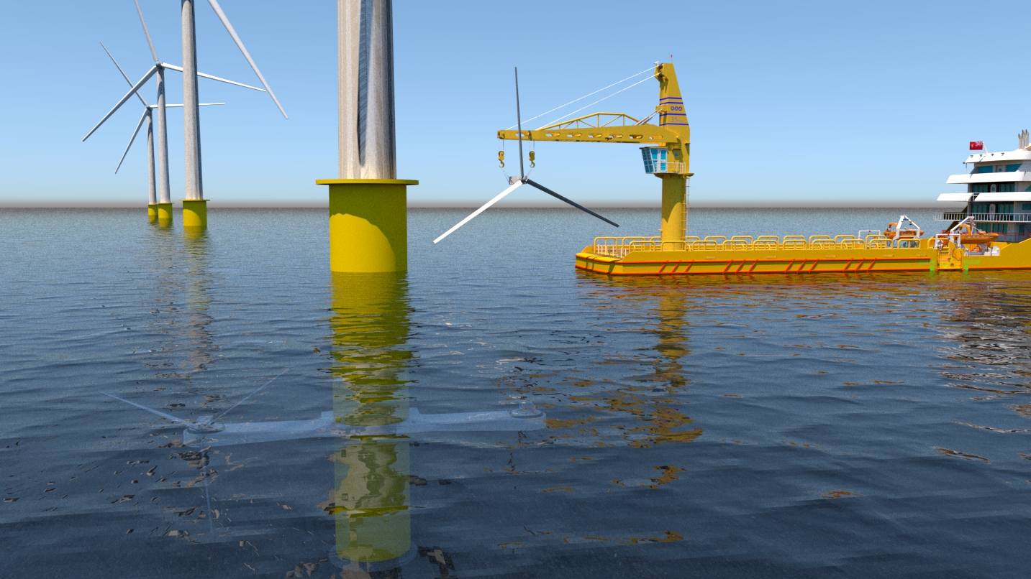
Tidal Turbine Installation & Retrieval
A Dynamic Positioning (DP) vessel is used for installation.

Slide 19
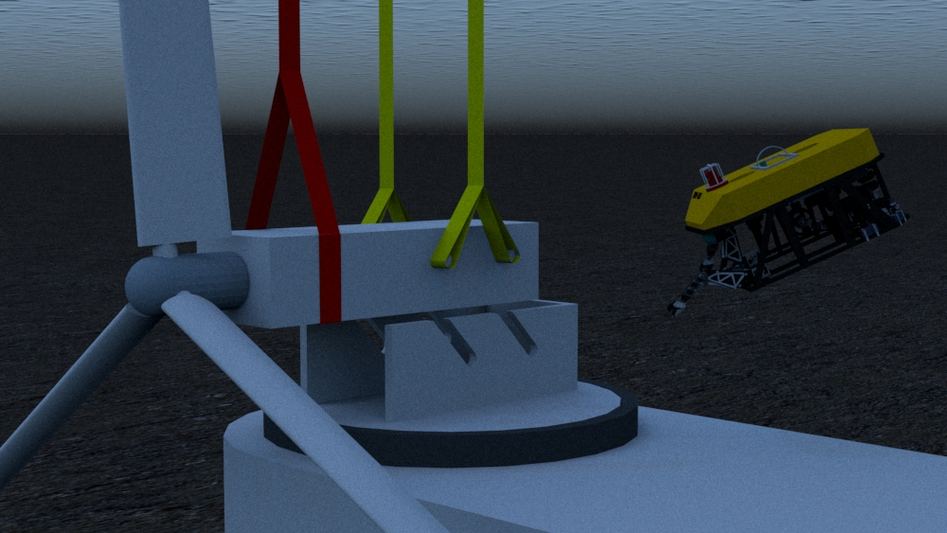

Slide 20
Operation

Slide 21
Operation

Slide 22
Maintenance
27m clearance from the tip of the wind turbine blade to the sea surface
A 4m clearance area from the tip of the tidal turbine to the sea surface.

Slide 23
Maintenance

Slide 24
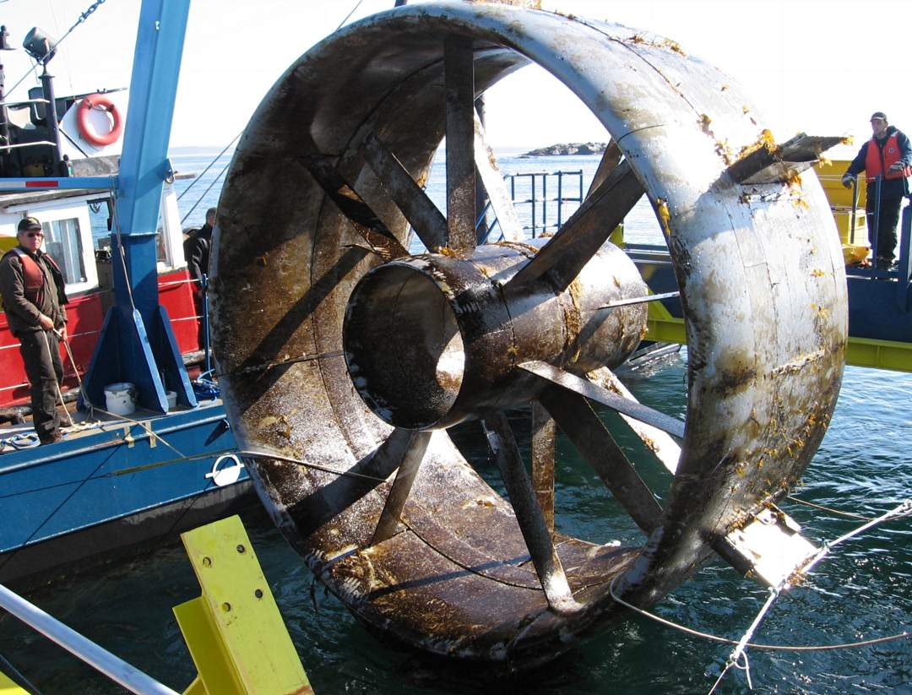
Biofouling
Consequences
Increase the weight of the structures
Increase the drag resistance
Loss of efficiency
Protection
Chemically active antifouling paints
Non stick, fouling release coating
[Racerocks, 2017]

Slide 25
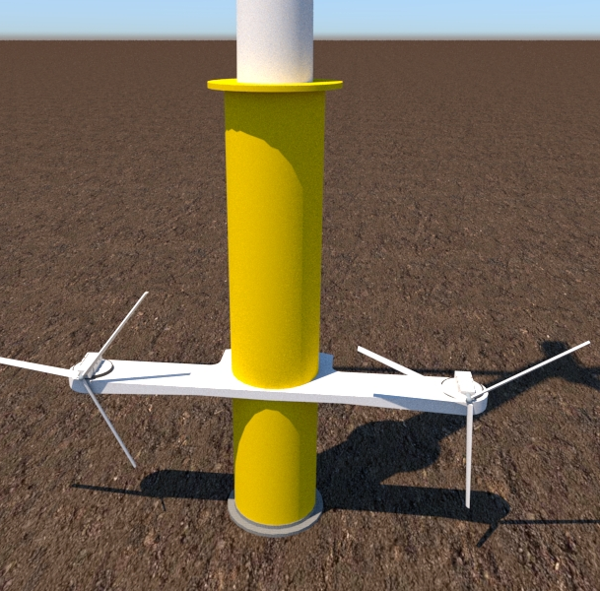
Supporting Structure
Monopile Foundation
Offshore wind turbine (OWT)
Stress comparison
Tidal current turbine
Structural Analysis
Vibration - Natural Frequency

Slide 26
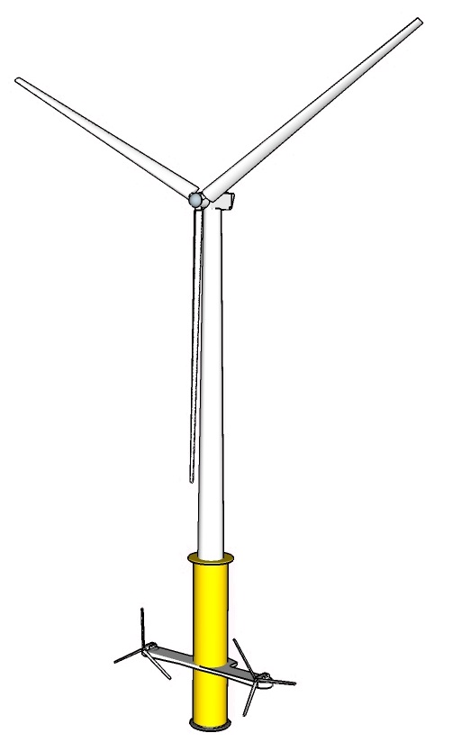
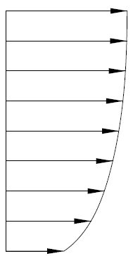
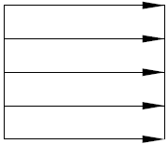
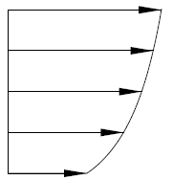
Structural Analysis - Loads
Dead Load
Wind turbine
Tower
Tidal current turbine & structure
Monopile
Aerodynamic load
Drag (structure)
Thrust (rotor)
Hydrodynamic load
+
Drag (structure)
Thrust (rotor)
Waves (structure)
26

Slide 27
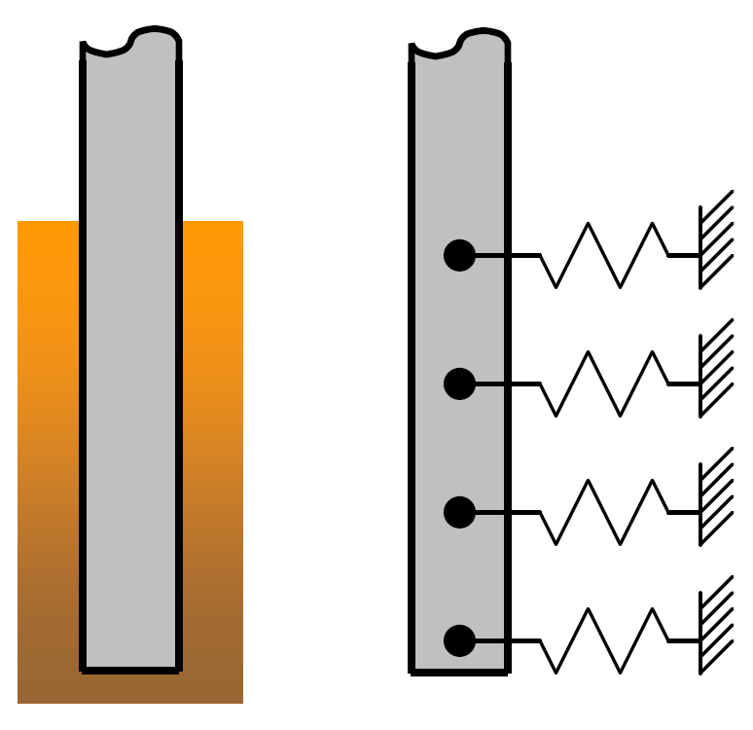
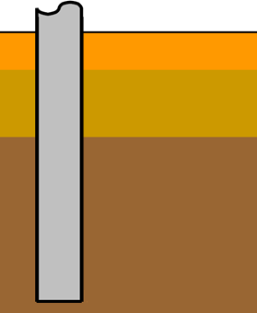
Structural Analysis – Soil-monopile interaction
Offshore Code Comparison Collaboration (OC3) – Phase II
27
[J. Jonkman and W. Musial ,2010]

Slide 28
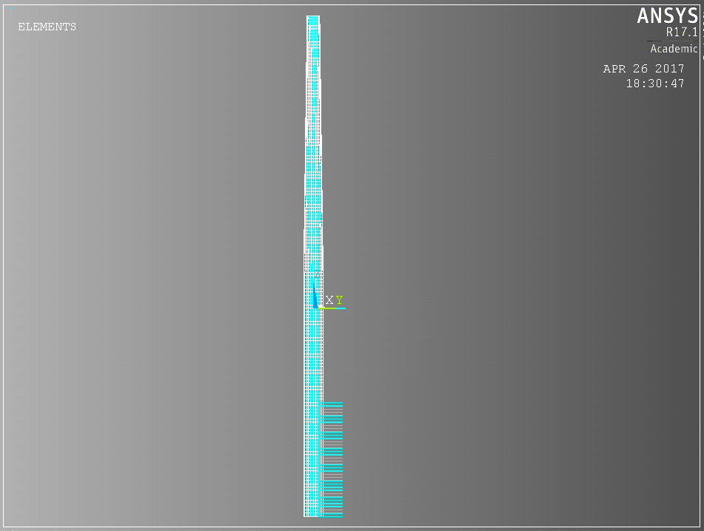
Structural Analysis – Model
Monopile &Tower
Beam elements
BEAM188
Non-linear springs
COMBIN39
Soil interaction
28

Slide 29
Structural Analysis – Load cases
Without Current Drag
LC 0 – Offshore Wind Turbine
+ Current Drag
LC 1 – Offshore Wind Turbine
+Tidal Drag, thrust, dead load
LC 2 – Hybrid Offshore Wind & Tidal
29

Slide 30
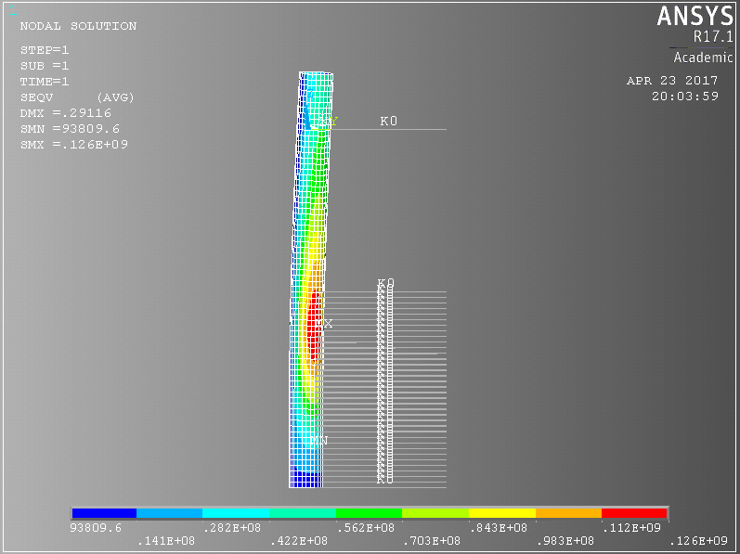
Structural Analysis - Von Mises Stress
Load case | Stress [MPa]
LC0 | 106
LC1 | 114
LC2 | 126
19%
11%
30
Notes:
Explain Von Mises Stress

Slide 31
Structural Analysis – Modification
Thickness modification
Load case | Stress [MPa] | Thickness [mm]
LC0 | 106 | 70
LC1 | 114 | 70
LC2 | 126 | 70
LC2_A1 | 112 | 80
LC2_A0 | 106 | 85
LC1
LC0
LC2_A1,A2– Hybrid Offshore Wind & Tidal - modified
31
Notes:
Design iteration

Slide 32
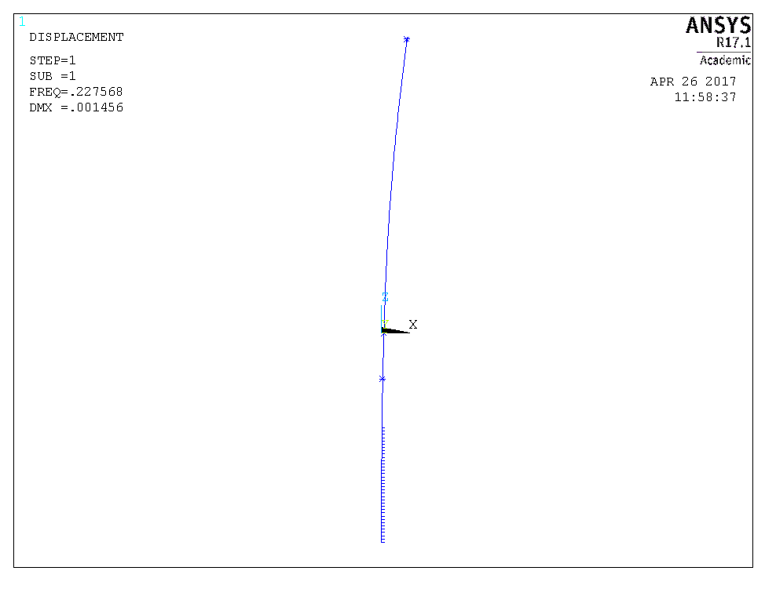
Vibration - Natural Frequency
Load case | Description | Natural Frequency [Hz]
LC0 | OWT | 0.2167
LC1 | OWT | 0.2167
LC2 | HOWT | 0.2178
LC2_A1 | HOWT | 0.2246
LC2_A0 | HOWT | 0.2276
Beam elements
BEAM188
Non-linear springs
COMBIN39
32

Slide 33
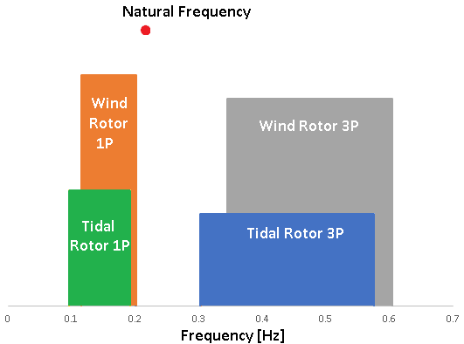
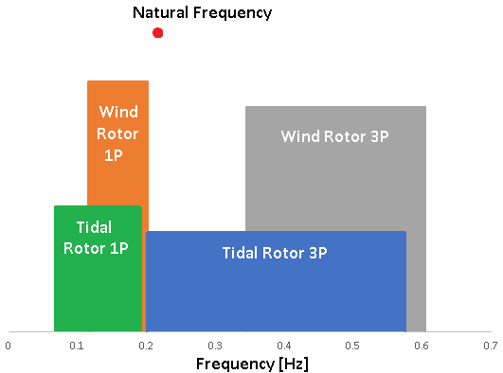
Vibrations
Turbine | Lower Rotor Speed [rpm] | Higher Rotor Speed [rpm]
Wind | 6.9 | 12.1
Tidal | 6 | 11.5
Turbine | Lower Rotor Speed [rpm] | Higher Rotor Speed [rpm]
Wind | 6.9 | 12.1
Tidal | 4 | 11.5
Beam elements
BEAM188
Non-linear springs
COMBIN39
33

Slide 34
Transmission Line
[Tennet, 2016]

Slide 35
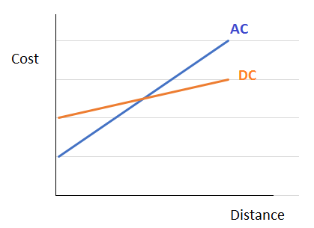
AC vs. DC
Losses, line and terminal costs included in cable cost
8 km
[Electrical Engineering Portal, 2014]
35

Slide 36
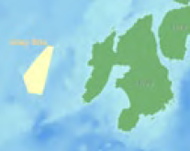
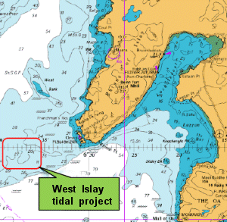
Environmental Impact Assessment
+
=
?
[SSE Islay Ofshore
Wind Proposal, 2009]
[DP Marine Islay Tidal Project Scoping Report, 2009]

Slide 37
Baseline Risk Assessment
Baseline Risk Assessment - Marine | Project Phases
 | Construction | Operation | Decommissioning
Physical
Geology
Marine & Coastal Processes
Contamination & Water Quality
Biological
Protected Sites and Species
Benthic Ecology & Intertidal Habitats
Fish and Shellfish
Marine Birds
Marine Mammals

Slide 38
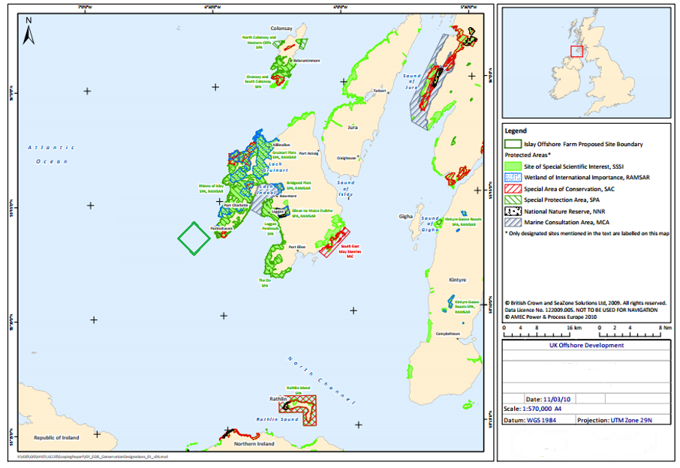
Marine Birds and Mammals
Environmentally
Protected Areas
[Crown Estate, 2009]

Slide 39
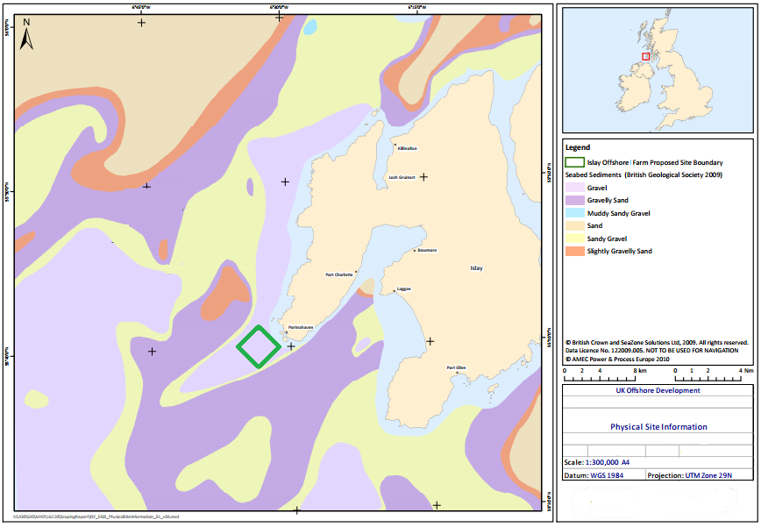
Benthic Ecology & Intertidal Habitats
Seabed Type
[Crown Estate, 2009]

Slide 40
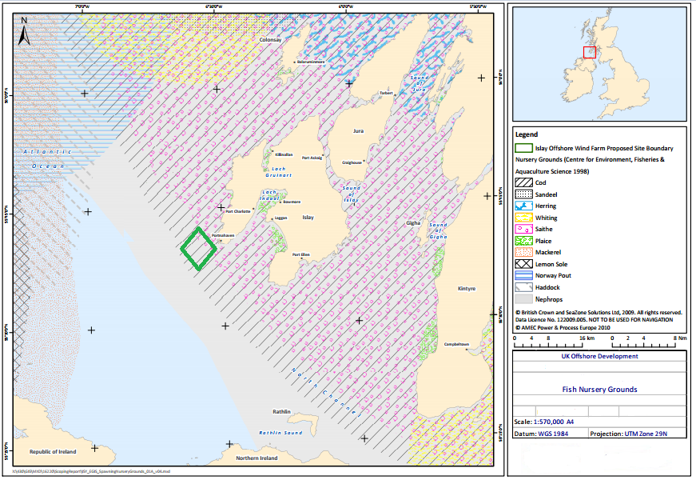
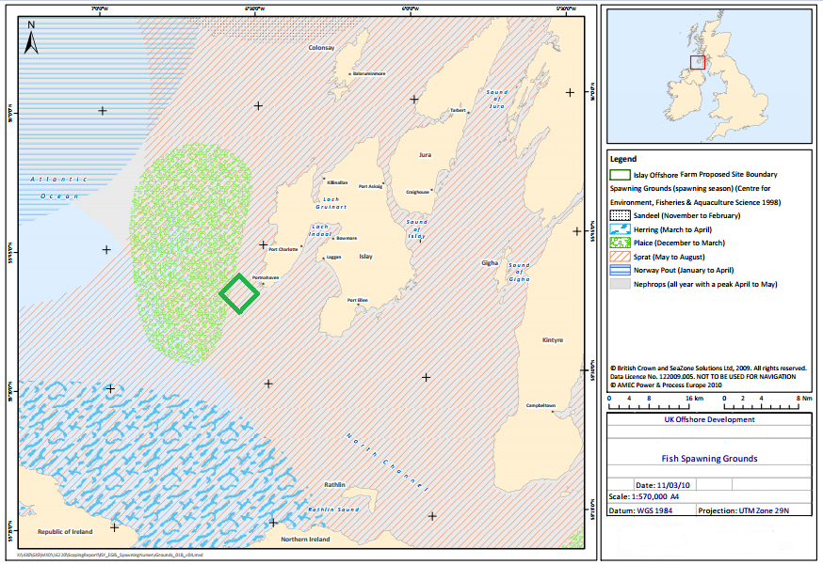
Fish and Shellfish
Nursery Grounds [Crown Estate, 2009]
Spawning Grounds [Crown Estate, 2009]

Slide 41
Expected Outcomes

Slide 42
Financial Analysis
Target Levelised Cost of Energy
Comparison with Existing Technology
Sensitivity Analysis

Slide 43
Contracts For Difference
Offshore Wind - 10.5p/kWh (2015 ~11.8/kWh)
Tidal Current – 30p/kWh
15 year Period (Assumed over 20 years)

Slide 44
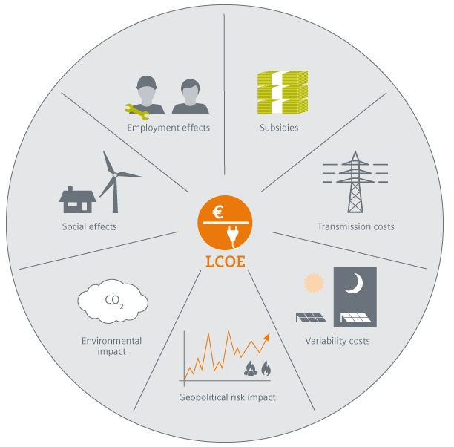
LCOE
Energy output: 80% wind, 20% tidal
Strike Price = £14.6p/KWh
Lifetime project expenditure must be lower than this
[Siemens,2013]

Slide 45
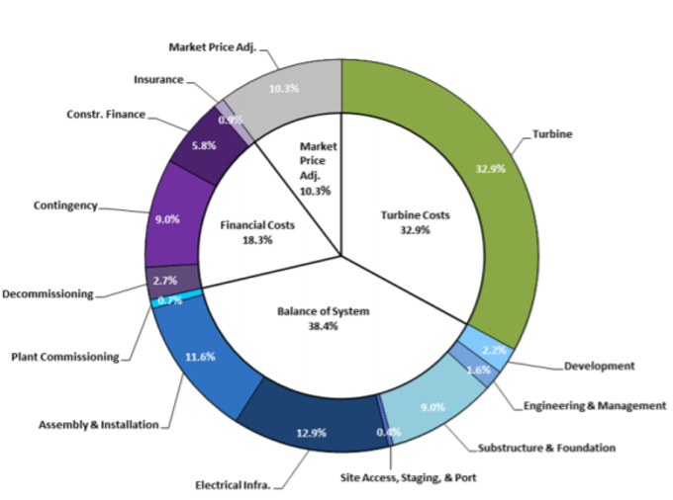
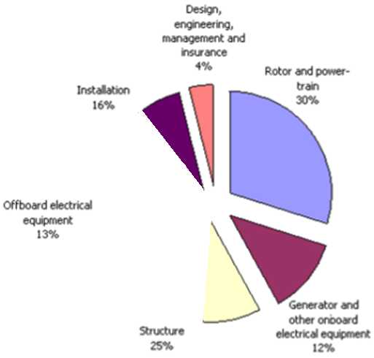
System Cost Estimation
Wind
Tidal
Savings:
Structure = 15%
Offboard Electrical Equipment = 13%
Installation = 8%
36% Saving
[NREL,2014]
[Carbon Trust,2012]

Slide 46
Offshore Wind Vs Hybrid

Slide 47
Sensitivity Analysis – Increasing Array Size

Slide 48
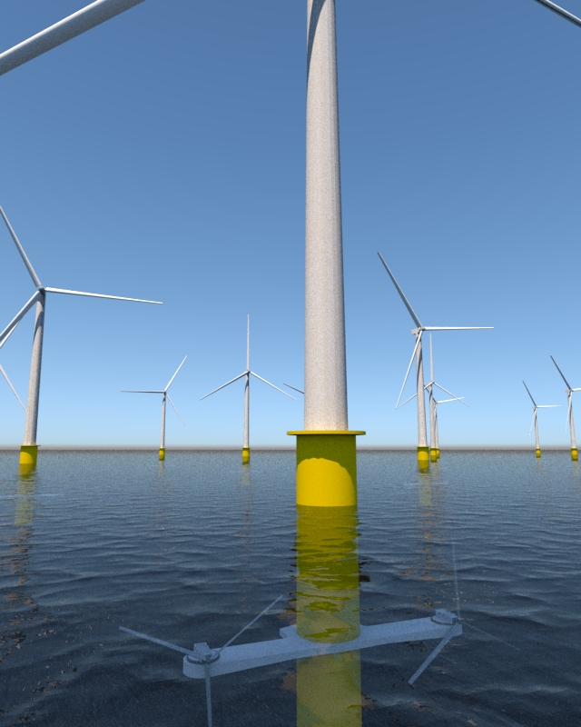
Financial Conclusions
Costs
Foundation reinforcement
Technology development
Savings
Shared cable and foundation costs
Offshore wind currently a better option
Government incentives pivotal
Tidal cost reductions decisive

Slide 49
Project Conclusions
Technically feasible thanks to current incentives
Limited locations
Promising power generation output
Unlikely significant environmental impacts
Structurally sound, possible vibration issues
Significant savings from shared costs

Slide 50
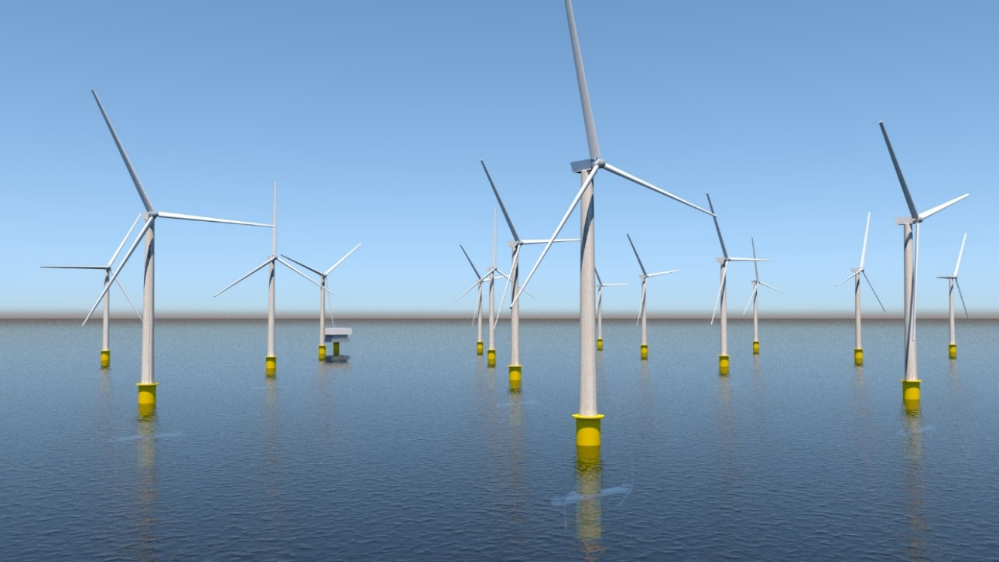
Future Potential
Tidal technologies more developed
Application of energy storage
Baseload generation possible

Slide 51
Thank You For Listening Any Questions?

