Slide 1
– TETHYS –
Innovative Floating Multi-Purpose Marine Renewable Energy Platform
Team Members
Alasdair Fulton, Giacomo Politi, Ignacio Alvarez Freire, Ioannis Tsichlis, Theofanis Katsoulis

Slide 2
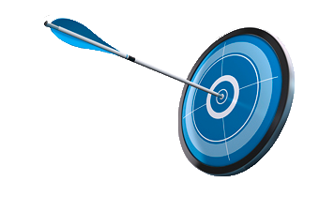
Introduction
Project Aim
Investigate the reduction of LCOE in floating renewable energy farms
Motivate industry to move far from shore into deep waters

Slide 3
Introduction
Why Far from Shore into Deep Waters?
Enormous Wind & Wave Resources
Opportunity for Wind & Wave Synergy
Limitations with Fixed Structures
Near-Shore Shallow Sites Developed/Leased

Slide 4
Introduction
The Project
Floating Wind Farm
TETHYS Platform

Slide 5
Deep Sea – Far from Shore

Slide 6
Floating Wind Farm
How to support O&M reducing the cost
O&M cost = 25% of LCOE
How to reduce Lifecycle Cost?

Slide 7
Floating Wind Farm
How to support O&M reducing the cost
O&M cost = 25% of LCOE
How to reduce Lifecycle Cost?
TETHYS
Multi-Purpose Platform

Slide 8
Pneumatically Stabilized Platform

Slide 9
Oscillating Water Column Integrated Wave Device

Slide 10
2x Integrated Wind Turbines

Slide 11
Substation
Personnel Accommodation

Slide 12
Operations & Maintenance Facilities
Offshore Assembly Workshop

Slide 13
Calm-side for safe Vessel Mooring and Equipment Transfer

Slide 14
Introduction
Other Purposes/Uses
Research Facilities
Aquaculture Facilities
Offshore Electrical Network Connection Hub

Slide 15
Introduction
Objectives
Feasibility of Tethys Concept
Levelised Cost of Electricity (LCOE) Calculation
LCOE Comparison with Mothership

Slide 16
Introduction
What’s next?
Wind & Wave Synergy
Location
Technical Analysis
Financial Analysis

Slide 17
Wind & Wave Synergy
Mix of Wind & Wave
Steady output - 80:20 ratio
Complementary energy sources
Area optimization
Wave subsidies
Notes:
Swell & Wind Decoupled – Average Output Smoothed
Optimum Ratio

Slide 18
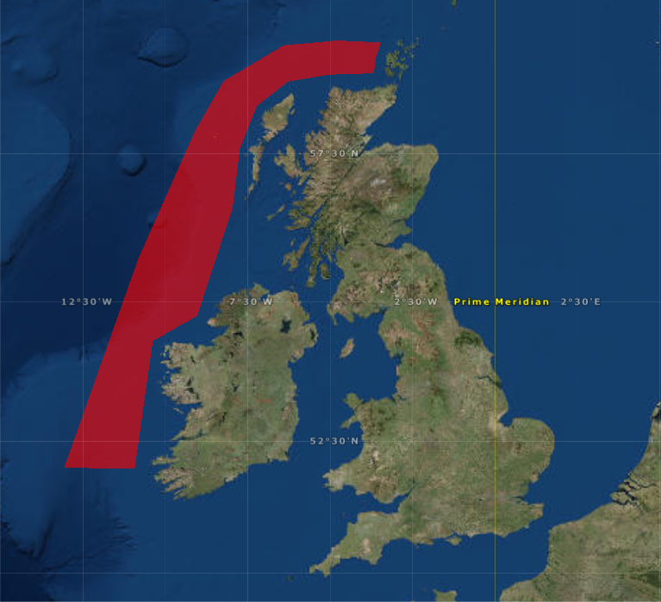
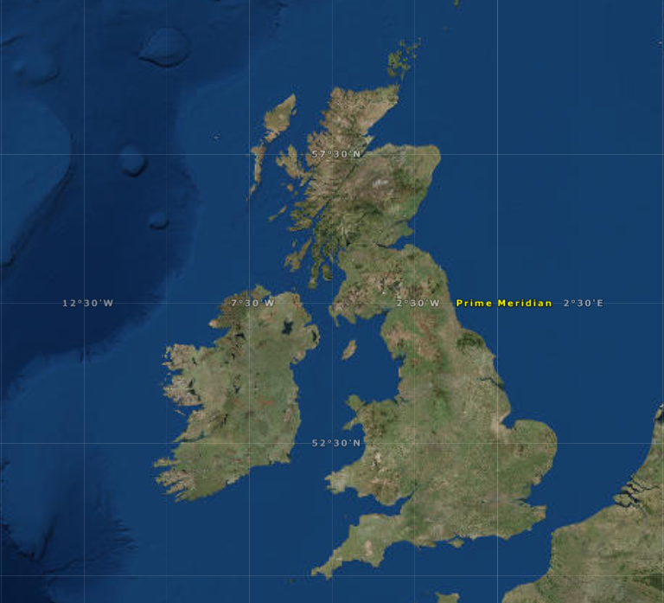
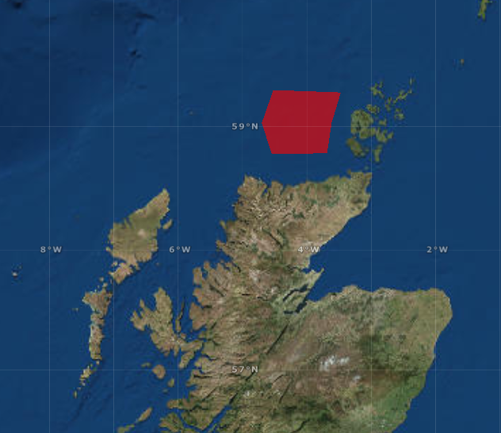
Location
Site Selection
Major wave resource
30 - 40 kW/m
Major wind resource
10 m/s
Depth
95 - 120 m
Grid Connection Point Dounreay (275 kV)

Slide 19
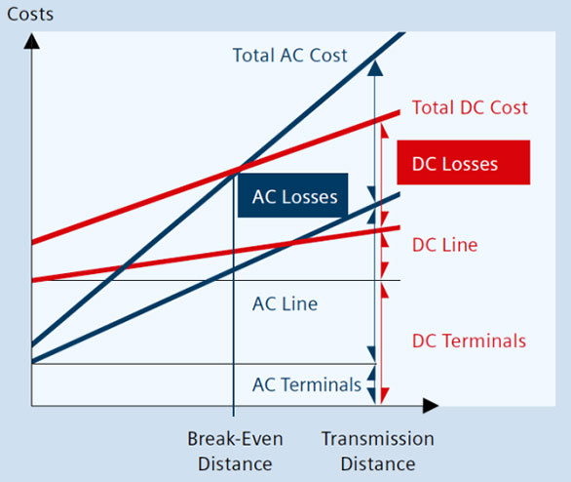
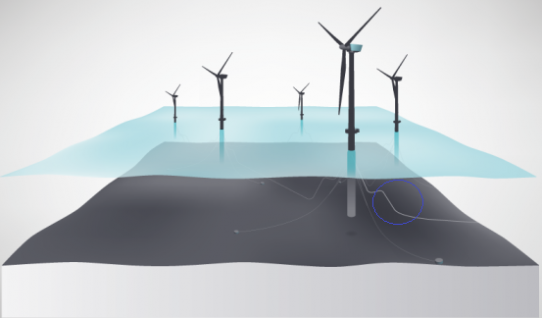
Grid Connection
Cable Arrangement – Key Challenge
Inter-array cables (33 kV)
Moored at specific points – umbilical cables
PSP & WTG Units floating > Dynamic cables
HVAC
Export Cable (132 kV)
Distance > 75 km from shore > HVDC
Commercial availability: ABB & Siemens
DC to reduce losses

Slide 20
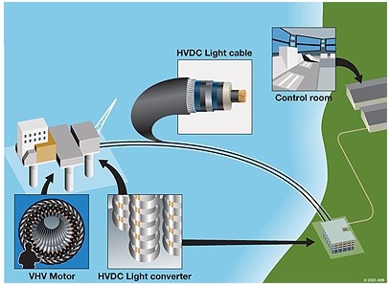
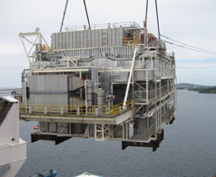
Transformation 33 kV AC 132 kV DC
Grid Connection
Offshore Substation
Capacity >100 MW
Distance from Shore >75 km

Slide 21
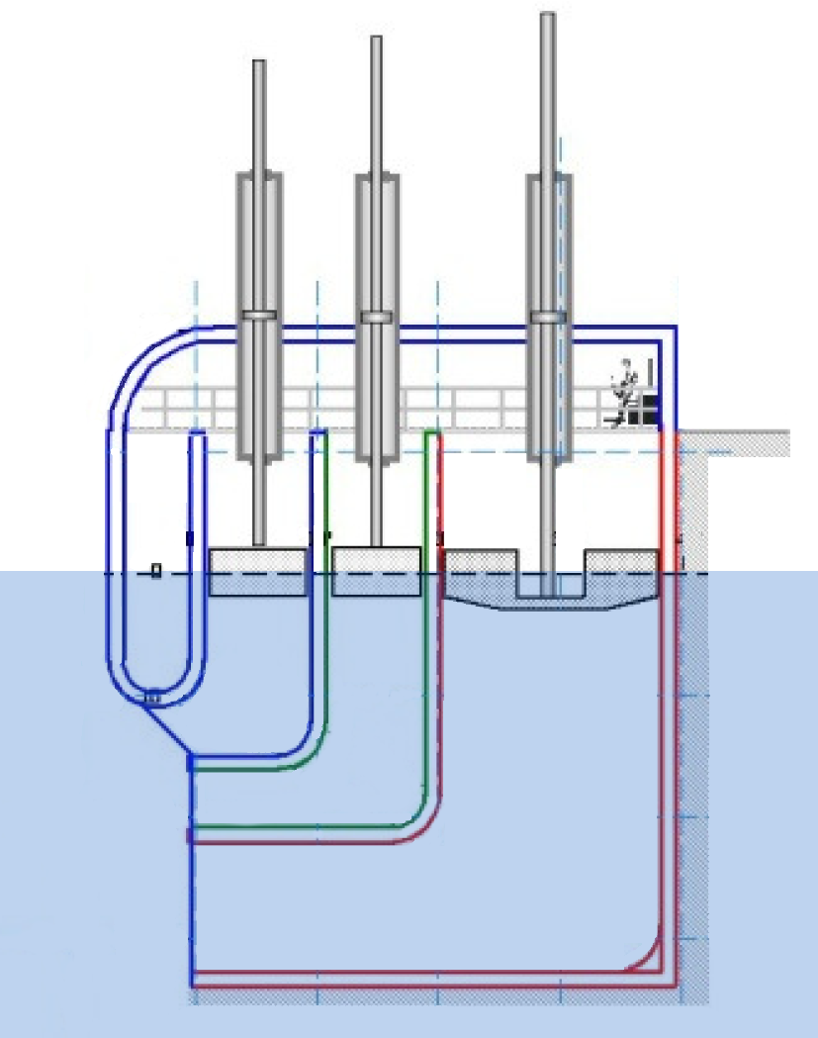
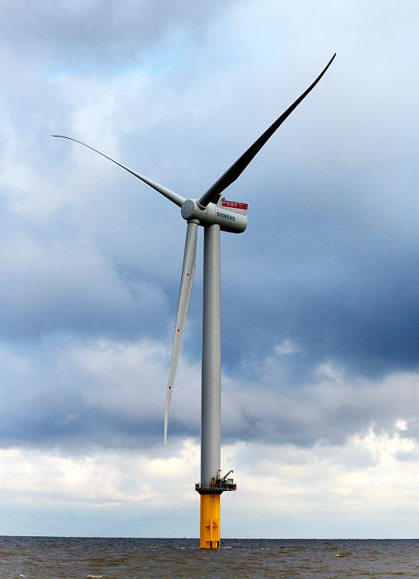
Windfarm
Windfarm/WEC - Specifications
WT Distance
1,200-1,400 m
Radius mooring lines
700-900 m
FLOAT INCORPORATED
Wave Energy Converter
28.8 MW
SIEMENS SWT-6.0-154
Wind Turbines
6 MW

Slide 22
Design Feasibility
TETHYS Layout
200 m
1000 m²
191°
50 m
720 m
WEC Power Take-Off
WS
A
H
Lay-Down Area
R
SS
C
A = Accommodation
SS = Substation
WS = Workshop & Stores
C = Crane
H = Helipad
R = Research Centre

Slide 23
Design Feasibility
Hydrostatics Model Design

Slide 24
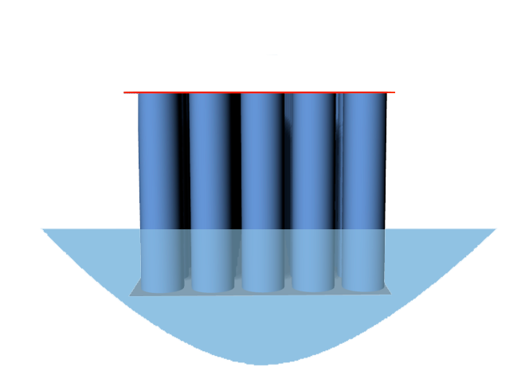
Design Feasibility
Hydrostatics Parameters
M
G
B
K
Keel
Center of Buoyancy
K
B
Center of Gravity
Metacenter
G
M

Slide 25
Design Feasibility
Design Feasibility
Hydrostatics Results - Floating Conditions
35.7 m > 0
Metacentric Height > 0
333,512 Tons
Displaced weight of water = total weight of the structure

Slide 26
Design Feasibility
Wave Energy Collector and PSP
Incoming Waves
Calm Side
50-70%
~20-25%
Integrated Design
Tuned to Absorb Waves Across Spectrum
Capacity Coefficient = 41%
No Moving Parts Under Water

Slide 27
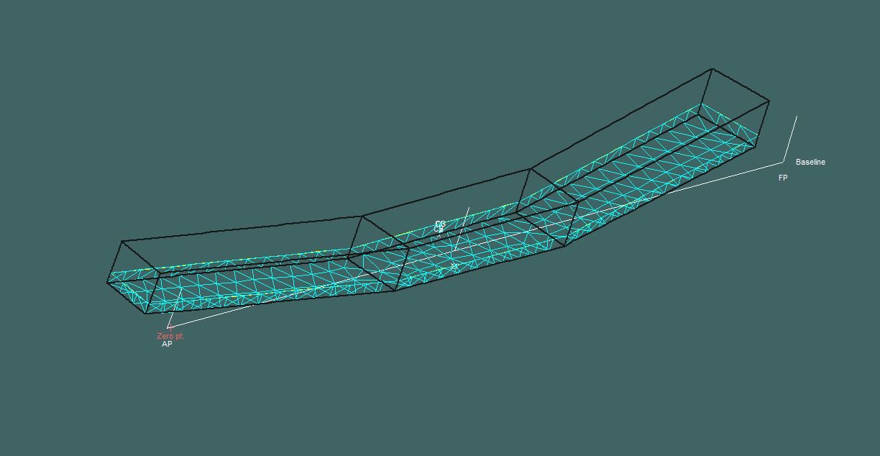
Design Feasibility
Hydrodynamics Model
Meshed design of the platform using MaxSurf

Slide 28
Design Feasibility
Hydrodynamics - JONSWAP Inputs
Analysis using the JONSWAP Spectrum - location based
Maxsurf Used to Analyse 6 Sea States
0.3 m to 7.5 m
Heave
Pitch
Roll
Sway
Surge
Yaw
6 Degrees of Freedom Analysed

Slide 29
Design Feasibility
Hydrodynamics Results
Heave

Slide 30
Cost Analysis
Cost Analysis: Levelised Cost of Electricity
Fixed Inputs
Platform
Energy Yield
Wind Turbine Energy Yield
Wind Turbine CAPEX
Wind Turbine OPEX
Platform CAPEX
Platform OPEX
Project Specific Inputs
Distance to Shore = 75 km
$$LCOE= \frac{\sum_{t=1}^{n}{\frac{{Cx}_{t}+{Ox}_{t}}{{\left(1+r\right)}^{t}}}}{\sum_{t=1}^{n}{\frac{E_{t}}{{\left(1+r\right)}^{t}}}}$$
SENSITIVITY
Water Depth = 100 m
WEC High / Low
Platform Size = 720 m
TETHYS vs Mothership
Number of Turbines (Variable)
LCOE £ per MWh

Slide 31
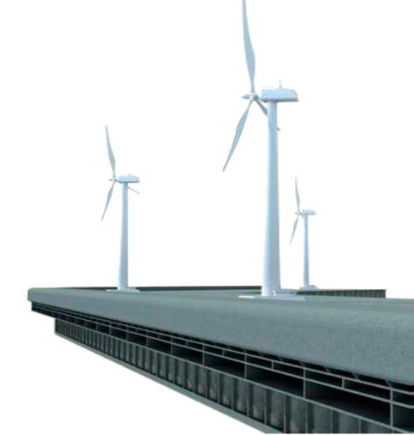
Cost Analysis
Cost Analysis: TETHYS LCOE - Wind & Wave Synergy
Industry Leading WEC
FLOAT Inc. L-Shaped OWC
6 x 6 MW WTs
16 x 6 MW WTs
80%
15%
20%
41%
172 GWh/yr
461 GWh/yr

Slide 32
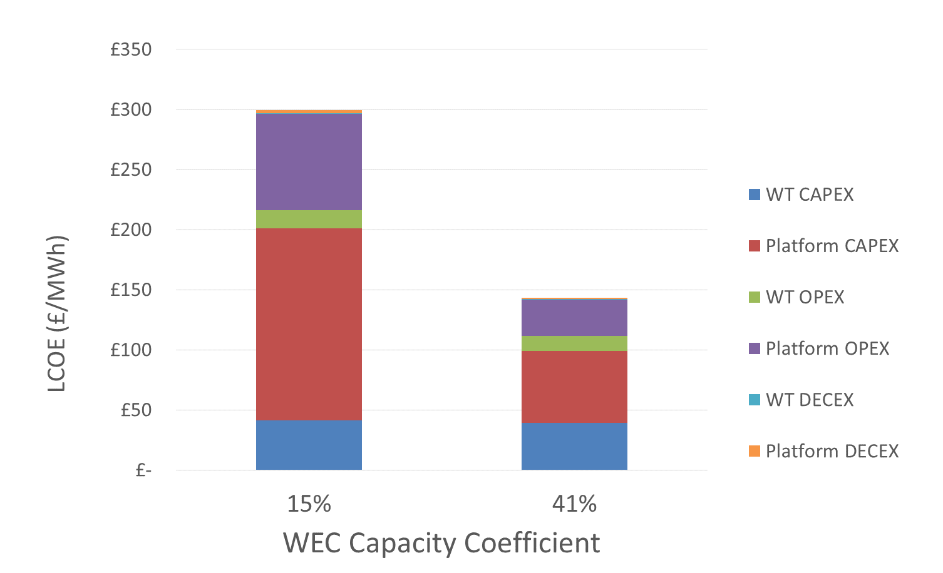
Cost Analysis
Cost Analysis: LCOE Wind & Wave Synergy
£296/MWh
60% Loss
Break Even
£182
22% Profit
£144/MWh
27%

Slide 33
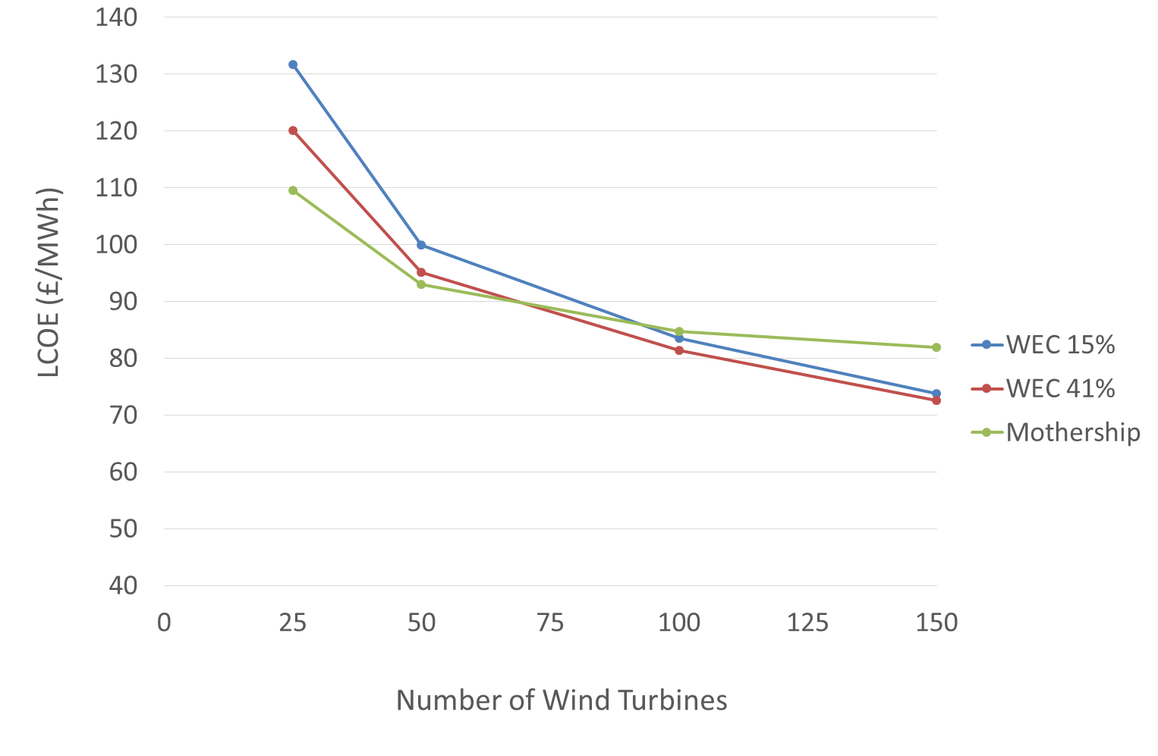
Cost Analysis
Cost Analysis: LCOE TETHYS vs Mothership
Scenarios
& Sensitivities
Low Case:
WEC 15% Cap. Coef.
High Case:
WEC 41% Cap. Coef.
Comparison:
Mothership
Wind Strike Price £155/MWh | Wave Strike Price £305/MWh

Slide 34
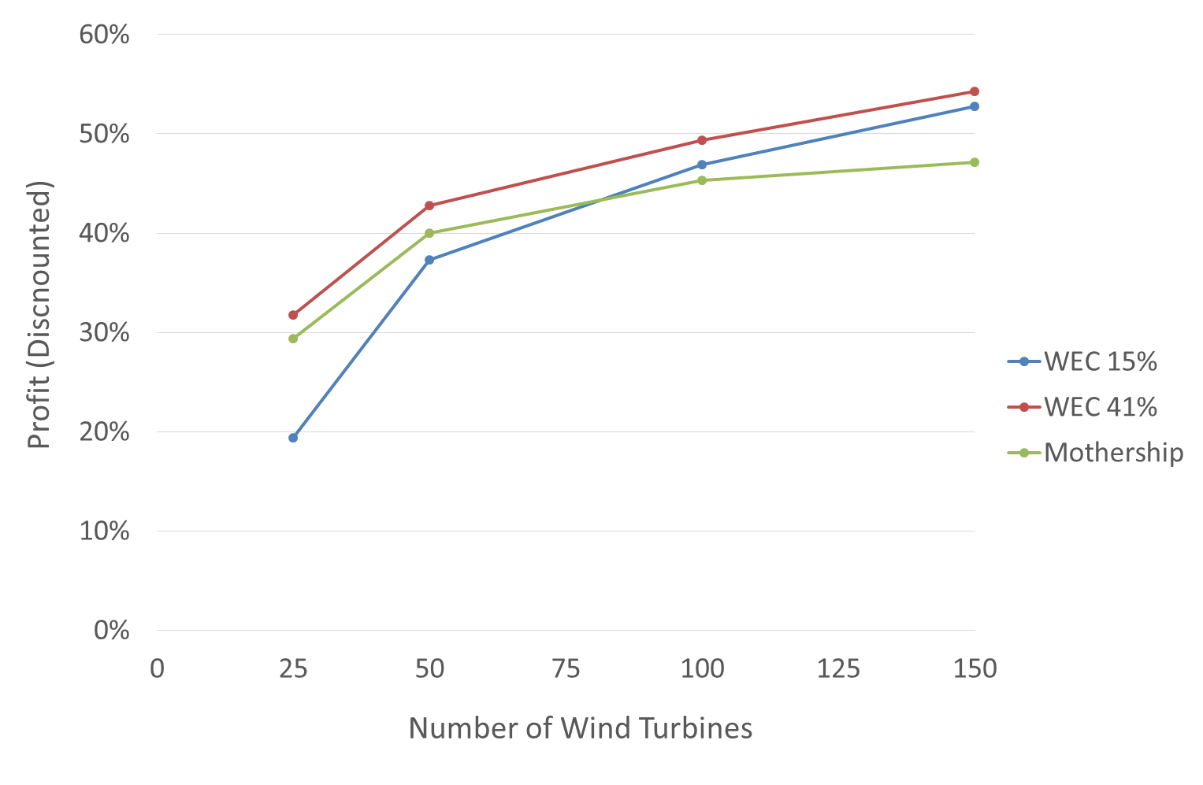
Cost Analysis
Cost Analysis: Profit TETHYS vs Mothership
Profit
Profit (Discounted)
WEC Strike Price £305/MWh
WIND Strike Price £155/MWh
High (41%) Case More Profitable
Wind Strike Price £155/MWh | Wave Strike Price £305/MWh

Slide 35
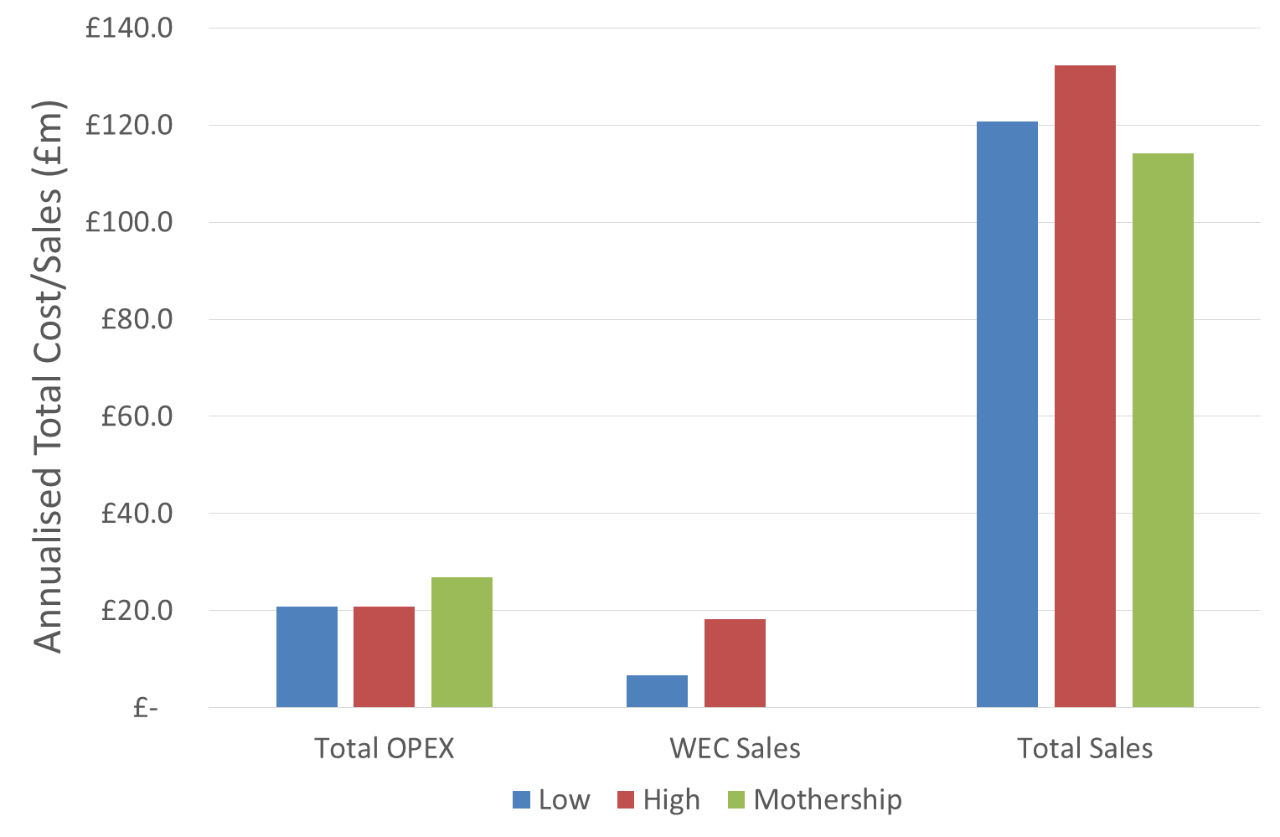
Cost Analysis
Cost Analysis: TETHYS vs Mothership
Comparison
Based on 50 Wind Turbines
Wave Energy Sales Contribute 17% in High Case (7% in Low)
Wave-Wind 8:100

Slide 36
Conclusions
Conclusions - Financial
Competes with Mothership
Profitable and Technically Viable
Improved Profitability
Wave Energy Extraction Feasible
Optimisation Required
Economics Influenced by Platform CAPEX & WEC Performance

Slide 37
Conclusions
Conclusions - Overall
Reduced Motion, Improved Safety
Stabilised, Comfortable,
Multi-Use Platform
Future Grid Benefits
Wind & Wave Combined
Expandable
Supports Wind Farm Expansion and Additional Renewable Farms

Slide 38
Any Questions?

