Slide 1
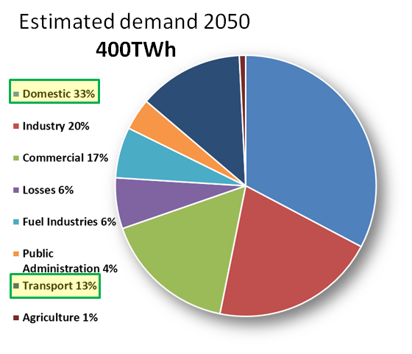
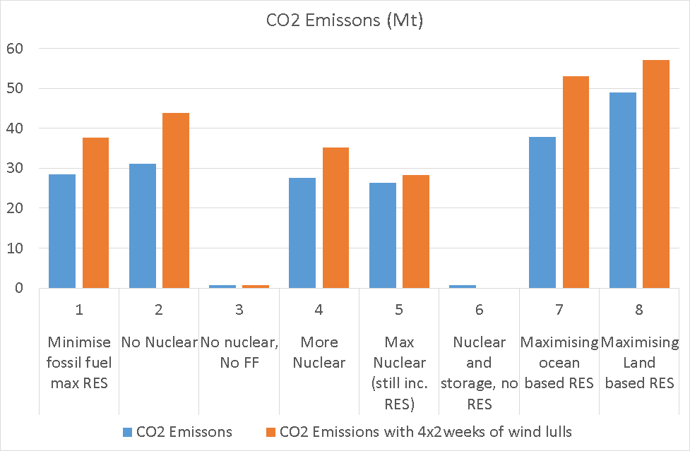
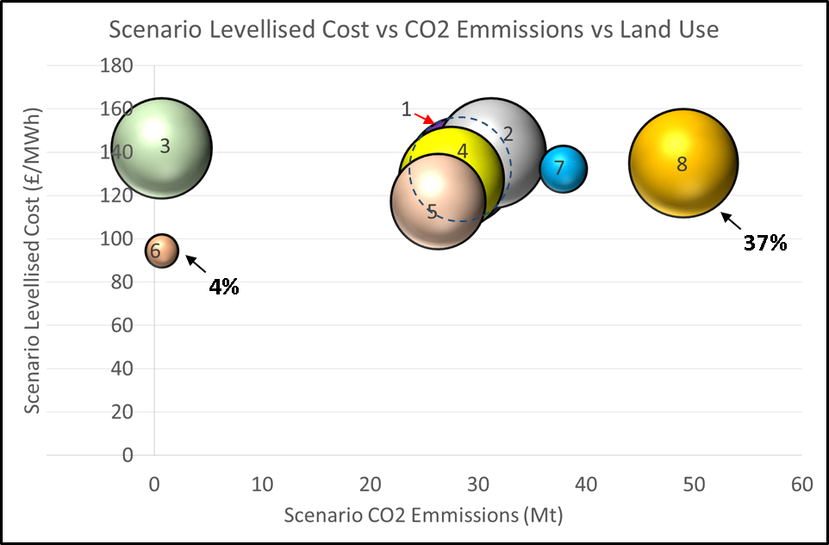
Low Carbon Future Grid Study for the UK
Project aim: To investigate how the UK can integrate the most low-carbon energy systems into the electricity grid by 2050
Project summary and key outcomes:
UK Electricity Demand Estimated for 2050 – Increase of 32%;
EnergyPLAN used to model UK electricity grid scenarios with low CO2 emissions to meet the 2050 demand;
All modelled scenarios showed a significant CO2 emissions reduction despite the demand increase (worst case down to 57Mt from 133Mt in 2014);
Renewable energy networks requires large areas of land – up to 37% of UK land, bearing in mind todays agriculture takes 71%;
Full commitment to nuclear has significant cost and land use advantages but is very contentious and is requires demand matching;
All future scenarios modelled require a coherent policy and decision making in order to be realistically achievable by 2050.
Group F Members:
Lynsey Duguid
lynsey.duguid.2015@
uni.strath.ac.uk
Miguel Santos-Herrán
miguel.santos-herran.2015@uni.strath.ac.uk
Akhil James
akhil.james.2015@
uni.strath.ac.uk
Aron Price
aron.price.2015@
uni.strath.ac.uk
Alícia Martínez Varela
alicia.martinez-varela.2015@
uni.strath.ac.uk

