Slide 1
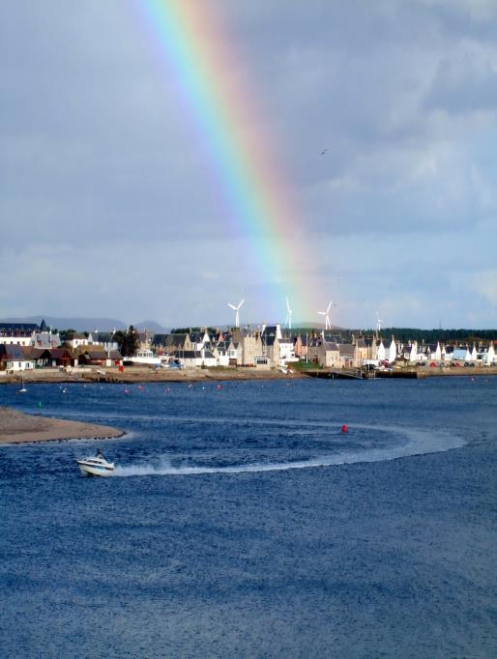
Scoping Future Integrated Energy Systems for Findhorn Eco-community
29th April 2014
Arnau Girona
James Copeland
Jamie MacDonald
Laura Rolo
Sophie Vivaudou

Slide 2
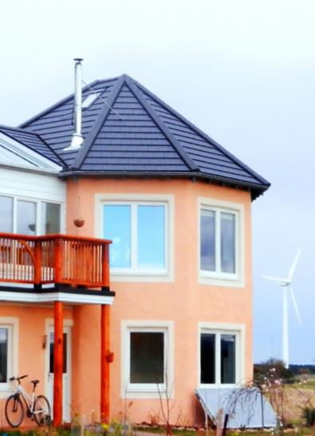
Background
Eco-village located in the North of Scotland
Current energy situation:
Annual demand = 1.2 GWh
Annual generation = 1.65 GWh
Planned Expansion of Eco village
Our Aim: To investigate energy systems at Findhorn Eco-Village and provide scope for future improvements.
Findhorn
Intro
Methodology
Thermal
Generation
Storage
S&D Match
Conclusions

Slide 3
Methodology
Current situation
High Demand
Heating system improvement
Supply Demand Match
Increment of demand
Generation
Unused on-site generation
Storage
Intro
Methodology
Thermal
Generation
Storage
S&D Match
Conclusions

Slide 4
How can thermal storage be used for load shifting and demand reduction?
Intro
Methodology
Thermal
Generation
Storage
S&D Match
Conclusions

Slide 5
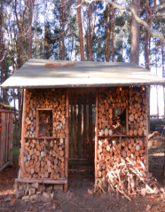
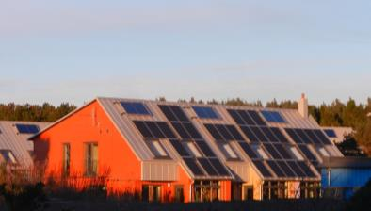
Biomass Boilers
Thermal Systems at Findhorn
Solar Thermal Panels
Woodstoves
Variety of Heating Systems at Findhorn
Our Focus refined to Centini houses
They present load reduction and shifting opportunities because:
1) Large storage tanks
2) Solar thermal technology
3) Electric immersion back Up
Intro
Methodology
Thermal
Generation
Storage
S&D Match
Conclusions

Slide 6
Load Shifting Utilising Thermal Storage
Storage capacity varies depending on temperature that tank is heated to
Approximate losses of < 0.4°C per hour but dissipated as heat in house. (Useful in winter)
Plenty storage potential to pre-charge tank during night or excess wind generation and then “coast” on this energy, avoiding future electrical load for heating
Intro
Methodology
Thermal
Generation
Storage
S&D Match
Conclusions

Slide 7
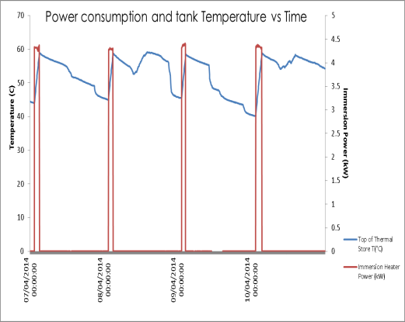
Load Shifting Utilising Thermal Storage
Shifting Options | Immersion Timing Before and After Shift to Night time (off peak) | To match with excess wind
Winter | 07:00 →9:30 & 19:00 → 21:30 23:30 → 5:00 | ?
Summer | 06:00 →07:30 00:30 → 04:00 | ?
We analysed monitored data from Findhorn
From graph we can observe: 1) Solar gain
2) Losses
3) Shifting ability of regular significant load (red line)
Intro
Methodology
Thermal
Generation
Storage
S&D Match
Conclusions

Slide 8
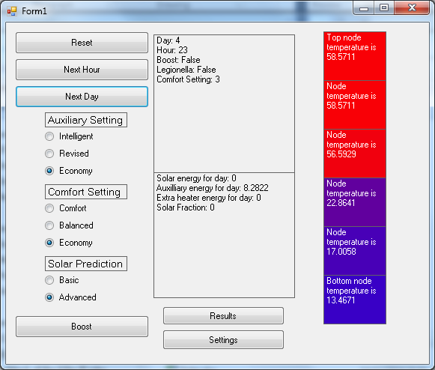
Demand Reduction using Controls
We Investigated a verified C# Program and modified the code to suit systems at the Centini houses
Example of programme display below
Intro
Methodology
Thermal
Generation
Storage
S&D Match
Conclusions

Slide 9
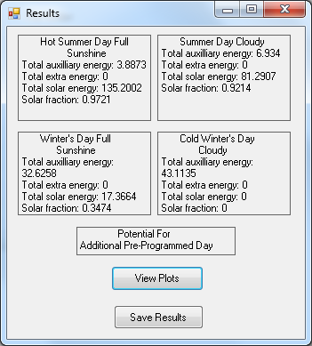
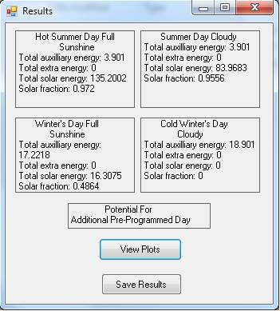
Demand Reduction using Controls
We programmed specific draw profiles weather data and tank specifications
Programme gives output of auxiliary energy use and solar factor
Model shows that auxiliary use can be reduced with the use of an intelligent control system
Intro
Methodology
Thermal
Generation
Storage
S&D Match
Conclusions

Slide 10
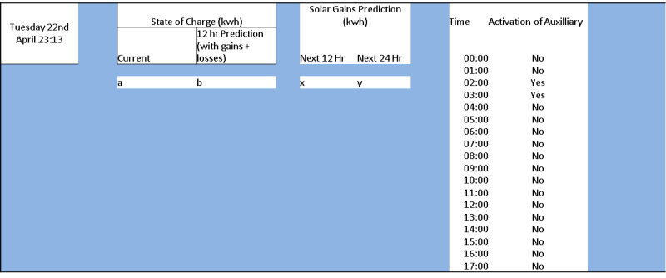
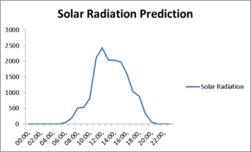
Demand Side Management
Incident Radiation (w/m^2)
Example template of hypothetical user display
Solar Thermal controls and various weather predictions can be communicated to user for increased control and management
Area for future development alongside improved Solar Thermal controls
Intro
Methodology
Thermal
Generation
Storage
S&D Match
Conclusions

Slide 11
What kind of new generation system can be used ?
Intro
Methodology
Thermal
Generation
Storage
S&D Match
Conclusions

Slide 12
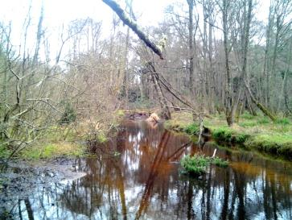
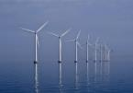
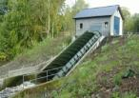
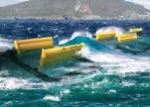
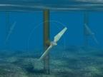
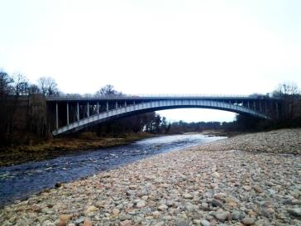
New Generation Options
Technology | Predictable | Steady | Low EI | Costs | Scale | Grid Connection | Enough Power output
Onshore wind
Offshore wind
Microhydro
Tidal Barrage
Wave
Tidal stream
Intro
Methodology
Thermal
Generation
Storage
S&D Match
Conclusions

Slide 13
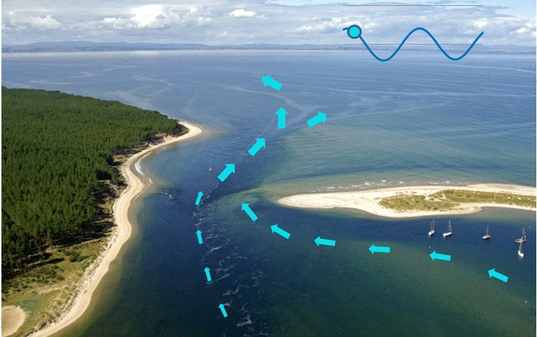
Findhorn Bay
Intro
Methodology
Thermal
Generation
Storage
S&D Match
Conclusions

Slide 14
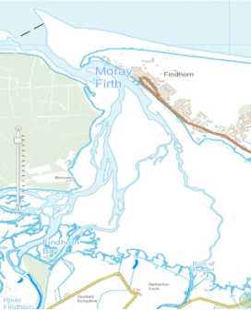
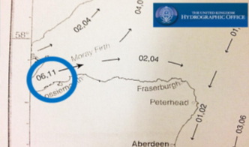
Tidal Resource
Historical Data
Tide Data Surface Speed
Times | Neaps (knots) | Springs (knots) | Direction | Neaps (m/s) | Springs (m/s)
Hw-6 | 0 | 0 | Slack | 0.00 | 0.00
Hw-5 | 0.2 | 0.4 | W | 0.10 | 0.21
Hw-4 | 0.3 | 0.8 | W | 0.15 | 0.41
Hw-3 | 0.5 | 0.9 | SW | 0.26 | 0.46
Hw-2 | 0.3 | 0.7 | SW | 0.15 | 0.36
Hw-1 | 0.3 | 0.5 | SW | 0.15 | 0.26
Hw | 0.3 | 0.6 | SW | 0.15 | 0.31
Hw+1 | 0 | 0 | Slack | 0.00 | 0.00
Hw+2 | 0.2 | 0.4 | E | 0.10 | 0.21
Hw+3 | 0.5 | 0.9 | E | 0.26 | 0.46
Hw+4 | 0.6 | 1.1 | NE | 0.31 | 0.57
Hw+5 | 0.3 | 0.7 | NE | 0.15 | 0.36
Hw+6 | 0.2 | 0.3 | NE | 0.10 | 0.15
Admiralty Tidal Stream Atlas
20 m3/s
Max!!
 | Tide Heights in meters above datum
Place | Lat N | Long W | MHWS | MHWN | MLWN | MLWS
Burghead | 57º 42’ | 3º 30’ | 4.1 | 3.2 | 1.6 | 0.6
Nairn | 57º 36’ | 3º 52’ | 4.3 | 3.3 | 1.6 | 0.7
Findhorn | 57º 40’ | 3º 39’ | 4.2 | 3.25 | 1.6 | 0.65
Intro
Methodology
Thermal
Generation
Storage
S&D Match
Conclusions

Slide 15
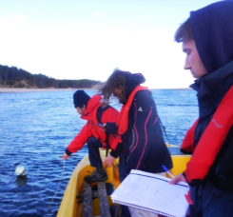
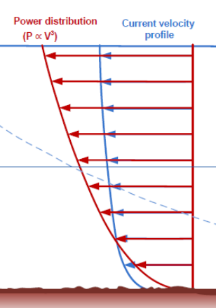
Tidal Resource
Site Survey
Measurements
State of Tidal and Moon
Locations
Spring Tide Current
2.11 m/s
Intro
Methodology
Thermal
Generation
Storage
S&D Match
Conclusions

Slide 16
Tidal Harmonic constituents – Aberdeen Port Date span 89-07
Constituent | Period (hr) | Period (s) | Amplitude (m) | Frequency (Rad/s) | Phase (Rad)
O1 | 25.8 | 92880 | 0.127 | 0.24 | 51.10
K1 | 23.93 | 86148 | 0.113 | 0.26 | 204.56
M2 | 12.42 | 44712 | 1.301 | 0.51 | 24.57
S2 | 12 | 43200 | 0.44 | 0.52 | 62.88
Tiidal form number |  | 0.137 | Semidiurnal tide
Harmonic Analysis
Exceedance Curves
$$V=A_{factor}\sum{H_{i}∙cos (ω_{tide,i}∙t+p_{i})}$$
Spring Tide
Neap Tide
$$PD=\frac{1}{2}∙ρ∙V^{3}$$
Vspring = 2.2m/s
Vneap = 0.74m/s
Vrmc = 1.08m/s
APD = 1.25 kW/m2
Intro
Methodology
Thermal
Generation
Storage
S&D Match
Conclusions

Slide 17
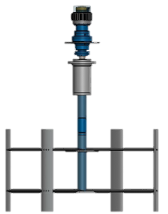
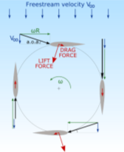
Tidal Stream Device
Floating
Vertical Axes
Small Scale
Cut-in
Cut-out
$$P_{mean}=\sum_{i}^{N}{P(V_{i})∙f(V_{i})}$$
Power Output
Average Monthly = 317.24 kW
Average Day = 10.23 kW
$$AE \left(kWh\right)=8760∙A_{v}∙P_{mean/day}$$
Annual Energy = 37.20 MWh
Intro
Methodology
Thermal
Generation
Storage
S&D Match
Conclusions

Slide 18
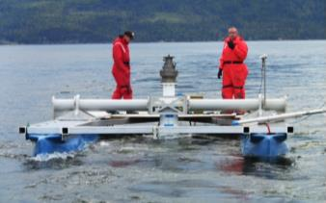
Project
Environmental Concerns
Barrier Effects on movement and Migration
Displacement
Underwater Collision
Underwater Noise
Intro
Methodology
Thermal
Generation
Storage
S&D Match
Conclusions

Slide 19
What kind of electricity storage system can be used ?
Intro
Methodology
Thermal
Generation
Storage
S&D Match
Conclusions

Slide 20
Introduction
Why integrate Storage in communities?
Increase use of own generation
Decrease dependency to grid ( “Non- clean” energy)
Economical aspects
Can be seen as a big load shifting
Objective
Inquiry about a suitable and feasible electrical storage system.
Intro
Methodology
Thermal
Generation
Storage
S&D Match
Conclusions

Slide 21
Technologies
What technology could be used?
 | Efficiency | Lifetime | Approx. Cost (£/kWh) | Advantages | Disadvantages
Battery (classical Lithium-ion) | 0.7-0.75 | 10-15 years | 400-1400 | -High efficiency -Mature Technology | -Need for thermal regulation -Cost -Rare material used
Redox Flow Battery | 0.65-0.75 | 15-20 years | 100-400 | -High modularity -Large range of Power -High rate of discharge -Lifetime | -Complex architecture -Maintenance cost -“New” technology -Risk of leak in the electrolyte -Vanadium and sulphuric acid
Hydrogen Storage | 0.25-0.35 | 5-10 years | <400 | -Clean fuel -Abundant resource | -Low efficiency - Technical problems with storage and transport -Cost
Compressed Air Energy Storage (CAES) | 0.4-0.5 | 30-40 years | 100-200 | -Clean fuel -High power, high capacity -Simplicity -Lifetime -Mature technology | - “Low” efficiencies -Noise ????
Intro
Methodology
Thermal
Generation
Storage
S&D Match
Conclusions

Slide 22
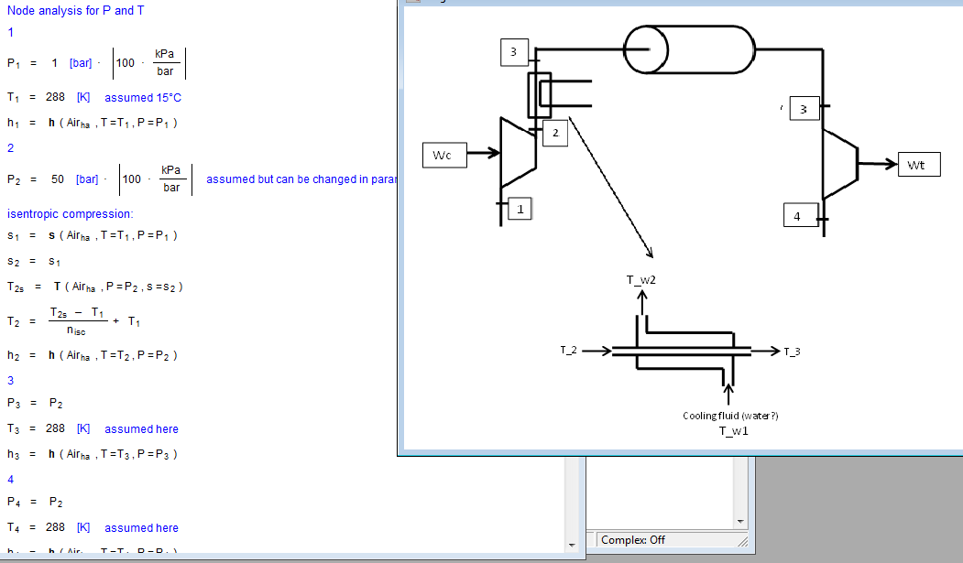
EES Analysis
Gas cycle analysis in EES software:
3
T_w₂
T_w₁
4
W_{c}
2
Wt
1
5
Intro
Methodology
Thermal
Generation
Storage
S&D Match
Conclusions

Slide 23
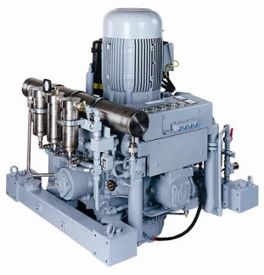
System proposed
Capacity: 1400kWh
Efficiency = 58% in theory + CHP opportunity
Power output can be adapted
2 Compressors from SAUER compressor:
200 bars
32 kW rated power
Water cooled
Storage tank
200 bars
185 m³ (2m radius,15 m long)
≈£200,000
Future work
Experimentation
Isothermal compression
Expansion stage
Cost effective solution
Intro
Methodology
Thermal
Generation
Storage
S&D Match
Conclusions

Slide 24
How the solutions studied influence the Supply and Demand match?
Intro
Methodology
Thermal
Generation
Storage
S&D Match
Conclusions

Slide 25
Initial Scenario
Demand
Generation
Installed
Meters
A 750 kW wind farm:
3 Vestas V29 225kW
1 Vestas V17 75kW
Winter
week
Power (KW)
Time (Hours)
SDM analysis using Merit software
Summer
week
Power (kW)
Week Analysis
Time (Hours)
Annual Analysis
Demand | Generation | Surplus | Deficit
1.2 GWh | 1.65 GWh | 858.27 MWh | 410.55 MWh
Intro
Methodology
Thermal
Generation
Storage
S&D Match
Conclusions

Slide 26
Improve heating system in 10 houses:
Thermal solar panels + electric backup
Storage tank – shift loads
Heating System
Winter week demand profile
Summer week demand profile
Initial
Scenario
Power (kW)
Power (kW)
Time (Hours)
Time (Hours)
Modified
Profile
Demand Reduction: 50MWh
Deficit Reduction: 17MWh
Power (kW)
Power (KW)
Time (Hours)
Time (Hours)
Annual Analysis
Demand | Demand | Surplus | Deficit
Initial | 1.19 GWh | 858.27 MWh | 410.55 MWh
Modified HS | 1.14 GWh | 895.90 MWh | 393.41 MWh
Intro
Methodology
Thermal
Generation
Storage
S&D Match
Conclusions

Slide 27
4 turbines: 25 kW rated Power
Tidal Generation
Month Analysis
Peak Power
240 kW
Demand
Generation
Peak Power
100 kW
Generation
Increase: 200MWh
Deficit Reduction: 94.14MWh
Annual Analysis
Generation | Demand | Generation | Surplus | Deficit
Wind | 1.19 GWh | 1.65 GWh | 858.27 MWh | 410.55 MWh
Wind & Tidal | 1.19 GWh | 1.85 GWh | 968.90 MWh | 316.41 MWh
Intro
Methodology
Thermal
Generation
Storage
S&D Match
Conclusions

Slide 28
Electricity Storage
Model CAES:
Capacity: 900kWh – 10 MWh
Discharge time: 12 hours (max. power)
Charge power 60 kW – 120kW
Annual Analysis:
Week Analysis – Storage: 10MWh – 120kW
Week Analysis: – Initial Scenario
Week Analysis – Storage: 1.5MWh – 60kW
Storage | Surplus | Deficit
NULL | 858.27 MWh | 410.55 MWh
CAES - 900 kWh - 60kW | 750.86 MWh | 326.75 MWh
CAES - 1.5 MWh- 60kW | 721.72 MWh | 305.01 MWh
CAES - 1.5 MWh- 120kW | 688.46 MWh | 284.30 MWh
Deficit Reduction: 105MWh
State of charge (%)
Surplus
Deficit
Intro
Methodology
Thermal
Generation
Storage
S&D Match
Conclusions

Slide 29
Conclusions
Technology | Benefits/ year | Life time | Installation cost | Payback period | Deficit reduction | Conclusions
Thermal (10 houses) | £5,710 | 25 Years | £50,000 | 8.7 Years | 5% | Economic benefits Demand reduction No significant deficit reduction
Tidal | £23,000 | 20 Years | £196,000 | 8.5 Years | 23% | Economic benefits Generation Increase Significant deficit reduction
Storage | £2,340 | 40 Years | £200,000 | 85 Years | 25% | Expensive Significant deficit reduction
Intro
Methodology
Thermal
Generation
Storage
S&D Match
Conclusions

Slide 30
Acknowledgments:
Supervisor Paul Tuohy
Findhorn Foundation: Vera, Michael, Paddy, Mari.
Findhorn Marine: Pippa.
University of Strathclyde staff.
SAUER Industrial compressors.

