Slide 1
Integration of EVs with Existing Distributed Energy Resources in Findhorn Ecovillage
Craig mcarthur, Georgios PAPOUTSIS, KONSTANTINOS PISOKAS, MARINOS MAVROULIS
INTRODUCTION

Slide 2
Project Aim
To study the effect of EV adoption on the electricity demand/generation in Findhorn Ecovillage
Objectives
Create a EV battery model to output time-series charging demand
Create a model to generate an annual time-series EV charging demand for Findhorn in Ecovillage
Model 25%, 50%, 75%, 100% EV Adoption
Simulate the new Ecovillage demand and assess the impact according to the Key Performance Indicator
Remain a net exporter of electricity
INTRODUCTION

Slide 3
Why?
Energy Consumption – UK 2016
Transport accounts for 40% of energy consumption
1 in 50 new cars sold is an electric vehicle
Implications for the grid
Is decentralization the future?
INTRODUCTION

Slide 4
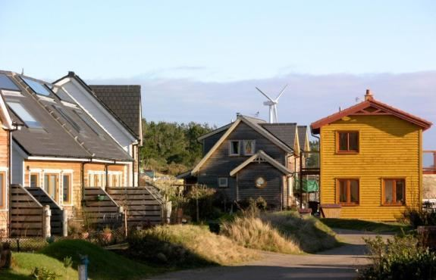
Findhorn Ecovillage
Distributed Energy Resources
Wind: 3 V29 (225kW), 1 V17 (75kW)
Solar PV (25kW)
Redox Flow Battery (Inactive)
Ecovillage of 500 residents
Emerging interest in EVs
Long-term affect for Ecovillage?
INTRODUCTION

Slide 5
Objectives
Create a EV battery model to output time-series charging demand
Create a model to generate an annual time-series EV charging demand for Findhorn in Ecovillage
Simulate the new Ecovillage demand and assess the impact according to determined Key Performance Indicators
Remain a net exporter of electricity
INTRODUCTION

Slide 6
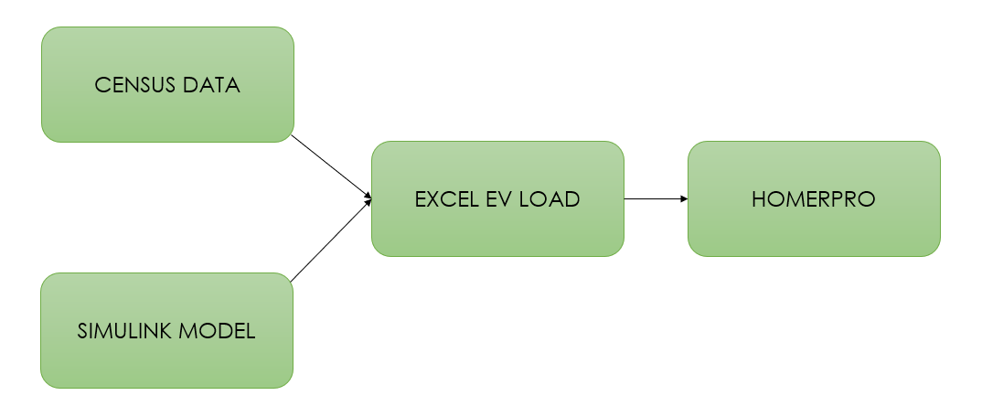
Model Methodology
CONSTRUCTING THE MODEL

Slide 7
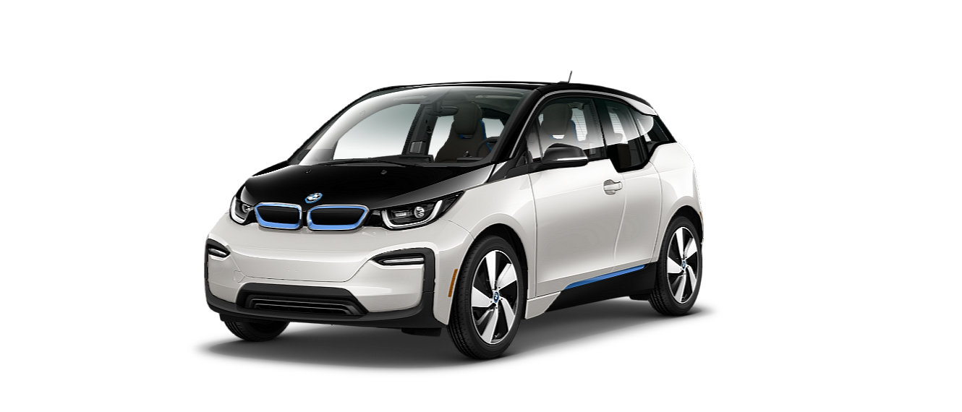
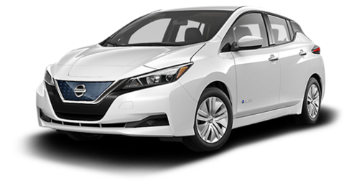
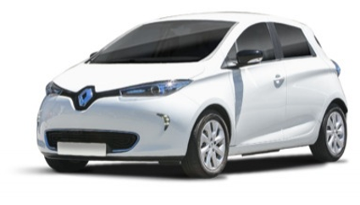
Selecting EVs
BMW i3
Nissan Leaf
Renault Zoe
CONSTRUCTING THE MODEL

Slide 8
Simulink EV Battery Model
Nominal Voltage
Rated Capacity
Simulink Battery Model
Charging Simulator
Time-series power demand
EV Type
Customisable
Parameters
CONSTRUCTING THE MODEL

Slide 9
Battery Charging Results
Nissan Leaf
CONSTRUCTING THE MODEL

Slide 10
Model Methodology
CONSTRUCTING THE MODEL

Slide 11
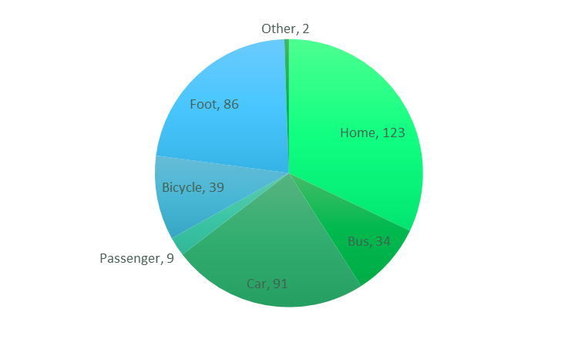
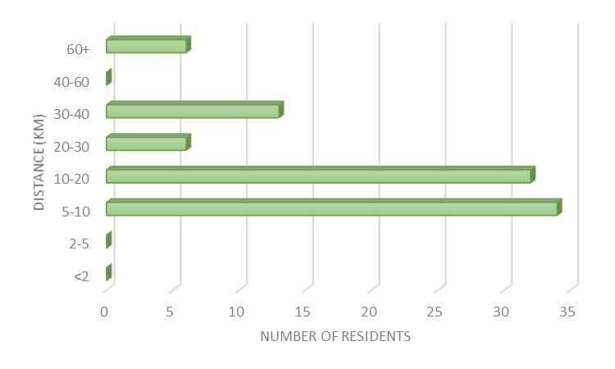
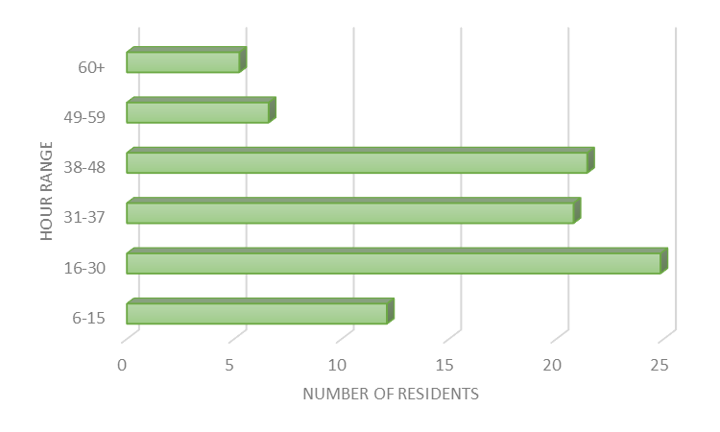
Findhorn Census Data
Method of Travel to Work
Distance Travelled to Work
Weekly Working Hours
CONSTRUCTING THE MODEL

Slide 12
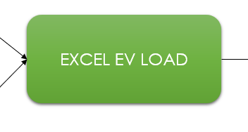
Model Methodology
CONSTRUCTING THE MODEL

Slide 13
Demand Profile Calculator
Simulink Results
EV Type
30 min Winter Demand
Carbon Emission Report
Hours Worked
Weekly
Home Travel Profile
Calculator
Weekly
Work Travel Profile
3-Week Simulation
30min Summer Demand
Average Weekly km Deficit
Distance Travelled
*Charging Behaviour
* Findhorn Ecovillage Carbon Assessment 2015
* My Electric Avenue – EV Study
CONSTRUCTING THE MODEL

Slide 14
Controlled vs Uncontrolled – 100% EV Adoption
MODEL OUTPUTS

Slide 15
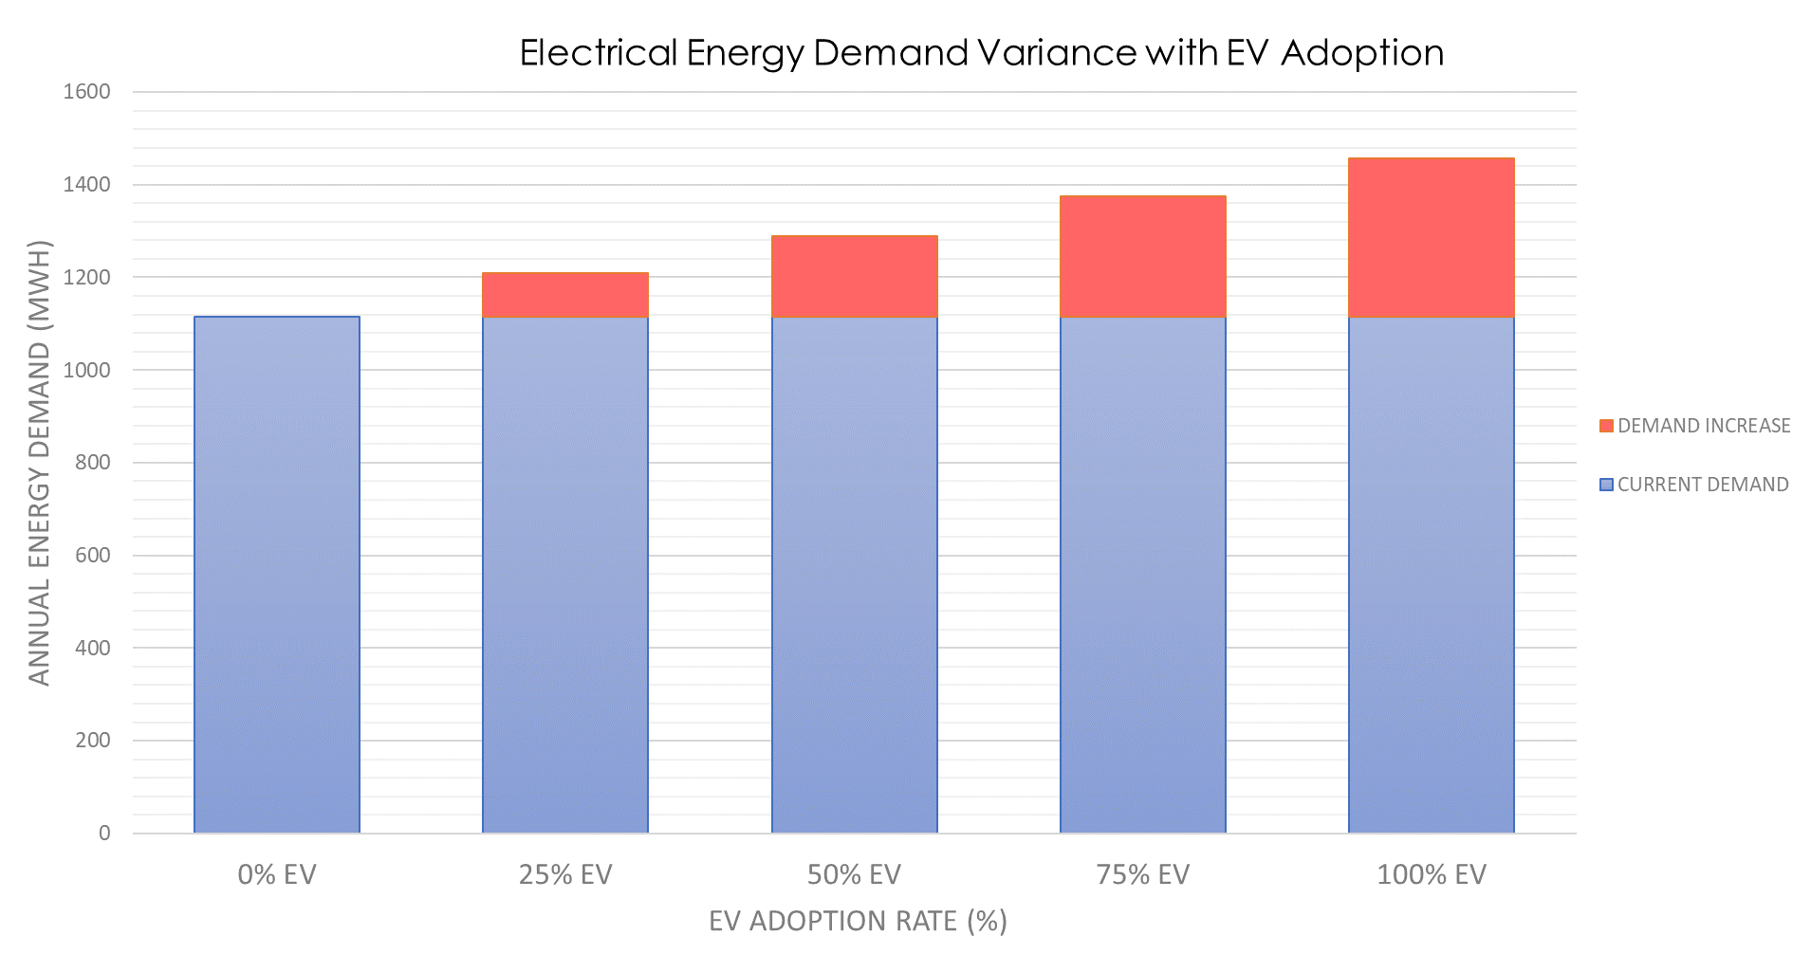
The Effect on Findhorn Ecovillage
Remain a net exporter of electricity?
Would storage assist?
Do Findhorn Ecovillage require additional generation?
MODEL OUTPUTS

Slide 16
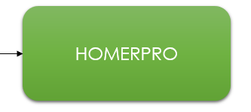
Model Methodology
HOMERPRO RESULTS

Slide 17
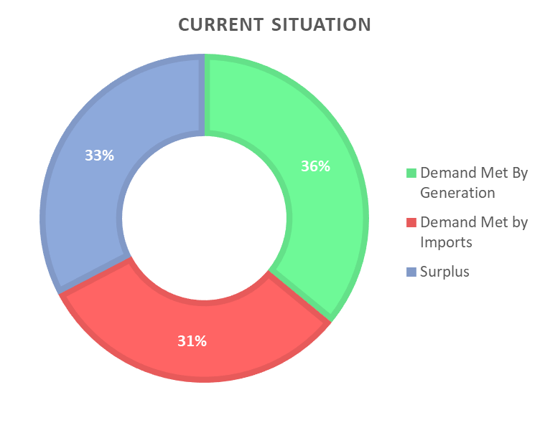
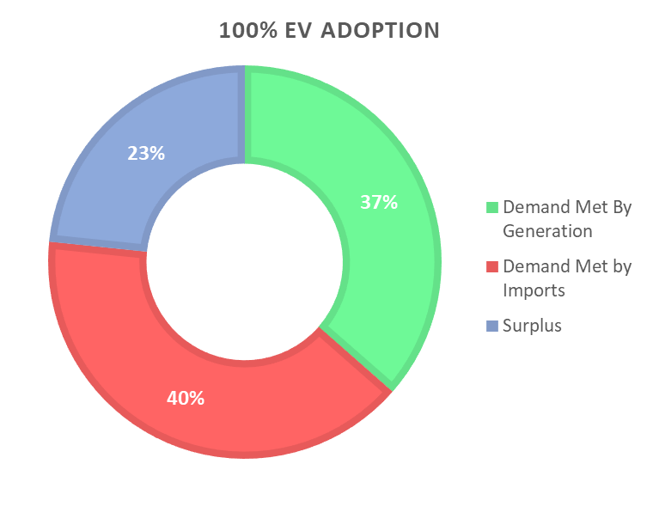
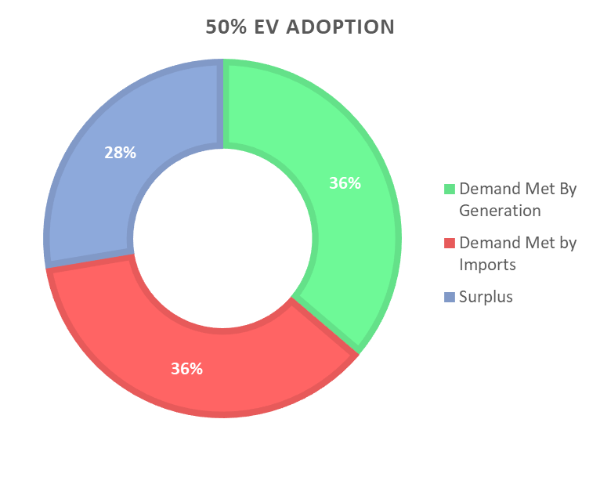
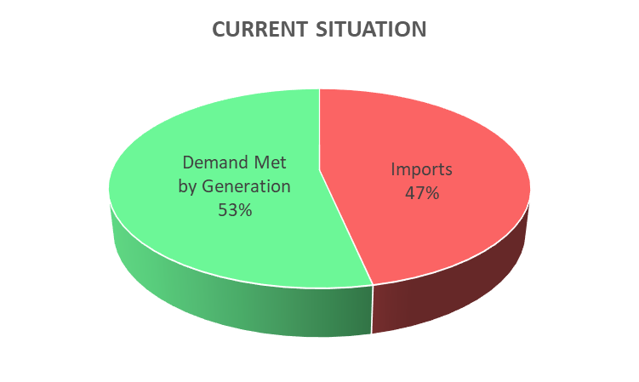
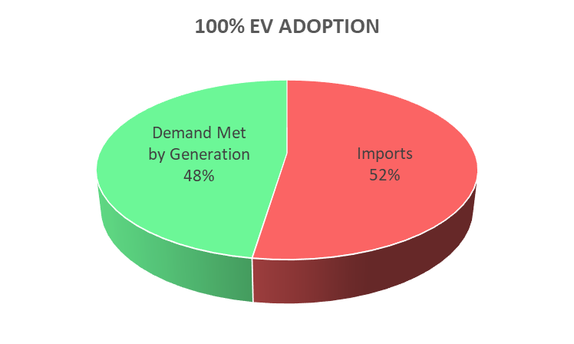
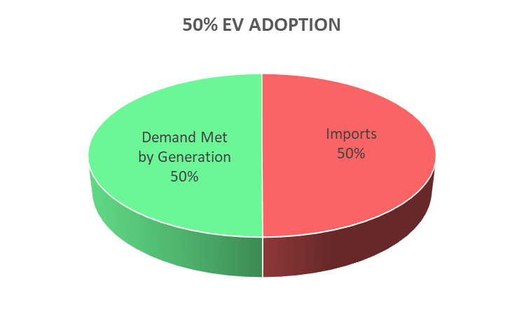
Total Electricity Implications
HOMERPRO RESULTS

Slide 18
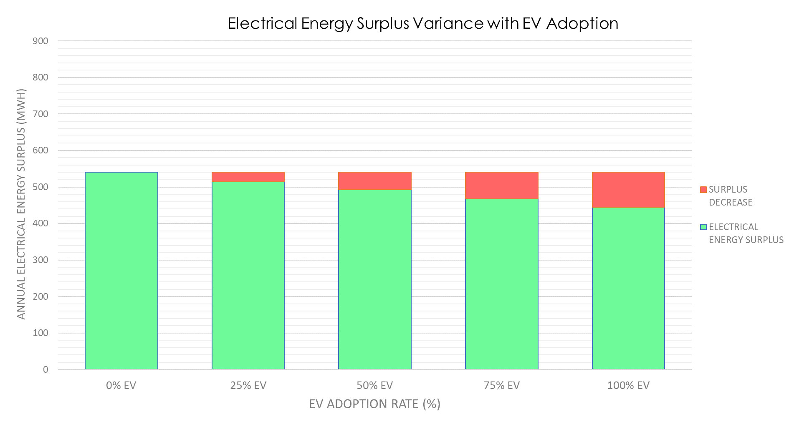
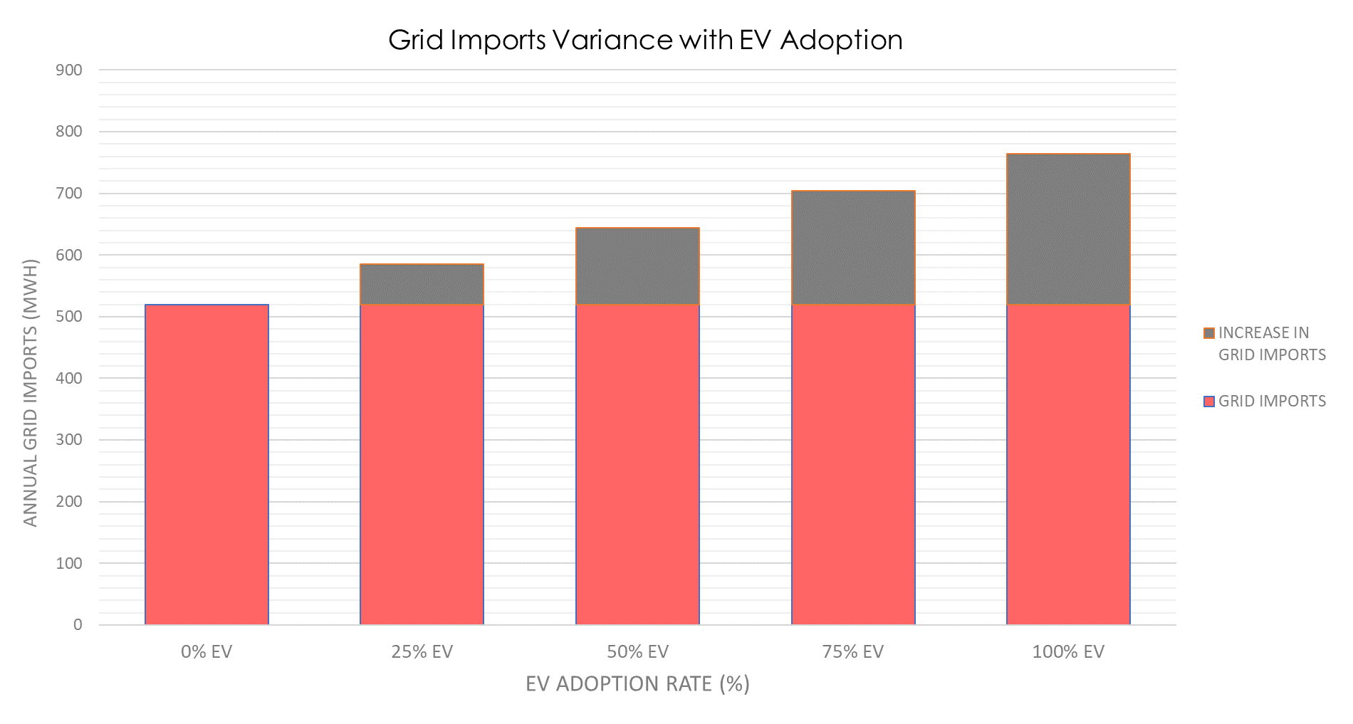
Investigating Further
Reduced surplus electricity to sell back to grid
Notable increase in dependence on grid
HOMERPRO RESULTS

Slide 19
Redox Flow Battery – 25 kW, 50 kWh
Scenario | Imports Increase (%) |  | Surplus Decrease (%)
 | Without Battery | Redox Battery | Without Battery | Redox Battery
25% EVs | 12.5% | 8.5% | -4.9% | -9.0%
50% EVs | 23.8% | 19.8% | -9.0% | -12.9%
75% EVs | 35.3% | 31.5% | -13.6% | -17.3%
100% EVs | 47.0% | 43.6% | -17.9% | -22.6%
HOMERPRO RESULTS

Slide 20
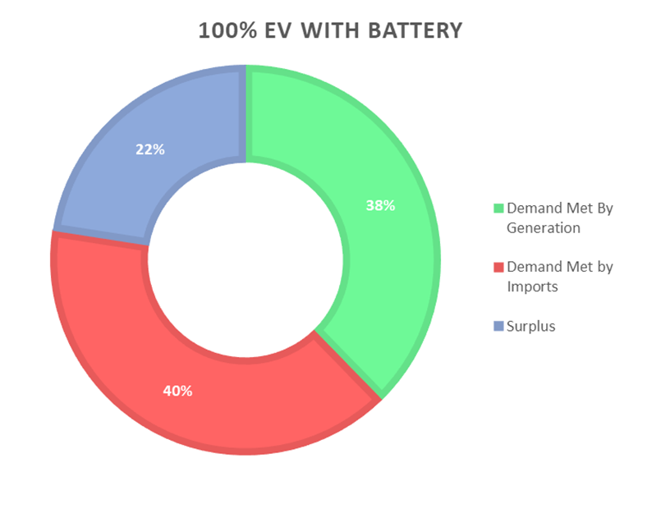
Redox Flow Battery – 25 kW, 50 kWh
HOMERPRO RESULTS

Slide 21
Integrating New Wind Generation
HOMERPRO RESULTS

Slide 22
Is Solar PV More Suitable?
HOMERPRO RESULTS

Slide 23
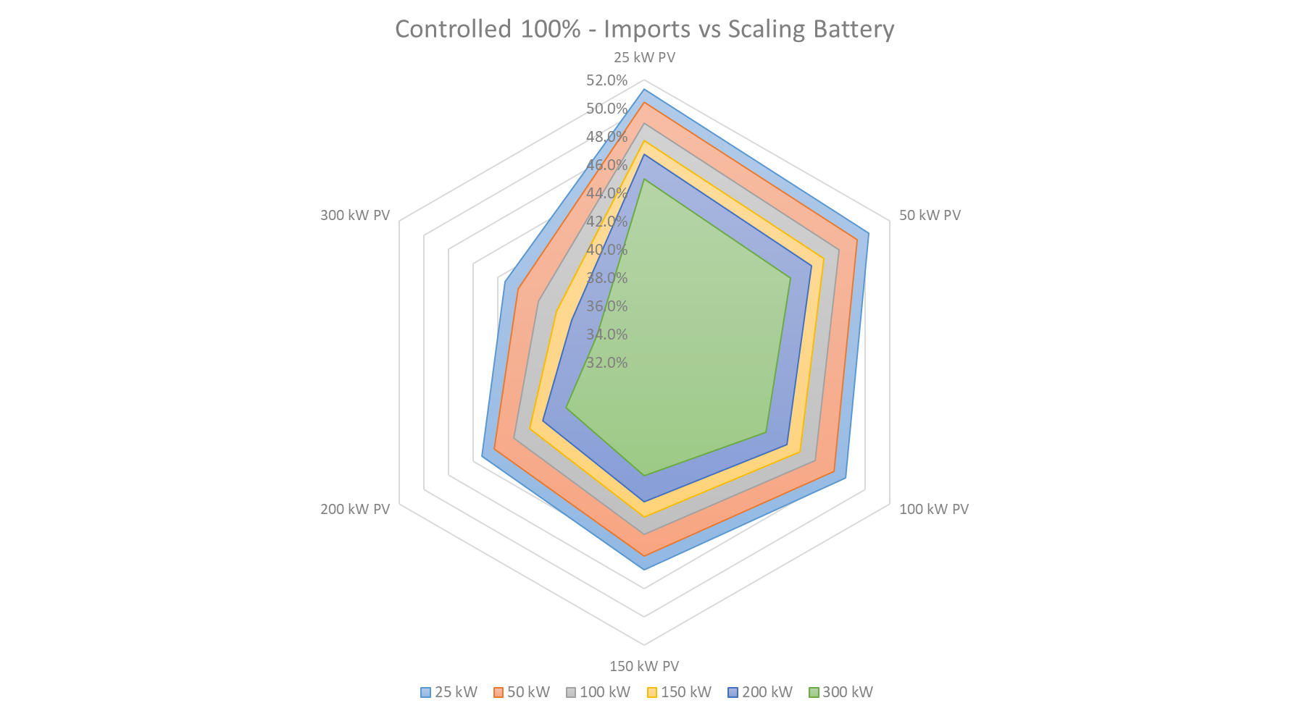
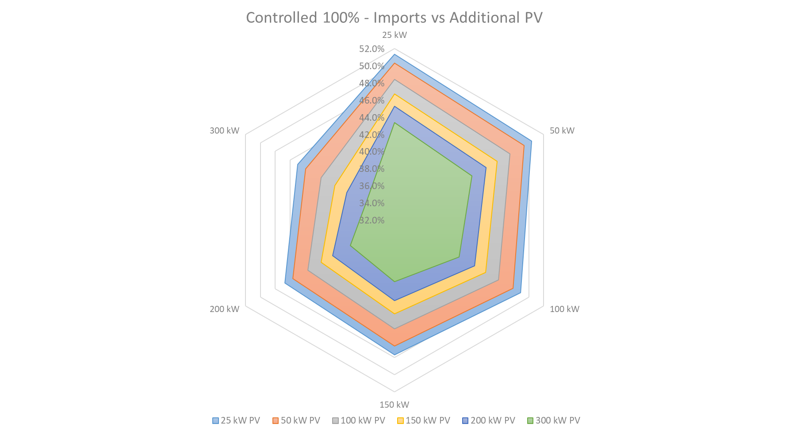
Net Exporter of Electricity?
SUGGESTIONS

Slide 24
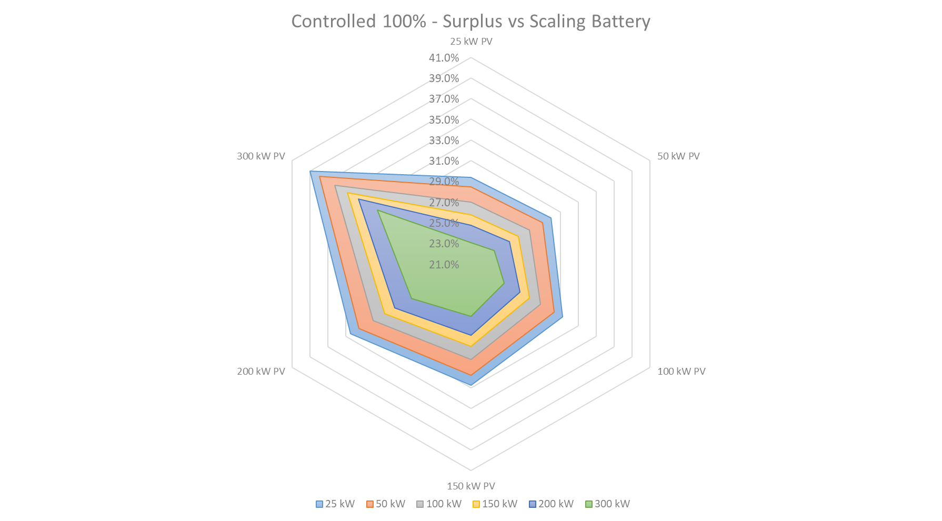
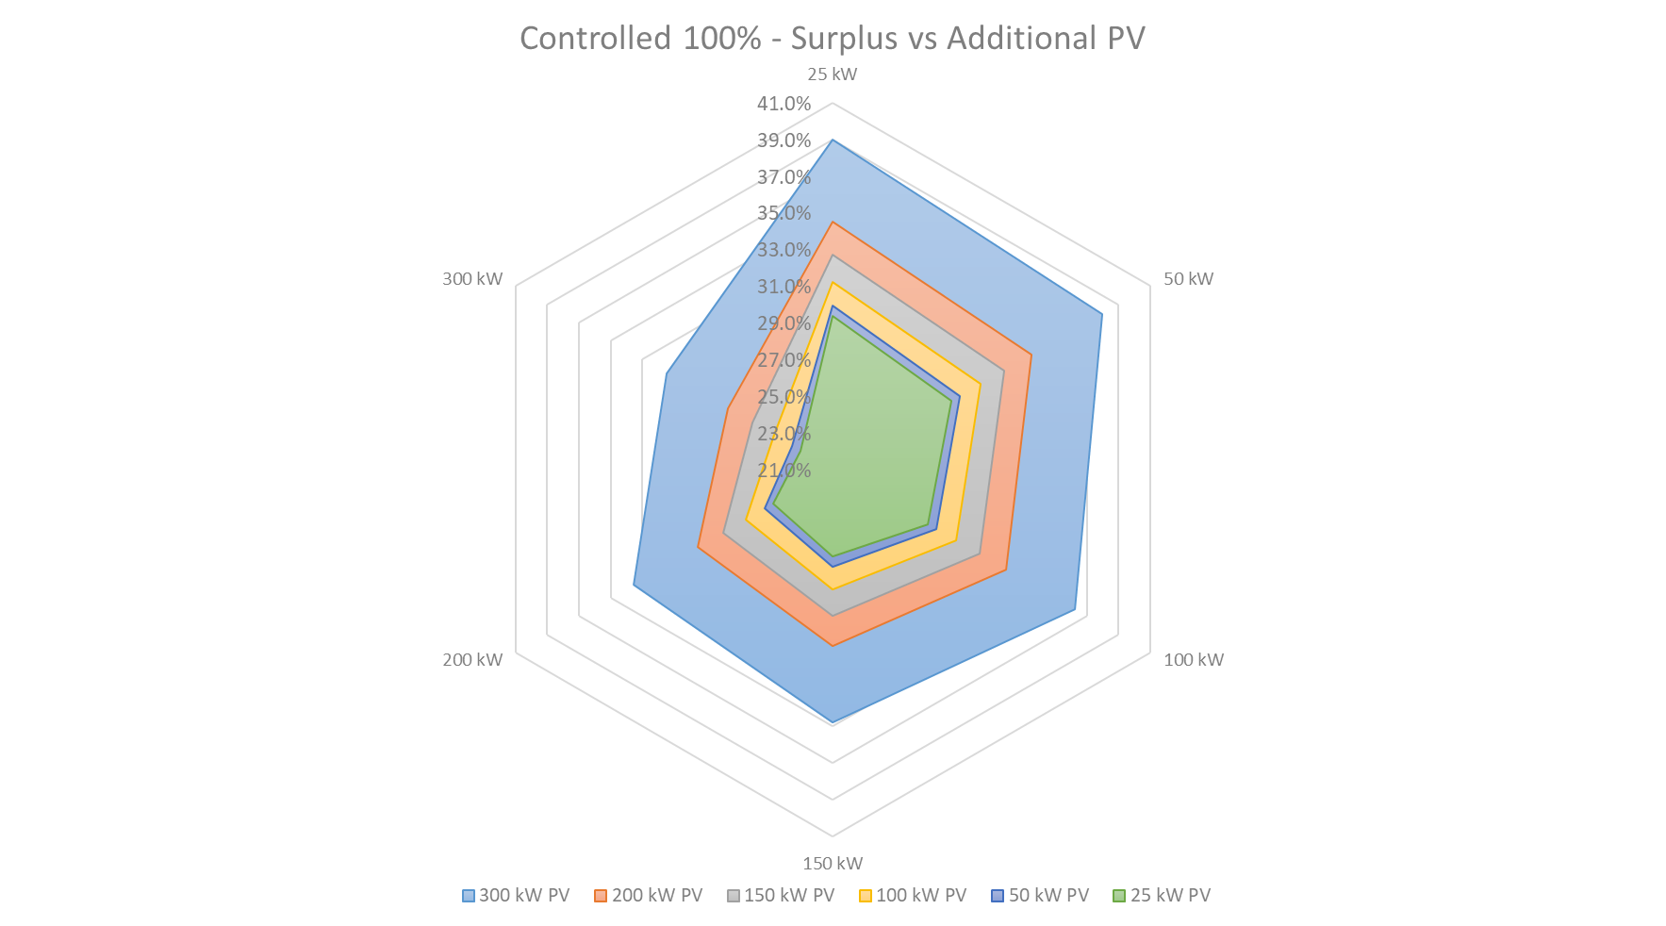
Considering the Surplus
SUGGESTIONS

Slide 25
Final Proposal
Implement controlled charging
Existing EV control
Utilise the Redox Flow Battery
Install 300 kW solar PV farm
Surrounding area owned suitable
SUGGESTIONS

Slide 26
Conclusion
Ecovillage will be net importer at 50% EV adoption
Mitigation required to remain net exporter
Current generation is wind-dependant
Requires complimentary generation during summer
300 kW solar PV installation achieves 43% grid imports at 100% EV adoption
Increases surplus, decreases grid imports
CONCLUSION

Slide 27
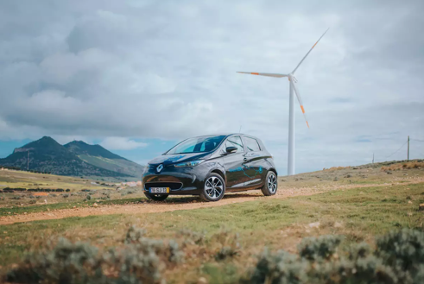
Future Work
Simulate further control situations and different charger types
Investigate vehicle-to-grid connection
Mitigate need for scaled storage
Financial analysis of surplus/import implications
Analyse carbon footprint consequences of adoption
Larger renewable capacity installation to reduce CO2 emissions
CONCLUSION

Slide 28
Questions?
CONCLUSION

