Slide 1
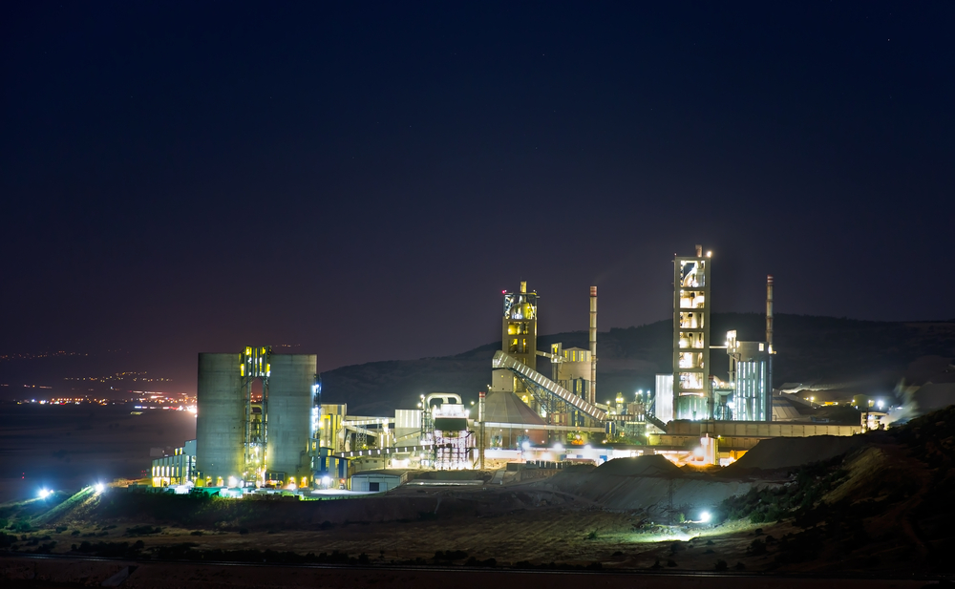
Improvement of large-scale industrial autonomy by implementing energy storage technologies
Nicholas Dodds
Victor Gandarillas
Richard Heelis
Andrew Lyden

Slide 2
Outline
Introduction
Storage Modelling
GSK: A Case Study
Economic Analysis
Conclusion

Slide 3
An uncertain future…
Industrial Challenges
Unstable Supply
Process Interruptions
Significant Cost
Rising Electricity Prices
Increased Cost
Carbon Footprint
Need to Reduce Emissions

Slide 4
Path towards industrial autonomy
Unstable Supply
Rising Electricity Prices
Carbon Footprint
Grid Autonomy
Onsite Generation
Spend Less On Importing
Challenges
Make Money On Exporting
Cleaner Energy Used & Exported
Will energy storage help further?

Slide 5
Objectives
To develop a model to investigate the effects of implementing different storage technologies.
Use the model to improve the understanding of implementing storage within supply/demand matching of industrial sites.
Investigate the economic feasibility and environmental impacts of different storage technologies.

Slide 6
Storage modelling
Excel Tool
Flow Diagram
Technical Outcomes

Slide 7
Storage Modelling tool
Excel Spreadsheet, VB Macros
Inputs: Demand, Supply and Storage Characteristics
Technical outcomes
Emissions Calculator

Slide 8
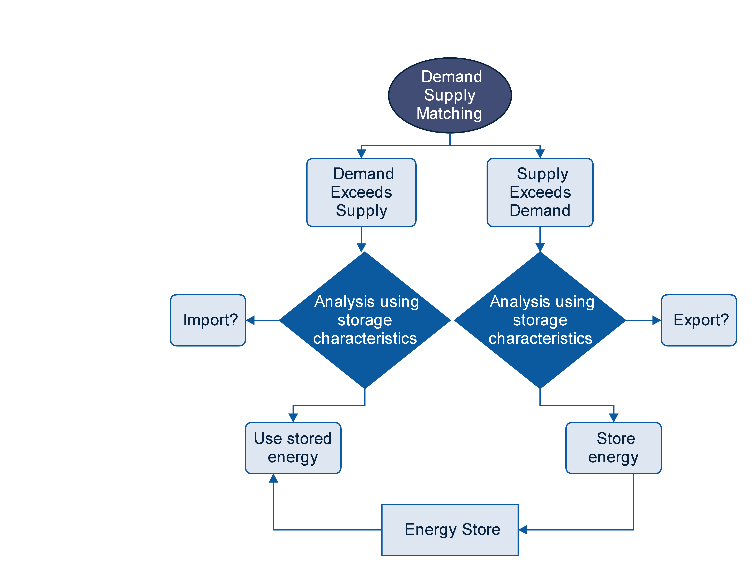

Slide 9
Storage Characteristics
Storage Technology Properties
Capacity
Power Rating
Round-trip Efficiency
Self-discharge
Charging Rate

Slide 10
Storage technologies
Storage Technologies | Efficiency (%) | Self-discharge (%) | Power Rating (MW)
Liquid Air | 55 | 1 | 0 → 300
Flow Batteries | 80 | 0.1 | 0 → 3
Electrochemical Batteries | 70 | 0.3 | 0 → 20
*Chen, Haisheng, et al. "Progress in electrical energy storage system: A critical review." Progress in Natural Science 19.3 (2009): 291-312.

Slide 11
Technical outcomes
% of hours the site is autonomous
% of the deficit which is supplied by the storage
% of the surplus generation which is exported
Reduction of onsite CO₂ emissions with storage (kg)
*All outcomes calculated hourly over a year

Slide 12
GSK: A Case study
2.5MW Wind Turbines
20MW Biomass
1MW Biogas
Scenarios
On-site Generation
Results

Slide 13
Mitigate the effect of…
Grid Blackouts
Rota-disconnections
Process interruption
Large cost
Unexpected
Planned
Hours of disconnection
Off-grid

Slide 14
ON SITE GENERATION AND DEMAND OF GSK OVER A YEAR
87%

Slide 15
scenarios
Increase in demand
On-site generation failures
Maintenance scenarios
Site failure
Reduced wind output
Unexpected
Fault
Planned
Flexible
Generation down
Future prediction

Slide 16
% Deficit (Demand-On site generation) supplied by the Storage over a year
Liquid Air Energy Storage
200 MWh

Slide 17
% HOURS OVER A YEAR WHEN THE FACTORY IS AUTONOMOUS
Liquid Air
200 MWh

Slide 19
Technical GSK results
The suitable selection of the maintenance period reduces the energy imported from the grid by 10%.
Without storage the % of hours that the site is autonomous over a year is 48%. With 200MWh liquid air energy storage this percentage increases to 70%.
Liquid air storage reduces CO₂ emissions by 23% over a year.
The best energy storage technology based on the % of hours of autonomy, % of the deficit supplied by the storage and % exports over a year is flow batteries.

Slide 20
Economic analysis
Storage Economics
Import/Export Costs
Net Import/Export Income
Capital Costs

Slide 21
Storage Economics
Pros
Cost savings by reducing import
Cons
Storage Capital Costs
Lost income by reducing export
Cost savings by reducing risks

Slide 22
Import and Export Costs
National Grid
Electricity Deficit
Import Tariff
8.2 p/kWh
Industrial Site
Electricity Surplus
Export Tariff
5.4 p/kWh

Slide 23
Net Import/Export Income
Storage Technologies | % Hours Autonomous | Net Income | Relative Income To No Storage
No Storage | 48.73 | - £ 360, 000
Liquid Air (100 MWh)
Electrochemical Batteries (50 MWh)
Flow Batteries (50 MWh)
-
68.57
- £ 560, 000
- £ 200,000
68.57
- £ 370, 000
- £ 10,000
68.57
- £ 330, 000
+ £ 30,000

Slide 24
Energy Storage Capital Costs
Liquid Air
Electrochemical Batteries
Flow Batteries
£ 660/kW
£ 400/kW
£ 1000/kW
Payback Period
100 years
*Chen, Haisheng, et al. "Progress in electrical energy storage system: A critical review." Progress in Natural Science 19.3 (2009): 291-312.

Slide 25
Future of Storage Economics?
Pros
Cost savings by reducing import
Cons
Storage Capital Costs
Lost income by reducing export
Cost savings by reducing risks
Energy Management
Storage Incentives

Slide 26
Conclusions
Storage Tool
Developed a custom storage tool to further understanding of implementing storage technology.
GSK
Technically and economically, flow batteries are the most suitable.
Recommendations
Storage not currently feasible.
Energy management is critical when implementing energy storage.

Slide 27
Thank you for listening, Questions?
Acknowledgements: Paul Strachan, Mark Dunn, Strathclyde staff, and many others

