Slide 1
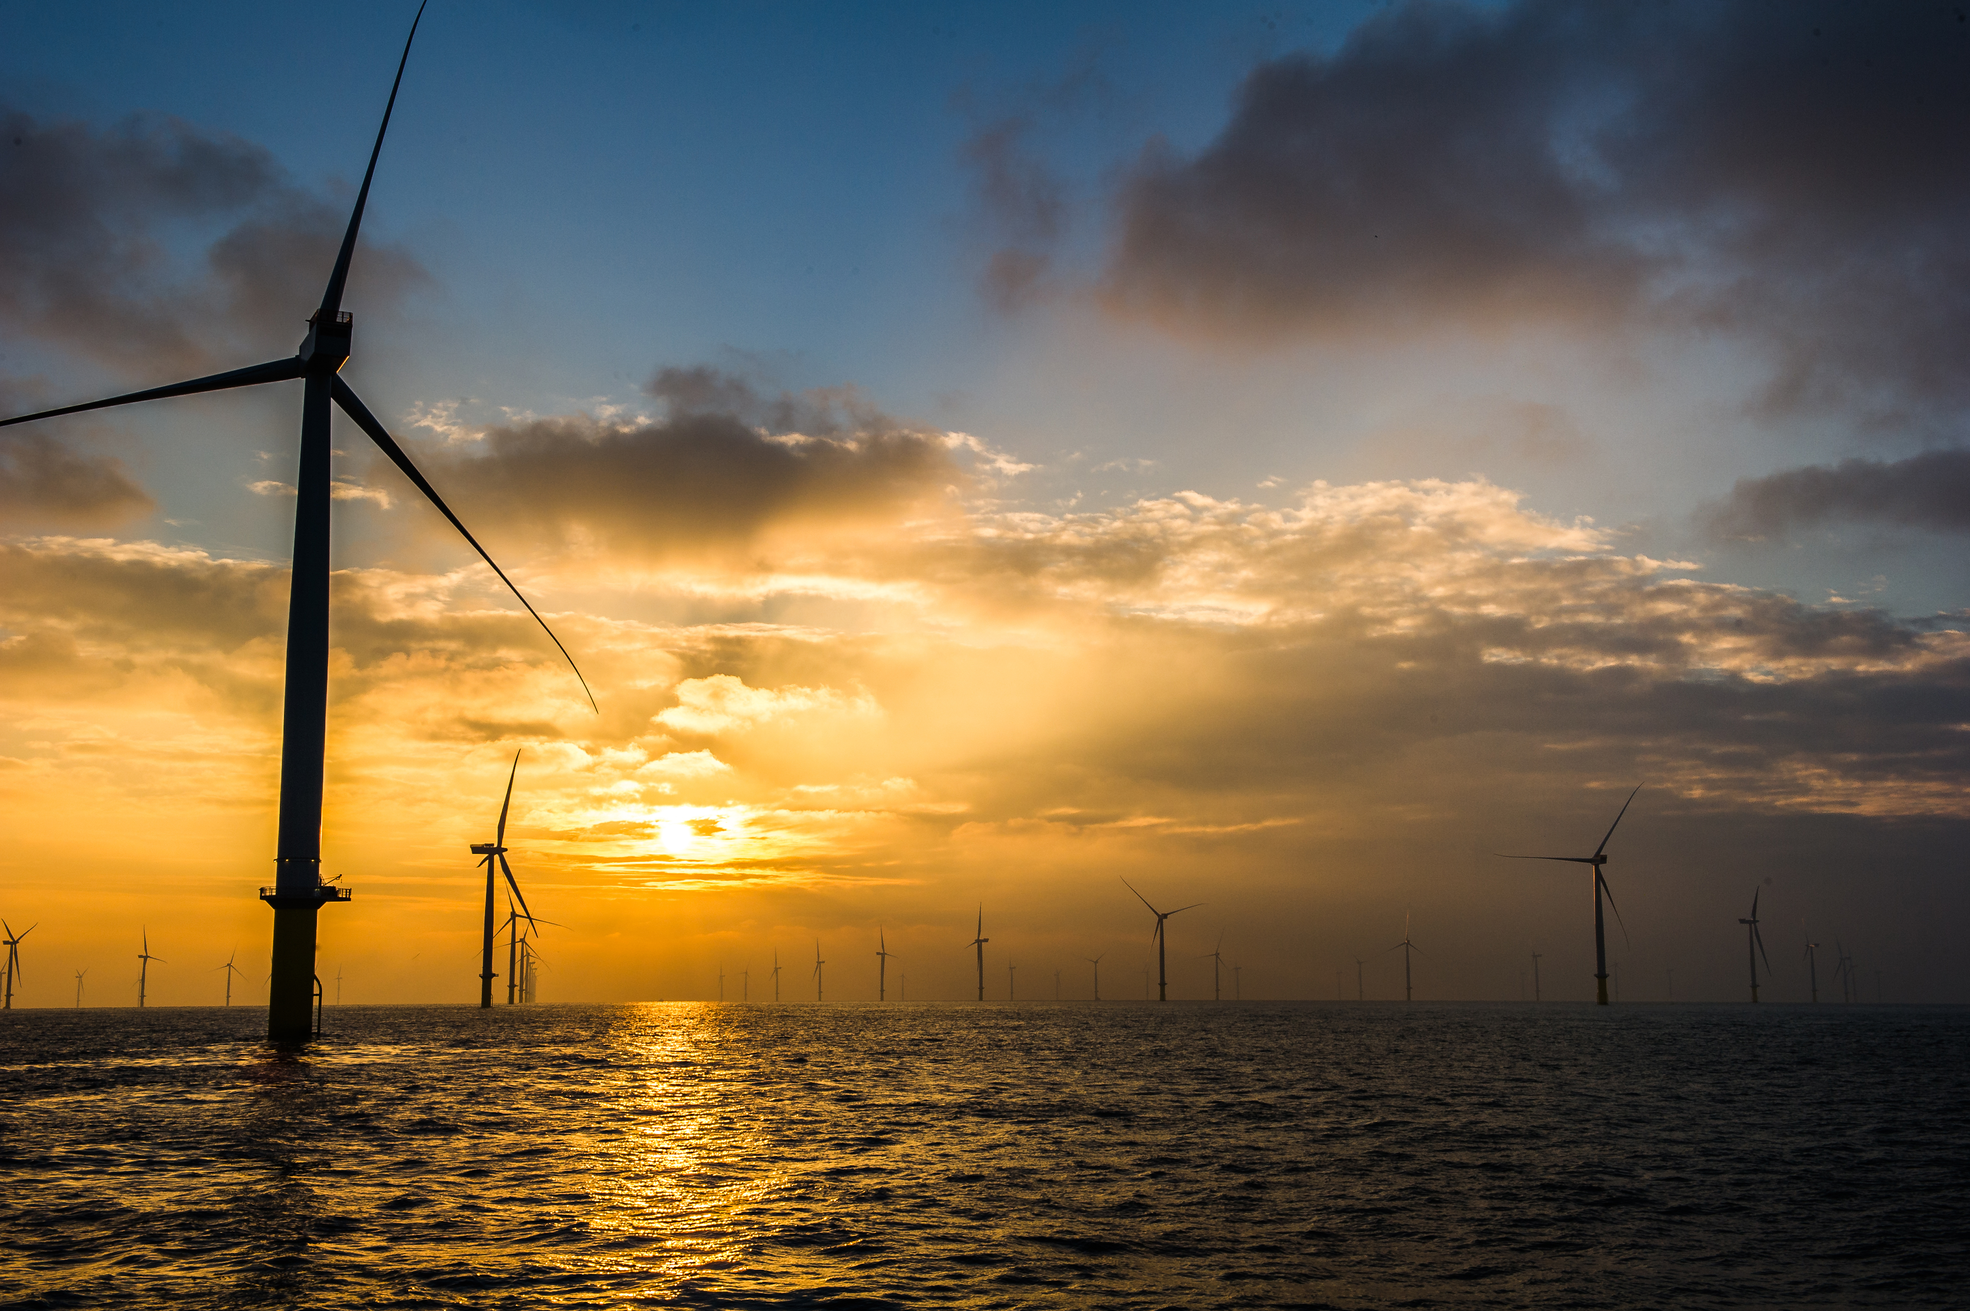
Technical and Economic Analysis for Far Offshore Wind Farm Accommodation
Source: http://pixshark.com/offshore-wind-farm-sunset.htm
Nick Chung
Ioannis Karakitsos
Godstime Martins
Pablo Morato Dominguez
Olga Uflewska

Slide 2
Outline
Project Overview
Methodology
Our Work
Conclusion

Slide 3
Objective
Determine the best maintenance support solution leading to a reduction of O&M costs for Far Offshore Wind Farms
Achieved by:
Examining Technical Feasibility and Economical Viability
Creating a Interactive Tool
Analysing Costs (O&M) of each Solution
Comparing the Solutions

Slide 4
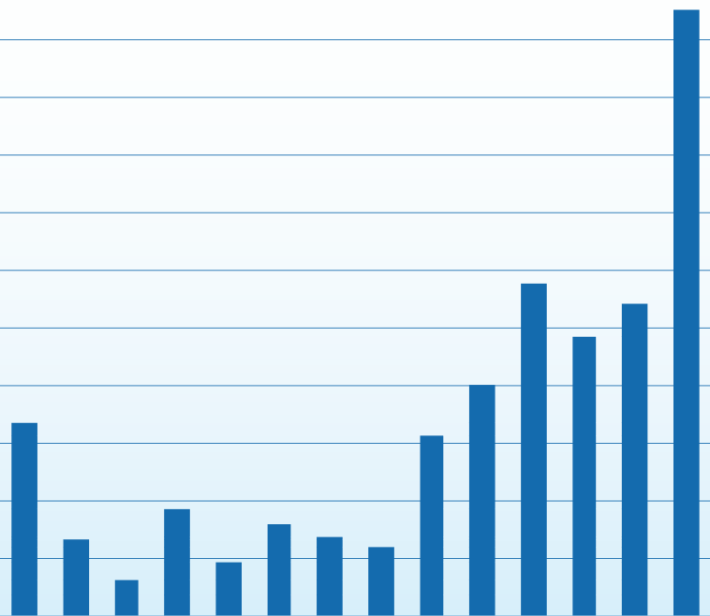
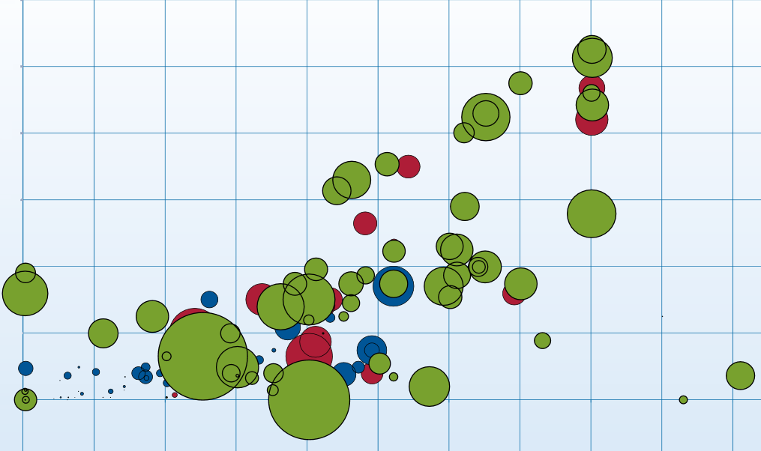
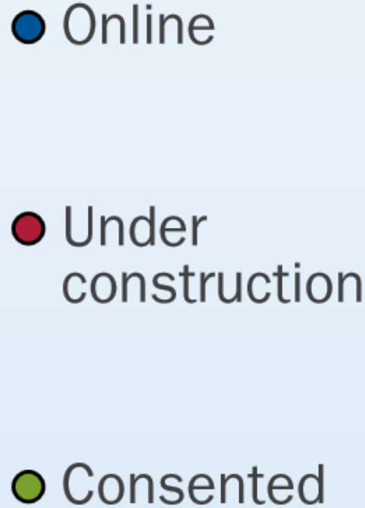
Why Far Offshore?
Source: https://www.ewea.org/fileadmin/files/library/publications/statistics/European_offshore_statistics_2012.pdf
Round 3
More Wind Potential
More Energy
Wind Technologies
Problems
Weather Conditions
Deeper Waters
More Expensive
Our Scope
Focus on O&M
600
to
0
MW
2002 to 2012, Consented and Planned
Source: http://www.ewea.org/fileadmin/files/library/publications/reports/Deep_Water.pdf
120
to
0
km
0 to 50m, Water Depth

Slide 5
Why Offshore Accommodation?
Advantages
Travelling less
Comfort for technicians
More time to work
Downtimes reduced
Disadvantage
Cost of Vessels

Slide 6
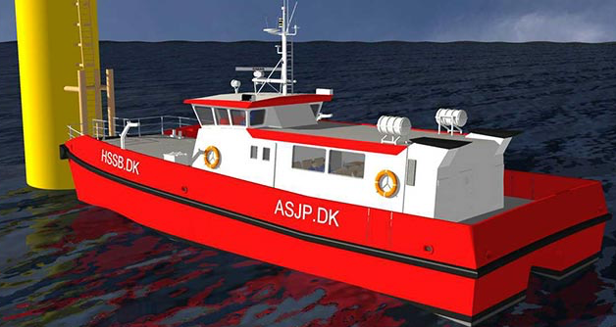
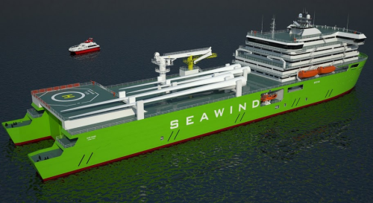
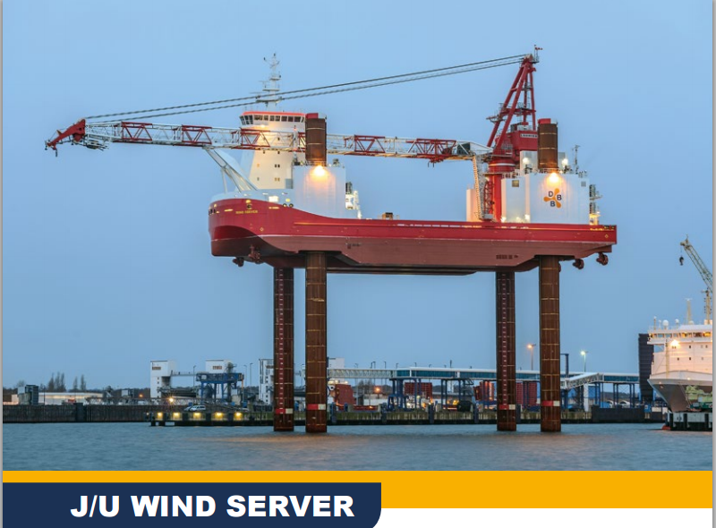
Solutions
Crew Transfer Vessel
Mothership
Source: http://www.hssb.dk/en/news/two-new-semi-swath-catamarans.asp
Source: http://www.renewableenergyfocus.com/view/15310/offshore-wind-farm-maintenance-vessel-designed/
Jack-Up
Source: http://soefart.dk/?art=5987

Slide 7
No Offshore Accommodation
Advantages
Fast
Cost to Charter
Disadvantages
Cannot Travel Far
Number of CTVs Required
No Major Maintenance

Slide 8
Mothership and CTV
Advantages
Accommodation
Possible to Access Turbine
Room for Storage
Disadvantages
No Large Replacements
Cost

Slide 9
Jack-up and CTV
Advantages
Large Replacements
Storage
Disadvantages
Slow Moving
Set-up time
Cost

Slide 10
Methodology
O&M breaks to
Corrective Maintenance

Slide 11
Methodology
O&M breaks to
Downtimes due to failures
Major concern:
Working hours
Corrective Maintenance
Preventive Maintenance
Decrease in power production

Slide 12
Methodology
O&M breaks to
Downtimes due to failures
Major concern:
Working hours
Corrective Maintenance
Preventive Maintenance
Decrease in power production
CTV
Required to access site
Small repairs
Jack-up
Large repairs

Slide 13
Methodology (Corrective Analysis)
Failures categorised per severity
(Failures per year per turbine)
Cleaning, No replacements
Small Repairs
Repair, cleaning, replacement of consumables
Small Parts
Large Parts> 50 tonnes
Large Repairs
Rotor, nacelle, yaw, main bearing replacement

Slide 14
Methodology (Corrective Analysis)
Failures categorised per severity
(Failures per year per turbine)
*
Times spent in each category (h)
Cleaning, No replacements
Travel Time
Small Repairs
Logistic Time
Repair, cleaning, replacement of consumables
Weather delay
Repair time
Small Parts
Large Parts> 50 tonnes
Large Repairs
Rotor, nacelle, yaw, main bearing replacement

Slide 15
Methodology (Corrective Analysis)
Failures categorised per severity
(Failures per year per turbine)
*
Times spent in each category (h)
=
Cleaning, No replacements
Travel Time
Small Repairs
Logistic Time
Repair, cleaning, replacement of consumables
Weather delay
Repair time
Small Parts
$$\frac{h}{yr}$$
Large Parts> 50 tonnes
Total Downtimes
Large Repairs
&
Rotor, nacelle, yaw, main bearing replacement
Small and large repairs
(days per year)

Slide 16
Methodology (Preventive Analysis)
Inputs:
-Travel time from shore
-Time among turbines
-Technicians
-Total days required per turbine
Total days required within limit?
YES
Outputs:
-Working hours
-Days per year required
-CTV needed
NO
Increase CTV number
Example:
150 turbines 150 km with 2 CTVs would take 282 days to complete
Instead 4 CTVs have to be used

Slide 17
Methodology
Solution | Preventive and small replacements | Large Replacements | Other parameters
No Offshore Accommodation | Travelling with CTV from shore. | Jack-up on the spot-market | Larger vessel needed for distance > 60 nm
Mothership | Travel time ≈ 0, & less number of CTV used | Jack-up on the spot-market | More flexible (less weather delay time) Cheaper than jack-up
Jack-up | Travel time ≈ 0, & less number of CTV used | Decreased downtimes since logistic times ≈ 0 | Cost reduction comparing when rented in spot market

Slide 18
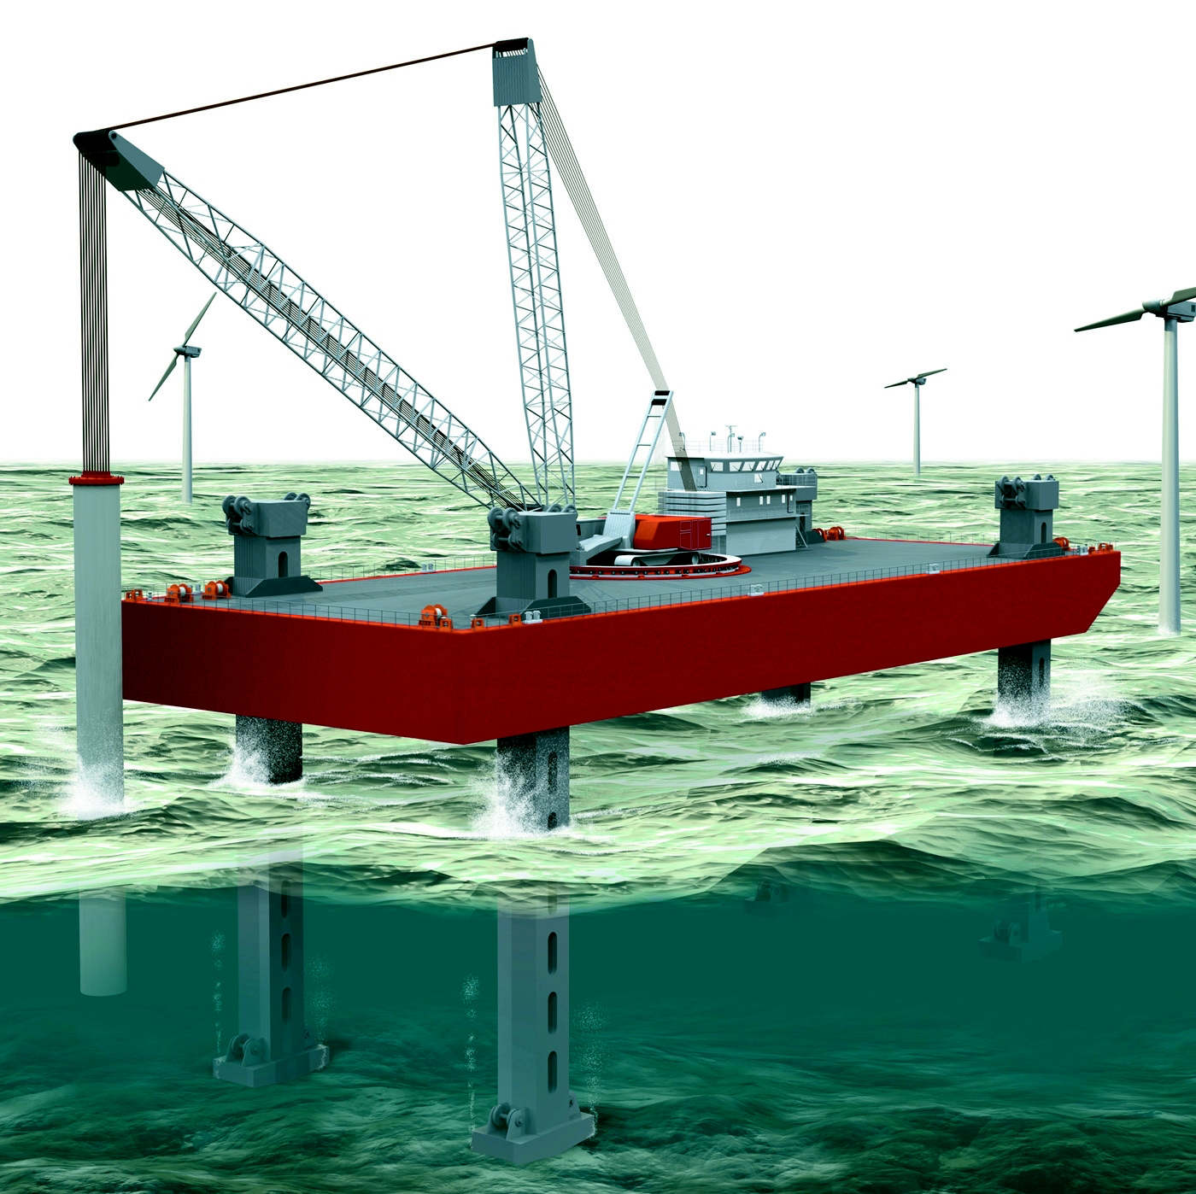
Environmental Impacts
Vessel Type | CTV | Mothership | Jack-up
*CO2 Emissions (kg/day) | 2238 | 1678 | 5476
Seabed Disturbance | Low | Low | Major
*CTV: Transit speed condition,
Mother-ship & Jack-Up: Standby condition
Jack-up operation
Source:http://www.maritimejournal.com/news101/marine-civils/port,-harbour-and-marine-construction/dutch_jv_begins_installation_work_on_offshore_wind_turbine_project

Slide 19
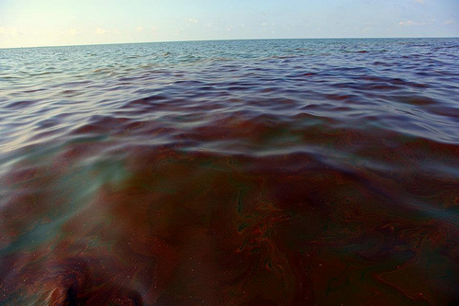
Environmental Impacts
Vessel Type | CTV | Mothership | Jack-up
Noise | Depends | Depends | Depends
Vibration | Low | Low | Low
Accidental pollution of sea caused by collisions | Depends on the number of CTVs | Major | Major
Source:http://www.safety4sea.com/pcg-and-crew-response-to-bunker-spill-in-the-philippines-13447

Slide 20
Main purpose
To choose the best support solution for each analysis performed

Slide 21
Features
Flexible
Large range of options
User friendly
Modify Inputs

Slide 22
FOWIT O&M Tool
Inputs

Slide 23
FOWIT O&M Tool
Main Outputs
Minimum cost solution
Maximum cost solution
Selection 2 solutions

Slide 24
FOWIT O&M Tool
Main Outputs
Cost Analysis Graph
Cumulative cost over the years

Slide 25
FOWIT O&M Tool
Detailed Outputs for each solution
Indicative graph

Slide 26
FOWIT O&M Tool
Detailed Outputs for each solution
Intermediate results
Specific figures

Slide 27
FOWIT O&M Tool
(1) Introduce inputs

Slide 28
FOWIT O&M Tool
(2) Click Calculate

Slide 29
FOWIT O&M Tool
(3) Choose potential solutions

Slide 30
FOWIT O&M Tool
(4) Cost Analysis Graph is displayed
* Lifetime: 25 years

Slide 31
FOWIT O&M Tool
(5) Graph is automatically updated
* Lifetime: 10 years

Slide 32
Sensitivity Analysis
No of Wind Turbines
Weather Delays
Distance
Logistic Times
Turbine capacity
Vessel Costs
Days limit per year
Fatigue Rates
Lifetime of the project
Sharing

Slide 33
Sensitivity Analysis
No of Wind Turbines
Weather Delays
Distance
Logistic Times
Turbine capacity
Vessel Costs
Days limit per year
Fatigue Rates
Lifetime of the project
Sharing

Slide 34
Sensitivity Analysis (1)
Distance from shore
 | 20 | 50 | 100 | 150
40 | NOA | NOA | NOA | MS
100 | NOA | NOA | MS | MS
200 | NOA | JU | JU | JU
Turbines
NOA-No Offshore Accommodation MS- Mother-ship JU- Jack

Slide 35
Sensitivity Analysis (2)
No of Wind Turbines | 200
Distance | 20
Base Case | NOA
Lifetime increases | Jack-up
No of Wind Turbines | 100
Distance | 50
Base Case | NOA
Failure Rates Increase | Jack-up

Slide 36
Sensitivity Analysis (3)
No of Wind Turbines | 200
Distance | 50
Base Case | Jack up
Higher WT Capacity | Mother-ship
No of Wind Turbines | 100
Distance | 50
Option without sharing | NOA
Sharing Option (50%) | Jack-up

Slide 37
Website

Slide 38
Conclusions
No ‘ultimate’ solution
Technical parameters of a wind farm changes
choice of a solution will change
FOWIT - a valuable addition to the decision making process

Slide 39
Thank you !
Technical and Economic Analysis for Far Offshore Wind Farm Accommodation
Source: http://pixshark.com/offshore-wind-farm-sunset.htm
Academic Supervisor:
Dr. Mahdi Khorasanchi

