Slide 1
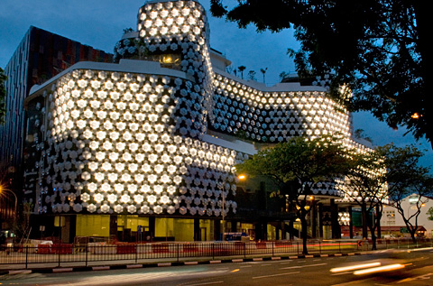
Feasibility and Impact
Evaluation of Dynamic Façades
Apostolos Kelepouris
Candice De Bartolo
Tongpong Sriboon
Ruth Prophet
Dynamic Façade Evaluation Group

Slide 2
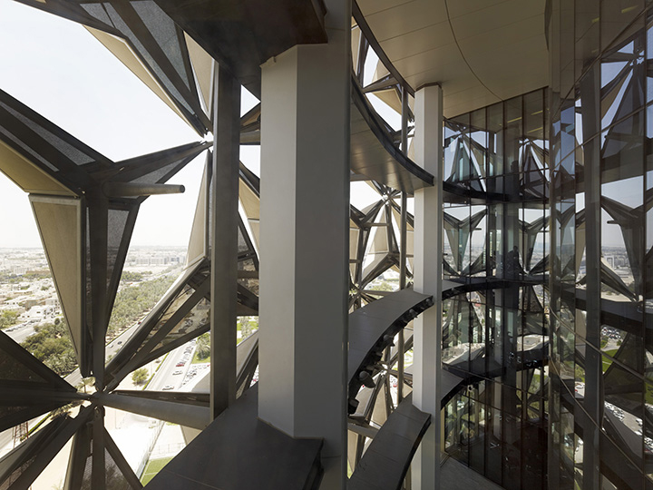
Overview
Introduction
Project Objectives
Base Case Model
Dynamic Shading Simulation
Dynamic Glazing Simulation
Financial Analysis & Carbon Saving
Conclusion & Website
Dynamic Façades Evaluation Group

Slide 3
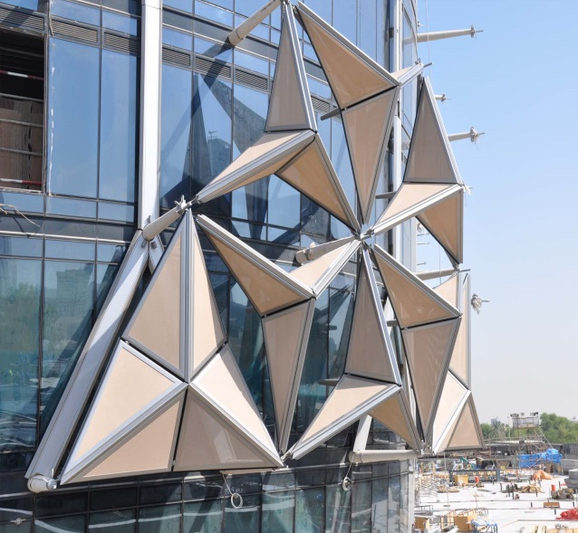
Dynamic Façade: Definition
“Also known as responsive facades. They exhibit an ability to comprehend and learn from their surroundings, adjusting behaviour accordingly. The building skin is not inert, but transforms dynamically to regulate the internal environment, reducing its power demands. Ideally they include methods for generating energy.”
The facade’s adaptability is based on the change of properties or behavior at a macro or micro scale.
Macro scale: changes in the facade configuration via moving parts (e.g. shading devices).
Micro scale: changes directly affect the structure of a material like thermo physical or opaque optical properties (e.g. smart glazing, PCM’s etc.).

Slide 4
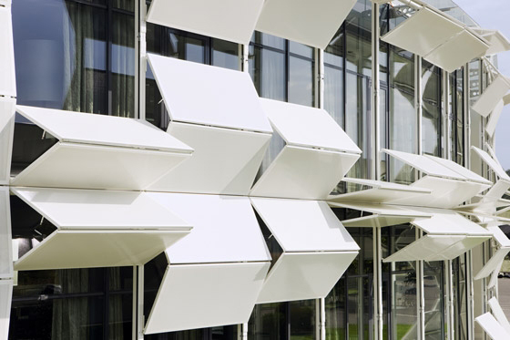
Objectives
Main Aim of Dynamic Façades Evaluation Group (DFEG) Project 2014-2015
"To conduct a feasibility study and impact evaluation of Dynamic Facades"
The project objectives are:
• Investigate how dynamic façades can be utilized to control energy use in buildings.
• Investigate various technology innovations in dynamic façades .
• Develop new methodology to evaluate dynamic facade performance.

Slide 5
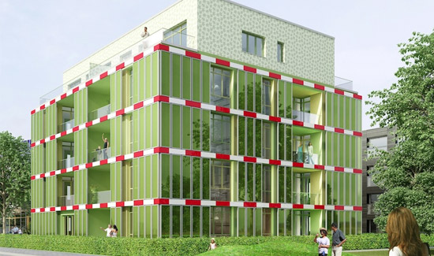
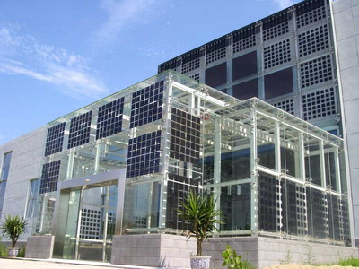
Existing dynamic facade technologies
Bioreactor facades
Dynamic shading devices
GAP solution facade system
Active smart glass technologies
Passive smart glass technologies
Photovoltaic (PV) integration
Phase Change Materials
Kinetic Facades
Double Skin Facades
Though there are currently many different technologies being researched to incorporate into a dynamic façade we chose 3 to model and analyse in further detail.

Slide 6
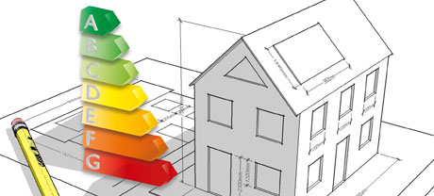
Building assessments and regulations
EPBD (Energy Performance of Buildings Directive): Legislation introduced by the EU to ensure less energy consumption in buildings.
The Sullivan report: A Low Carbon Building Standards Strategy for Scotland.
English Building Regulations: Issued by the Department for Communities and Local Government
BREEAM: BRE Environmental Assessment Method for buildings and large scale developments. First published by BRE and is used for projects worldwide.
CIBSE TM46: Chartered Institution of Building Services Engineers. Offers a comprehensive outline of building energy benchmarks.
Notes:
BRE: Building Research Establishment

Slide 7
Methodology
To analyse various façade innovations, in order to improve the energy performance of buildings. The options that are investigated include shading model and glazing model .
The aim is to determine the most efficient option for dynamic façade applications and make suggestions for efficient utilization.

Slide 8
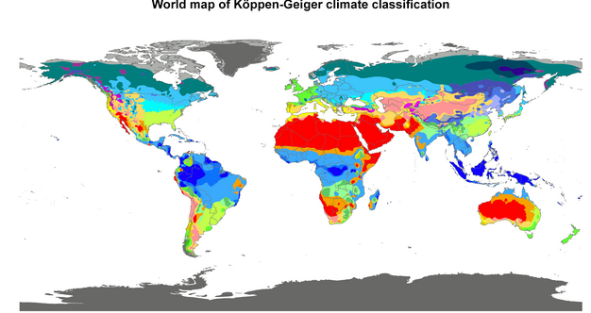
Locations and Climate Types
Dijon, France: Temperate climate, hot summer and cold winter ΔT(winter/summer) = 40°C
Cairo, Egypt: Hot desert climate, hot during the day and cool even freezing at night due to important solar radiation loss
Singapore : Humid subtropical climate, hot and humid climate
3 Locations in different continents: Europe, North Asia and Africa

Slide 9
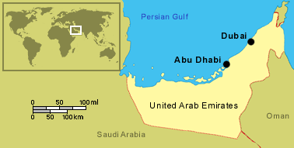
Climatic Zones
Climate: Abu Dhabi
Latitude: 24.43^{O}
Hot desert
Between June and September, the months are hot and humid
The cooler season spans from November to March
Big cooling requirements during the entire year
Maximum temperature spans from 28 to 47 degrees
More suitable for shading and smart glazing

Slide 10
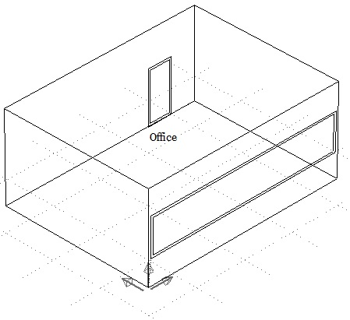
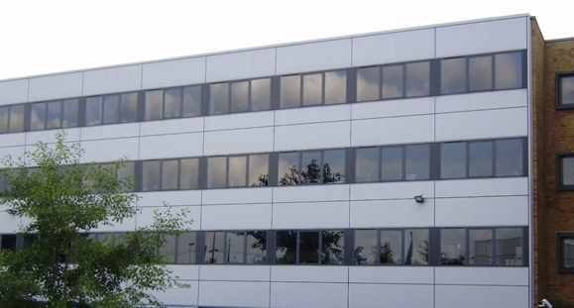
ESP-r base case model
Office
Volume:168m³
Multi-storey building
Façade
1.5m x 8m window
Window surface: 12m²
Double glazing
Proprietary steel wall cladding system
Floor/Walls
Concrete slabs on permanent steel decking & steel insulated panels
Construction systems taken from Tata Steel case studies
Façade
3.5m
1.5m
6m
8m
Notes:
In order to test the methodology that we developed for the dynamic façade evaluation we chose an office located in a multi-storey building. The office is representative of the one in the picture and the model we created with its dimensions is the one above. We used this as a base case model. Afterwards, we applied dynamic attributes on its façade and compared the energy performance of the advanced models with the energy performance of this base case model.

Slide 11
Base case materials
The structure layers were taken from Tata Steel case studies. Certain layers were slightly simplified.
Ceiling/floor(reversed)
North/East/West walls
18mm Chipboard (exterior)
25mm Insulation (mineral wool batt)
140mm Concrete
30 mm Plasterboard
1mm Steel
10 mm Air Cavity
50 mm Insulation
10 mm Air Cavity
95mm Air Cavity
30 mm Plasterboard (2 layers)
Glazing
12.5mm Plasterboard
Façade
From left to right
1.2 mm of steel (exterior)
75 mm of air
25 mm of insulation (fiberglass batt)
12.5 mm of sheathing
50 mm of insulation (mineral wool)
2 layers of plasterboard (15 mm each)
6mm Plate glass
12mm Gap
6mm Plate glass
Notes:
The materials that we used for the model were taken from Tata Steel case studies. However, certain layers were slightly simplified for the simulation process.

Slide 12
Base case model attributes
Heating/cooling system capacity (ESP-r): 3000W
Heating/cooling schedule
Weekdays: 19^{O}C-24^{O}C between 8 a.m. and 6 p.m.
15^{O}C-26^{O}C rest of the day
Saturday:19^{O}C-24^{O}C between 8 a.m. and 5 p.m.
15^{O}C-26^{O}C rest of the day
Sunday: 10^{O}C-30^{O}C
Façade
3.5m
1.5m
6m
8m
Notes:
In the base case model we applied a heating/cooling system with a 3000W capacity in ESP-r in order to regulate the temperature inside the office between certain limits.

Slide 13
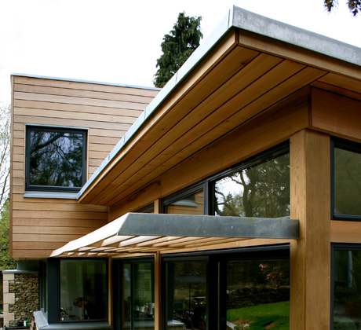
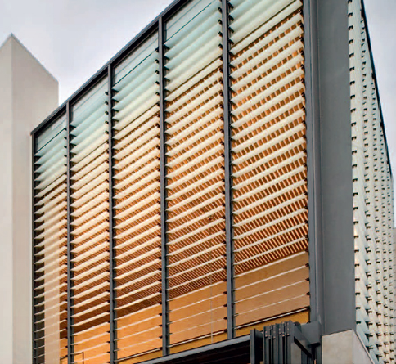
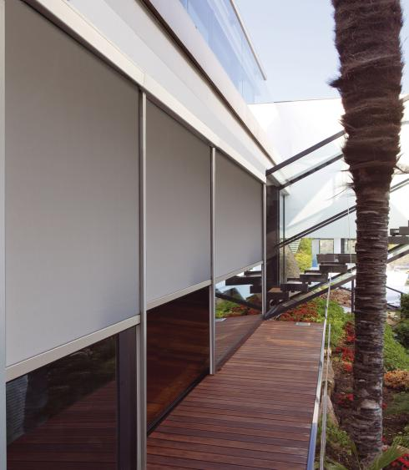
Shading systems
Types
Louvers
Overhangs
Roller blinds
Model Simulation
ESP-r
2 different cases (horizontal, tilt)
52 weeks
Notes:
As we mentioned at the beginning, the simulation of dynamic shading systems is one of the cases that we studied in this project. We developed a methodology to simulate them in ESP-r. Among the shading systems that are currently being used in buildings we decided to focus on overhangs. Horizontal overhangs are most commonly used in buildings whereas overhangs with a tilt are an extreme case which is not chosen by architects due to their significant visual impact in the buildings. However, we simulated both cases.

Slide 14
Sun path analysis
No need to change the depth/tilt throughout the week because the sun’s altitude at noon doesn’t change significantly
No need to change the depth/tilt throughout the day because the maximum length was applied for each day in order to provide shade as much as possible
Notes:
From the sun path analysis, we found that the sun’s altitude at noon when the need for shading is more important, doesn’t change significantly throughout the week. This means that the depth or tilt of the dynamic shading device doesn’t need to change every single day. Also there is no need to change the depth or tilt throughout the day because the maximum depth/tilt can be applied for the sun’s altitude at noon when the temperature is higher. In the morning and in the afternoon, even though the window coverage is slightly smaller, the temperatures are lower. However, If someone wants to achieve maximum shading during the whole day, then alternative shading schemes should be investigated.

Slide 15
Dynamic shading simulation
Depth
Tilt
Dynamic
Fixed
Dynamic
Fixed
Base case model
No shading devices
Weekly analysis (52 weeks)
Energy Performance:
Annual Heating and
Cooling delivered
kWh
60^{O}
1.5m
1m
Notes:
For the evaluation of dynamic shading we applied the following process. We did a weekly analysis of our models. We simulated the base case model, which has no shading devices attached on the façade, for 52 weeks and found the annual heating/cooling energy used. We did the same for 2 models with dynamic shading, one with dynamic tilt and another one with dynamic depth. We followed the same process for 2 more models with static shading.

Slide 16
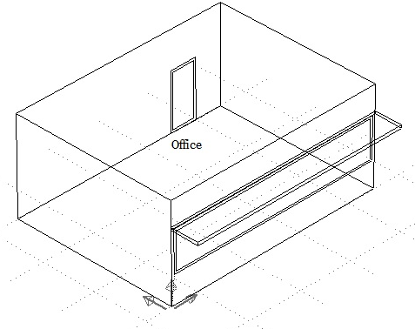
Horizontal shading (depth)
Dynamic depth
Length: 8m
Maximum depth: 1m
Minimum depth: 0.1m
Fixed depth: 1 m
Depth changes every week during the year when necessary
Maximum depth for every week is defined by the sun’s altitude at noon (12:00)
Maximum depth during winter
Minimum depth during summer
Sun’s altitude takes its lowest values during winter (42^{O}) and its highest values during summer (89^{O})
1m
Notes:
One of the dynamic shading cases was the depth of the overhang. It has a horizontal position above the window and its depth changes throughout the year between 1m and 0.1 m according to our sun path analysis. For the corresponding static model, we kept the depth at 1 m for the whole year.

Slide 17
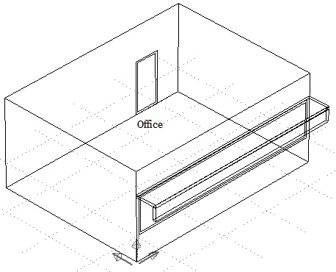
Tilt shading (angle)
Dynamic tilt
Overhang dimensions: 1m x 8 m
Maximum tilt: 90^{O} (horizontal)
Minimum tilt: 60^{O}
Tilt changes every week
Maximum tilt for every week is defined by the sun’s altitude at noon (12:00)
Maximum tilt during summer (90^{O})
Minimum tilt during winter (60^{O})
Fixed tilt: 60º
Sun’s altitude takes its lowest values during winter (42^{O}) and its highest values during summer (89^{O})
0.866m
0.5m
60^{O}
1.5m
1m
Notes:
The second dynamic shading case study was the tilt of the overhang. Its position changes between 60 and 90 degrees according to the sun path analysis in this area. The corresponding shading device with a fixed tilt was also studied and we kept it at 60 degrees throughout the whole year.

Slide 18
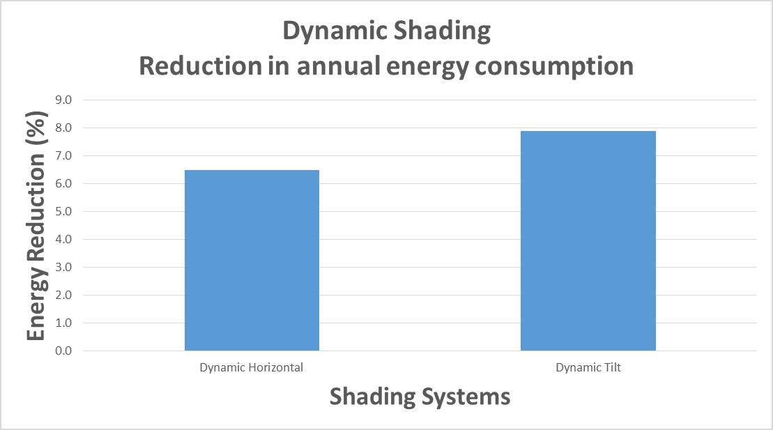
Results of shading simulation
7.9 %
6.5 %
Reduction in annual energy consumption
Dynamic tilt: 7.9%
Dynamic horizontal depth: 6.5%
Fixed tilt: 8.9%
Fixed horizontal depth: 7.5%
Notes:
This graph shows the reduction in annual energy consumption of the dynamic shading models compared to the base case model.

Slide 19
Dynamic shading conclusions
Dynamic tilt
Bigger energy reduction than dynamic horizontal
Dynamic tilt energy reduction: 7.9%
Steady tilt
Best results: 8.9% reduction in heating/cooling requirements
Steady tilt shading blocks useful light during the whole year
Blocks the view from the inside
Not an option from an architectural perspective (visual impact on the building)
Studied for academic purposes
Supplementary investigation
Integration of lighting control in combination with dynamic tilt→Bigger reduction in cooling requirements (lights increase temperature inside a building)
Alternative shading schemes should be investigated (for more beneficial results)
Notes:
As expected, the dynamic tilt gave a bigger energy reduction compared to the dynamic horizontal case study and achieved a 7.9% energy reduction. The steady tilt gave the best results with 8.9% of reduction in heating/cooling requirements. However, it also blocks useful light during the whole year, blocks the view from the inside, it is not an option from an architectural point of view because it has a big visual impact on the building and it was studied mostly for academic purposes. In order to make a more accurate evaluation of dynamic facades, the integration of lighting control should be integrated in the model. This would show that dynamic shading has bigger energy savings than the ones we found in this evaluation because lights increase the temperature inside the building. Also, alternative shading schemes should be investigated in the future which may give even more beneficial results.

Slide 20
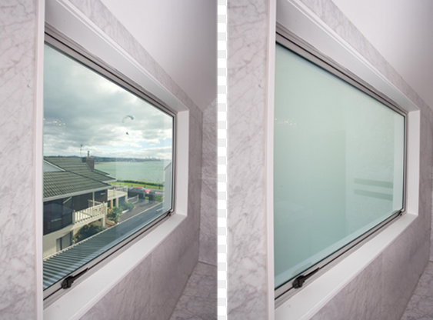
Dynamic Glazing
Why might it be a relevant feature for dynamic façades?
Energy requirements drive building design
Designers choose glazing systems to maximize daylighting but minimize glare as well as unwanted heat loss and gain
Critical for daylighting, occupant comfort and energy use
Challenges in building design for the Abu Dhabi location
Source: durashieldmarine.com
By adapting to their environment, dynamic glazing might handle these multiple parameters
Saving energy means saving money
Notes:
As we have previously seen, there are several existing dynamic façade technologies and we thought that dynamic glazing could be relevant for our dynamic façade because windows are crucial features of building design and they play a critical role in building energy performance. Designers choose glazing systems according to climate and building use in order to maximise daylighting, ensure occupant’s comfort and minimise energy requirements. All these parameters are especially critical for the Abu Dhabi climate where building design is extremely challenging. As dynamic glazings have the ability to adapt their optical properties to their environment, they appear to be a good way to accomodate these multiple parameters that can be conflicting and vary according to season. Consequently, smart glazings could achieve energy savings which also means monetary savings.

Slide 21
Dynamic Glazing Technologies
Passive Smart Glass:
Responds to its environmental
conditions, not controllable
Active Smart Glass:
Responds to an electrical stimulus, controllable manually or automatically
Smart glass
Passive
Photochromic
Thermochromic
Active
Liquid Crystal
Electrochromic
Suspended Particle Device (SPD)
Notes:
Dynamic glazing technologies are new technologies which are still under development. They are classified into two categories. On one hand we have passive glazing technologies that respond to changes of their environmental conditions (changes of T for TC while changes of light levol for photochromic) and consequently they are not controllable technologies, while on the other hand, we have active glazing technologies that modify their optical properties in response to an electrical signal and can be controlled both manually and automatically. However, all these technologies are still quite immature and some challenges remain in terms of cost-effectiveness, practicality and durability.

Slide 22
Smart Glazings Selection
One passive glazing and one active glazing
Good solar control by changes in the light transmittance to reduce heat gain and discomfort
Active glazing
Technology with the highest degree of commercialization
Possible incorporation of photovoltaic cells into electrochomic windows
Controllable technology
Passive glazing
No electrical power supply
No active control required
Low effort for installation and maintenance
Electrochromic
Thermochromic
Notes:
Given these technologies, we had to make a choice on what glazing types we wanted to feature in our façade. We found it relevant to pick one active technology and one passive technology capable of controlling solar heat gain in the room. Firstly we chose electrochromic glazing as it is the most commercialised type of dynamic glazing and it allows for a customised control to meet the occupant’s requirements. Secondly, we chose thermochromic glazing which is a self-regulated technology whose operation does not required an additional energy source.

Slide 23
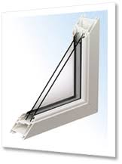
Glazing Systems Simulation
Dynamic Simulated Models
Static Simulated Models
Low-e Glazing
Triple Glazing
Electrochromic glazing with different period controls
Thermochromic glazing with different ranges of switching temperature and solar transmittance
Switchable glazing types
Base Case Model
Typical Double Glazing
Energy Performance:
Annual Heating and
Cooling delivered
kWh
Insulated glazing types
Notes:
The next step was the simulation of the dynamic glazing systems. Once the annual energy delivered was obtained for the base case model, the double glazing was replaced by the dynamic glazings. Different glazing types were investigated and the ones that gave the best results were selected and then compared with the results given by static glazings with improved insulation properties (Low-e glazing and triple glazing). As dynamic glazing technologies are quite complex to implement, this comparison was conducted to investigate if they could achieve higher energy savings than energy efficient static glazings.

Slide 24
Results of glazing simulation
4.9 %
4.2 %
Typically commercialised thermochromic glazing did not reduce significantly
the energy consumption
Best results obtained for the thermochromic glazing with the lowest
solar transmittance and the lowest switching temperature range
Dynamic glazings improved the annual energy consumption by more than 4%
Peak cooling was reduced
Notes:
As the base case model is our baseline, the results are presented in the form of the reduction of the annual energy consumption resulting from each glazing. It appears that the lowest energy saving was achieved with a typical commercialised thermochromic glazing while the best results were given for a thermochromic glazing with more ideal properties in terms of solar transmittance and switching T. For both thermochromic and electrochromic glazing, there was an improvement in the energy consumption which ranged between 4 and 5%, which is close to the performance of triple glazing. This might be explained by the fact that peak cooling was reduced during the hottest periods. Now, I give the floor to Tongpong for the financial analysis of dynamic facades.

Slide 25
Financial Analysis & Carbon Saving
Modeled Building
Shading Devices
Glazing Systems
Dynamic Tilt Shading
Thermochromic Glazing
Electhrochromic
Glazing
Payback Period, IRR
Payback Period, IRR
Payback Period, IRR
Carbon Saving
Carbon Saving
Carbon Saving
Triple
Glazing
Payback Period, IRR
Carbon Saving
Steady Horizon
Shading
Payback Period, IRR
Carbon Saving
Notes:
Thank you very much, Candice. In terms of financial and Carbon saving, the model was divided in 2 Categories, Shading Device and Glazing Systems.
For Shading devices we would like to compare the performance only steady shading system and a dynamic shading system
In this case we did not mention about steady tilt shading because it not suitable to install relate to the vision and the impact from lighting problems.
So we will mention only steady horizontal and dynamic tilt.
Another category which we mentioned is glazing systems and we explored Triple glazing, Thermochromic and Electhrochromic glazing for compare these smart technologies with basic glazing systems.

Slide 26
Energy & Carbon Saving
Analysis of Dynamic Facades
Energy saving unit and Carbon saving rate of each model
(kWhr/year/ room 6m x 8m) compare to the base case room.
List | Steady Horizon Shading | Dynamic Tilt Shading | Triple Glazing | Thermo chromic Glazing | Electro chromic Glazing
Energy Saving Unit (kWhr/year/room) | 550 | 580 | 352 | 398 | 336
Energy Saving Cost (£/year/ room ) | 77 | 81.20 | 49.28 | 55.72 | 47.04
Energy Saving Cost (£/year/ m² ) | 1.6 | 1.69 | 1.02 | 1.16 | 0.98
Carbon Saving Rate (kgCO2/year/room) | 101.75 | 107.19 | 65 | 73.5 | 62.52
Carbon Saving Rate (kgCO2/year/m²) | 2.1 | 2.2 | 1.4 | 1.5 | 1.3
0.14 £ / kWhr is normally rate of electricity cost
0.185 kgco2 / kWhr is normally rate of carbon dioxide
(http://www.energysavingtrust.org.uk/content/our-calculations)
Notes:
With the results obtained from the simulation, we were able to gain the energy savings of each technology, which is shown in the first row of the table.
The dynamic tilt shading has the maximum energy saving almost six hundred kWhr per year per room. Compare with the Electhrochromic glazing has the minimum of energy saving unit nearby three hundred.
Let’s imagine if you multiplied this energy saving by the number of rooms in a building, the total energy saved would be a significant amount.
Then we multiply the energy saving unit by the electricity cost and we got the maximum energy saving cost of a dynamic tilt shading around eighty pound per year per room contrasts with the minimum energy saving cost of EC Glazing that has the number around forty pound per year per room.
Again for the carbon saving rate, we multiplied Energy saving unit by Carbon rate, for this case the dynamic tilt shading device has the maximum carbon saving rate around one hundred kg per year per room as opposed to EC glazing which has a saving of around sixty two kg.

Slide 27
Financial Analysis
of Dynamic Facades Model
Capital cost of each model (£/ room 6m x 8m) come from the
average capital cost of 3 different product or companies*
Pay back period of each model (years/ room 6m x 8m)
Divided the total investment cost by Energy saving cost per year.
Internal rate of return.
The percentage for getting investment cost back in each of payback period.
List | Steady Horizon Shading | Dynamic Tilt Shading | Triple Glazing | Thermochromic Glazing | Electrochromic Glazing
Capital Cost (£/room) | 795 | 1,240.8 | 828 | 1,392 | 2,328
Pay Back Period (year) | 10.34 | 15.29 | 16.81 | 25 | 49.20
IRR (%) | 9.68 % | 6.54 % | 5.94% | 4 % | 2.03 %
The average capital cost of product come from Tata, Dexone, Prolouver, SDP (http://www.alibaba.com/product-detail/Aluminum-louver-solar-shading_1861272021.html)
Notes:
We then analyzed the material capital costs of the various dynamic façade models.
We sourced these capital costs from 3 different companies which have this cost data available to the public.
We the multiplied the capital cost of the materials by size of shading or glazing required for our model.
And finally we got the total cost of material for each model.
In this case, the steady horizon shading has the lowest cost of material which is around eight hundred pound per room which is significantly less than the EC glazing material which is nearby two thousand pound per room.
Similarly, as in the case of capital cost, the steady horizontal shading has the minimum number of pay back years at approximately ten years and EC glazing has the largest number of payback years by a considerable margin at approximately fifty years.

Slide 28
Conclusion
New methodology developed to assess the performance of dynamic facades.
By using a specific software developed at Strathclyde (ESP-r).
Improved methodology : lighting control integration, combination of dynamic shading and smart glazing.
After investigating the case study, we concluded that a balance of human comfort, energy saving and cost effectiveness is necessary.
The results are specific for this case study and a corresponding analysis should be conducted for different cases.
Source: http://uk.phaidon.com//
Notes:
In conclusion, Dynamic facades are quite new technology, and so they are difficult to model on current software. As such we were able to develop a new methodology to simulate dynamic facades using ESP-r.
Initial methodology could be improved further by investigating lighting control. Also combining dynamic shading and smart glazing using our methodology should also be investigated.
After investigating the case study, we concluded that a balance of human comfort, energy saving and cost effectiveness is necessary.
The results are specific for this case study and a corresponding analysis should be conducted for different cases.

Slide 29
Website : Dynamic Facades
Notes:
if you want to see more details about dynamic facades group project, please visit to our website.

