Slide 1



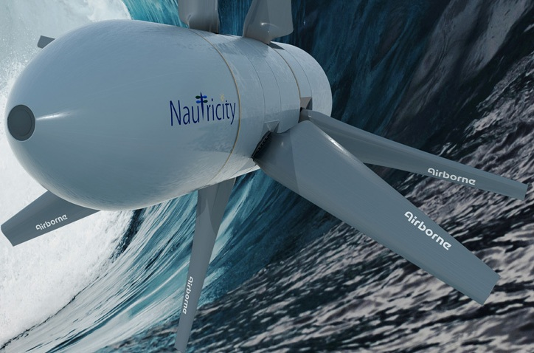

A Methodology for a Decision Support Tool for a Tidal Stream Device
A Methodology for a Decision Support Tool for a Tidal Stream Device
Andrew Cooper
Julen Garcia-Ibanez
Ciaran Gilbert
Stuart Mack
Xabier Miquelez de Mendiluce
29/04/2014

Slide 2
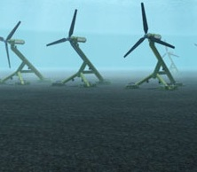
A Methodology for a Decision Support Tool for a Tidal Stream Device
A Methodology for a Decision Support Tool for a Tidal Stream Device
Index
Introduction
1
Wave/ Tidal Interaction Tool
2
Exceedance Curve Calculation Tool
3
Blade Element Momentum Analysis Tool
4
Material Analysis Tool
5
Techno-Economic Analysis Tool
Conclusion
1
Introduction
Tool 1
Tool 2
Tool 3
Tool 4
Tool 5
Conclusion
1
1

Slide 3
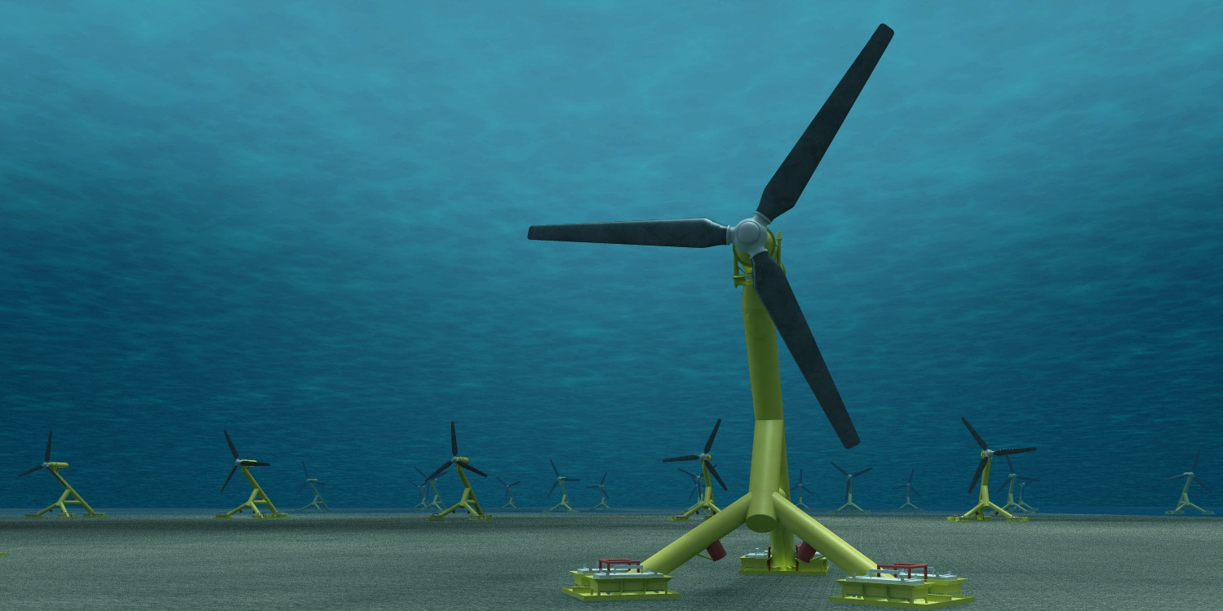
A Methodology for a Decision Support Tool for a Tidal Stream Device
A Methodology for a Decision Support Tool for a Tidal Stream Device
Background
Why Tidal Stream Energy?
Predictable
Minimal visual and environmental impact
7,743 miles of coastline
Why a methodology for a decision support tool?
Timeframe
Lack of data and other projects feedback
2
Introduction
Tool 1
Tool 2
Tool 3
Tool 4
Tool 5
Conclusion
1

Slide 4
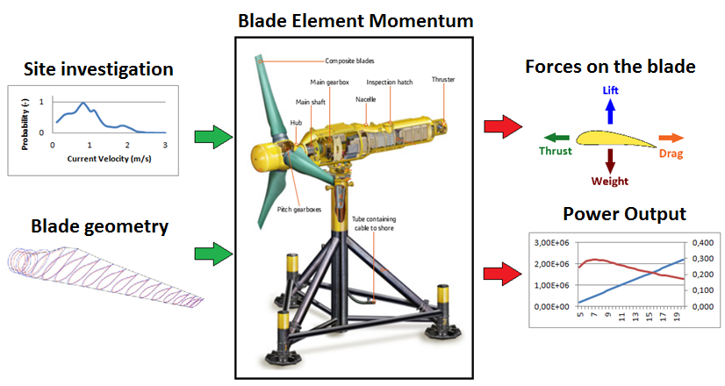
A Methodology for a Decision Support Tool for a Tidal Stream Device
A Methodology for a Decision Support Tool for a Tidal Stream Device
Aim
To develop a methodology that supports the decision making process of the design of cost-efficient Tidal Stream devices creating, efficient, compact and reliable engineering tools that provide a techno-economic assessment of a tidal energy project
3
Introduction
Tool 1
Tool 2
Tool 3
Tool 4
Tool 5
Conclusion
1

Slide 5
A Methodology for a Decision Support Tool for a Tidal Stream Device
A Methodology for a Decision Support Tool for a Tidal Stream Device
Diagram
1
2
3
4
5
Wave/Tidal Interaction
Exceedance Curve Calculator
BEM Analysis
Material Analysis
Techno-Economic Analysis
4
Introduction
Tool 1
Tool 2
Tool 3
Tool 4
Tool 5
Conclusion
1

Slide 6
A Methodology for a Decision Support Tool for a Tidal Stream Device
1
Wave/Tidal Interaction Tool
Description
Tool calculates the key parameters for a tidal stream device in a site location
Valuable in eliminating sites which do not have the correct velocity characteristics
5
Introduction
Tool 1
Tool 2
Tool 3
Tool 4
Tool 5
Conclusion

Slide 7
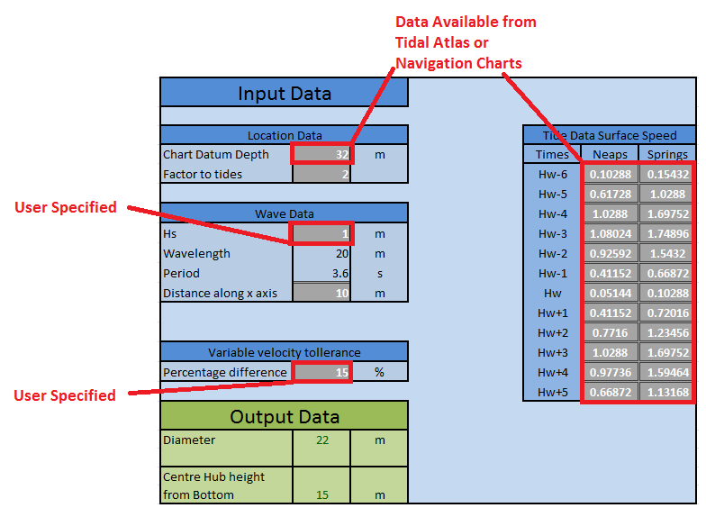
A Methodology for a Decision Support Tool for a Tidal Stream Device
1
Wave/Tidal Interaction Tool
Inputs
Surface Tidal Stream [m/s] Depth of Site [m]
Allowable Change [%]
Wave Height [m]
Wave Period [s]
6
Introduction
Tool 1
Tool 2
Tool 3
Tool 4
Tool 5
Conclusion

Slide 8
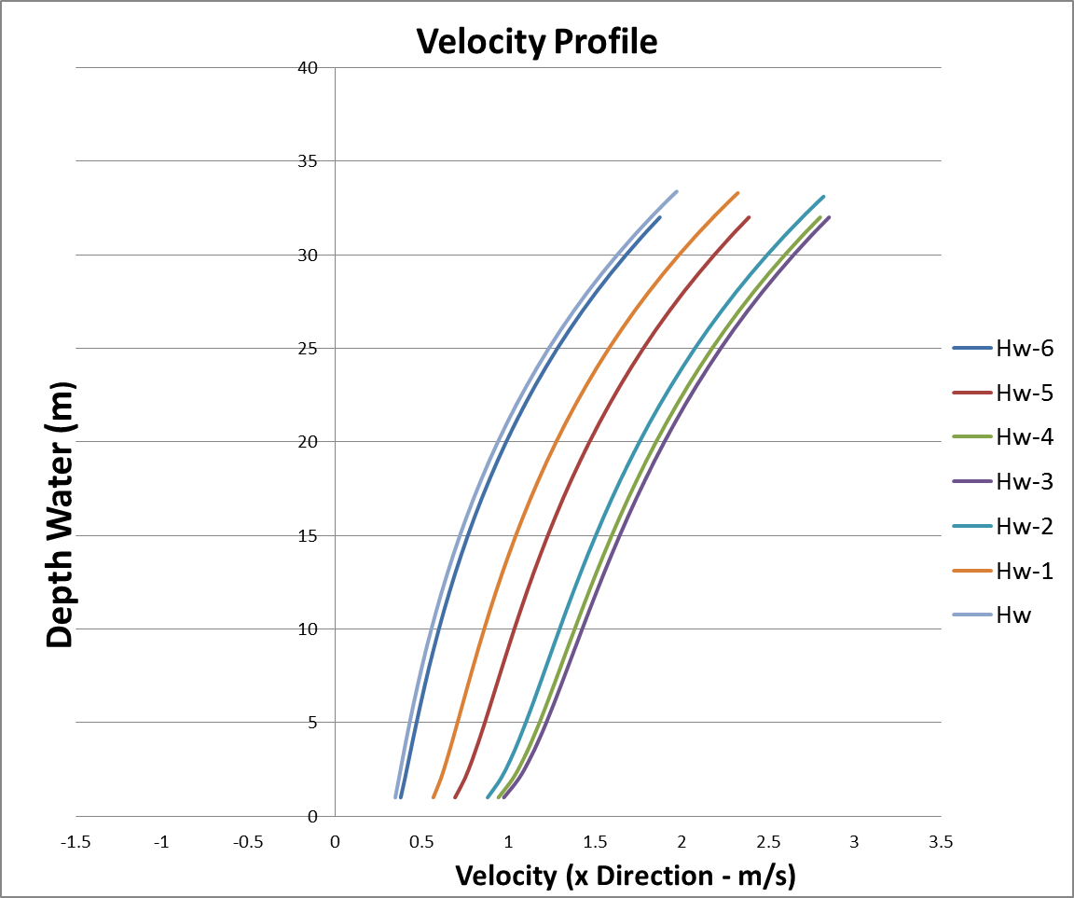
A Methodology for a Decision Support Tool for a Tidal Stream Device
1
Wave/Tidal Interaction Tool
Outputs
Available Region [m]
Hub-Seabed Distance [m]
7
Introduction
Tool 1
Tool 2
Tool 3
Tool 4
Tool 5
Conclusion

Slide 9
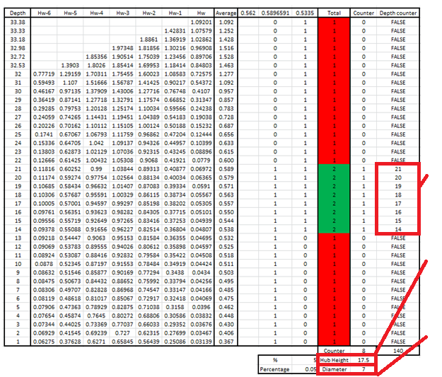
A Methodology for a Decision Support Tool for a Tidal Stream Device
1
Wave/Tidal Interaction Tool
Available Region
Hub Height
Diameter
8
Introduction
Tool 1
Tool 2
Tool 3
Tool 4
Tool 5
Conclusion

Slide 10
A Methodology for a Decision Support Tool for a Tidal Stream Device
1
Wave/Tidal Interaction Tool
Methodology
Add 1/7th Power Law to free surface velocity
Calculate wave particle velocity
Calculate wave drift force
Sum the three velocities together
Find region of least variation change with the implementation of a percentage difference
1/7th Law
V_{particle}
V_{drift}
9
Introduction
Tool 1
Tool 2
Tool 3
Tool 4
Tool 5
Conclusion

Slide 11
A Methodology for a Decision Support Tool for a Tidal Stream Device
2
Exceedance Curve Calculation Tool
Description
Exceedance curve shows the number of days a year the tidal flow rate exceeds speed values
Used to analyse different rates of change at different sites
Important in calculating power output of a system
Probability values are used in further tools
10
Introduction
Tool 1
Tool 2
Tool 3
Tool 4
Tool 5
Conclusion

Slide 12
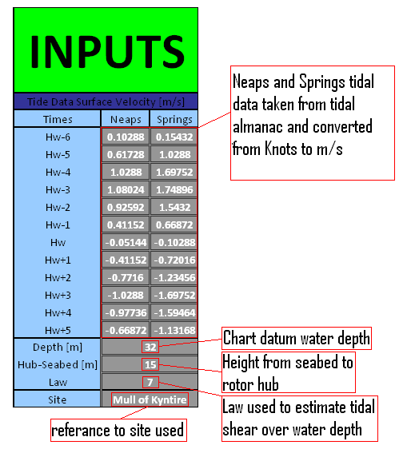
A Methodology for a Decision Support Tool for a Tidal Stream Device
2
Exceedance Curve Calculation Tool
Inputs
Tidal Stream Input [m/s] Depth of Site [m]
Hub-Seabed Distance [m]
Tidal Shear Law
Entry of site name
11
Introduction
Tool 1
Tool 2
Tool 3
Tool 4
Tool 5
Conclusion

Slide 13
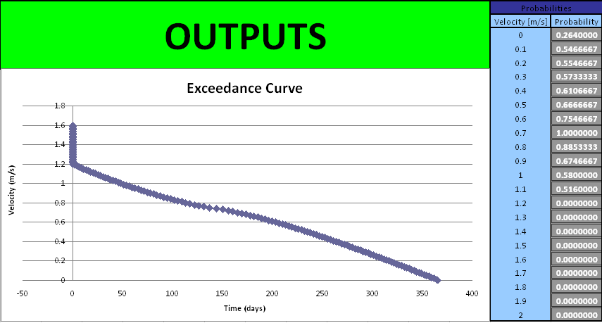
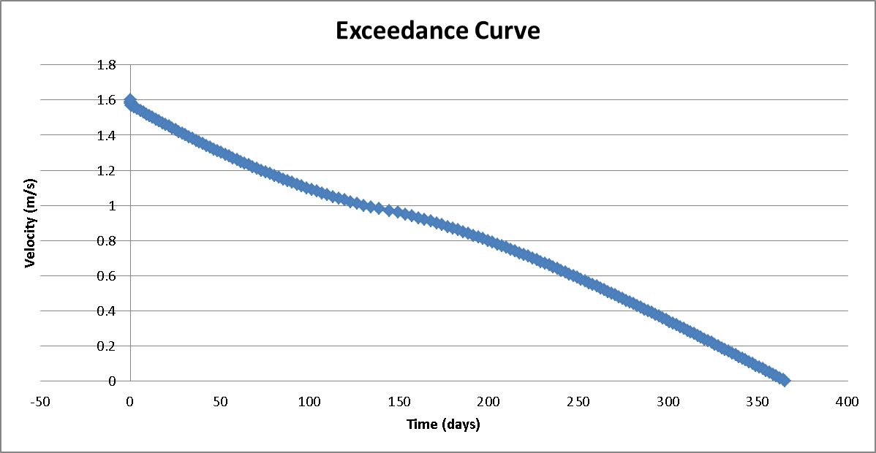
A Methodology for a Decision Support Tool for a Tidal Stream Device
2
Exceedance Curve Calculation Tool
Outputs
Exceedance curve [m/s]
Flow probabilities [%]
12
Introduction
Tool 1
Tool 2
Tool 3
Tool 4
Tool 5
Conclusion

Slide 14
A Methodology for a Decision Support Tool for a Tidal Stream Device
2
Exceedance Curve Calculation Tool
Methodology
Surface speeds altered for hub depth using 1/7th power law
Adjust the tidal curve to fit a sinusoidal curve
Increase the sampling rate by interpolating between the hourly values of flow rate on the sinusoidal curve
Create 1200 by 100 matrix of flow speeds
Count values to find flow speed distribution
13
Introduction
Tool 1
Tool 2
Tool 3
Tool 4
Tool 5
Conclusion

Slide 15
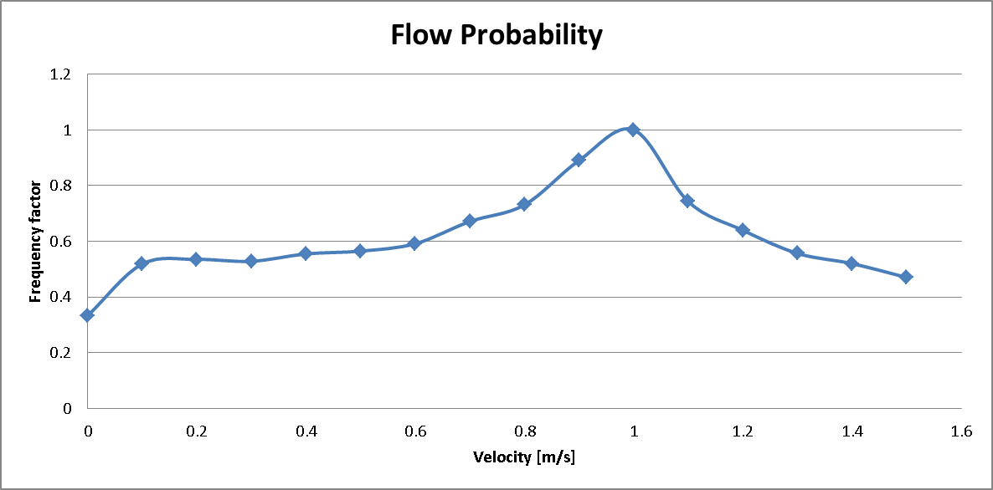
A Methodology for a Decision Support Tool for a Tidal Stream Device
2
Exceedance Curve Calculation Tool
Methodology
Divide counted values for each set flow speed by the total number of values to find probabilities
Tidal flow speed distribution curve calculated
Exceedance curve data calculated from probabilities and then plotted as an output
Flow Velocity Distribution
14
Introduction
Tool 1
Tool 2
Tool 3
Tool 4
Tool 5
Conclusion

Slide 16


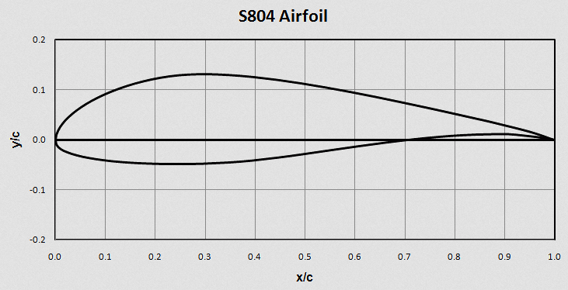
A Methodology for a Decision Support Tool for a Tidal Stream Device
A Decision Support Tool for the Resource, Performance and Survivability Analysis of Tidal Turbines
3
Blade Element Momentum Analysis Tool
Description
HARP_Opt
NREL
Matlab
Blade Element Momentum
Blade Design
Structural Optimisation
Thickness
Genetic Algorithm
Annual Energy Output
Mass
15
Introduction
Tool 1
Tool 2
Tool 3
Tool 4
Tool 5
Conclusion
6

Slide 17
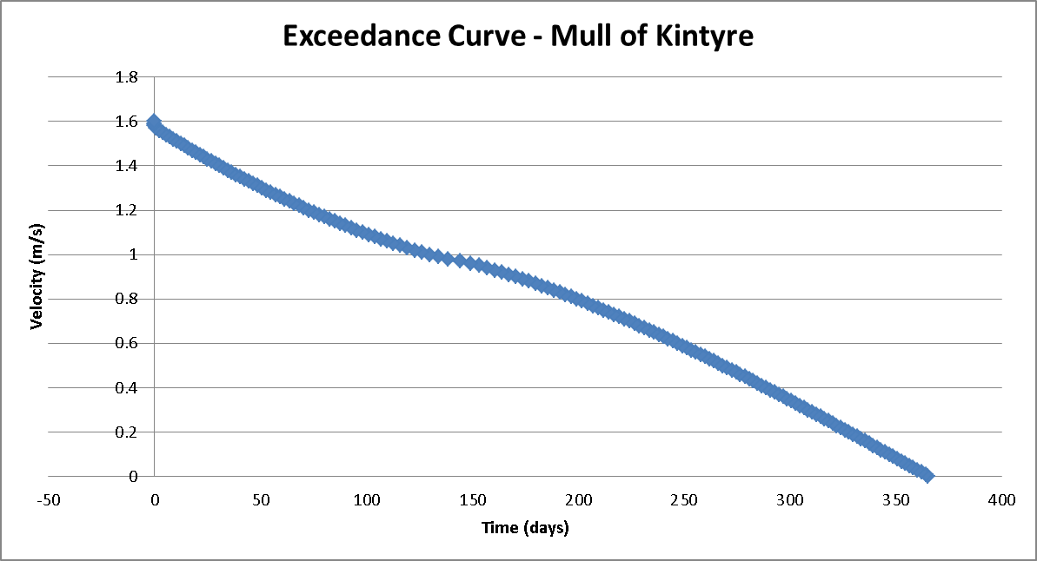
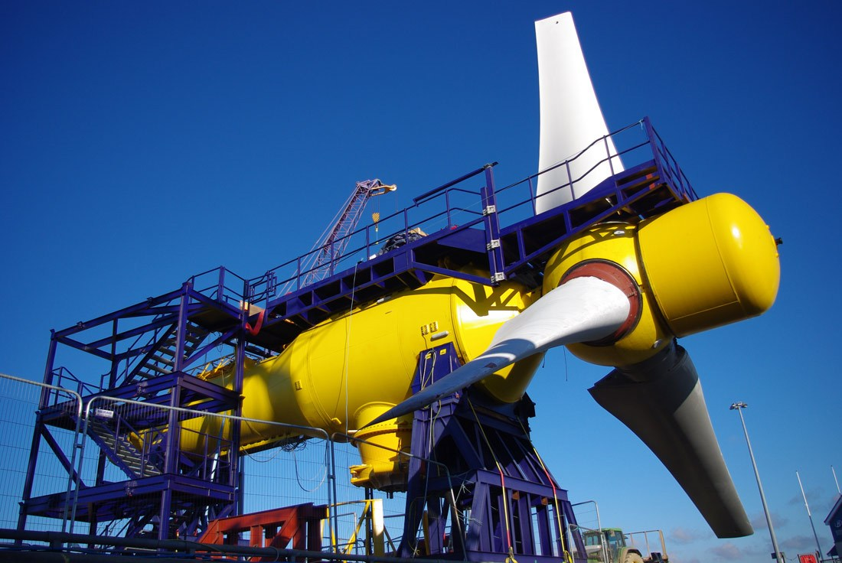
A Methodology for a Decision Support Tool for a Tidal Stream Device
A Decision Support Tool for the Resource, Performance and Survivability Analysis of Tidal Turbines
3
Blade Element Momentum Analysis Tool
Inputs
Depth of Site [m]
Hub-Seabed Distance [m]
Turbine Diameter [m]
Flow probabilities [%]
Young’s Modulus [GPa]
Allowable Strain [%]
Material Density [kg/m³]
Blade Family (C_{D}, C_{L}, Geo)
Genetic Algorithm Control
16
Introduction
Tool 1
Tool 2
Tool 3
Tool 4
Tool 5
Conclusion
6

Slide 18
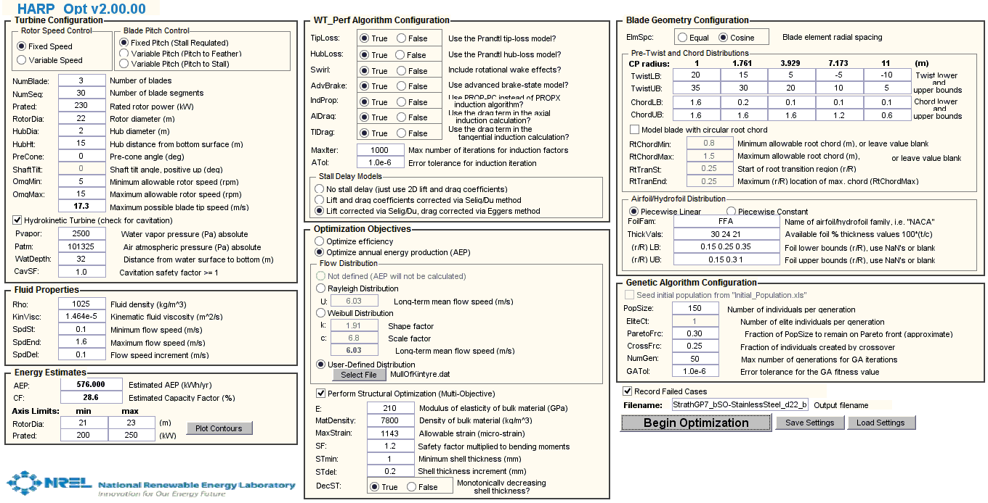
A Methodology for a Decision Support Tool for a Tidal Stream Device
A Decision Support Tool for the Resource, Performance and Survivability Analysis of Tidal Turbines
3
Blade Element Momentum Analysis Tool
Inputs
17
Introduction
Tool 1
Tool 2
Tool 3
Tool 4
Tool 5
Conclusion
6

Slide 19
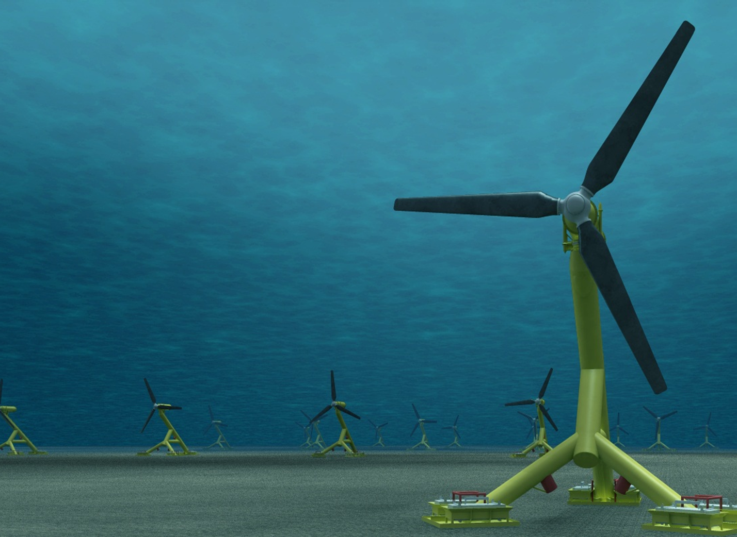
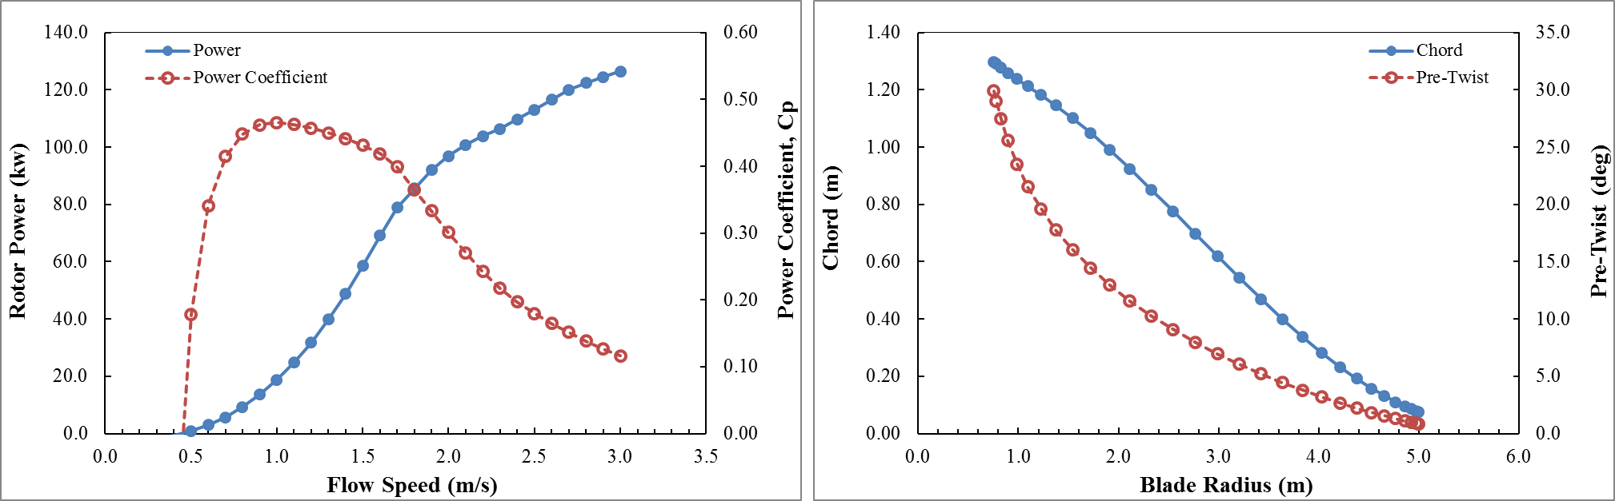
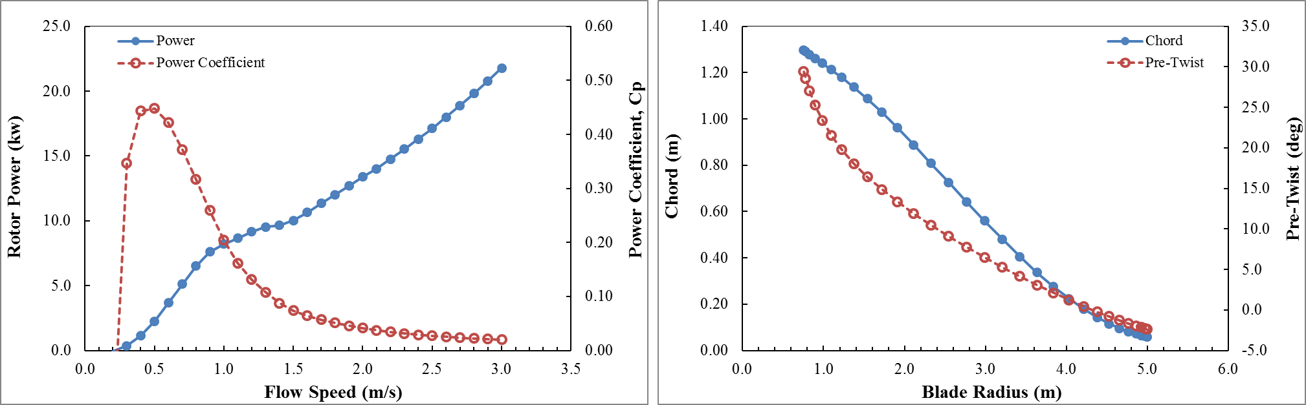
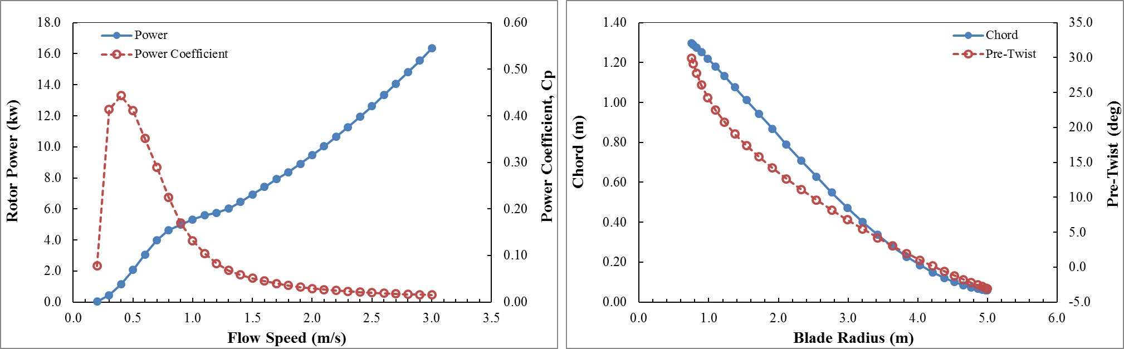
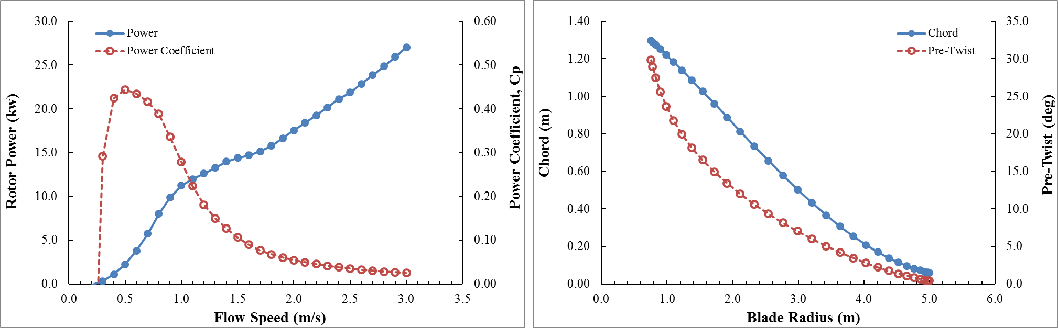
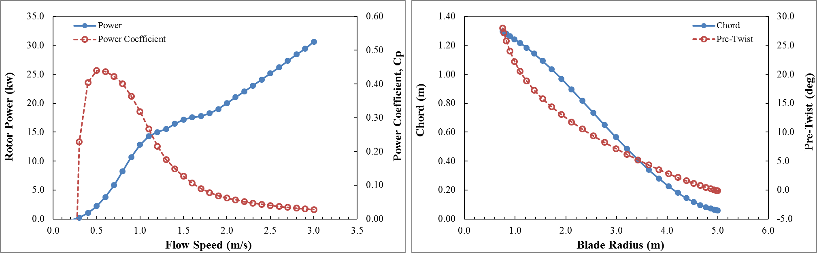
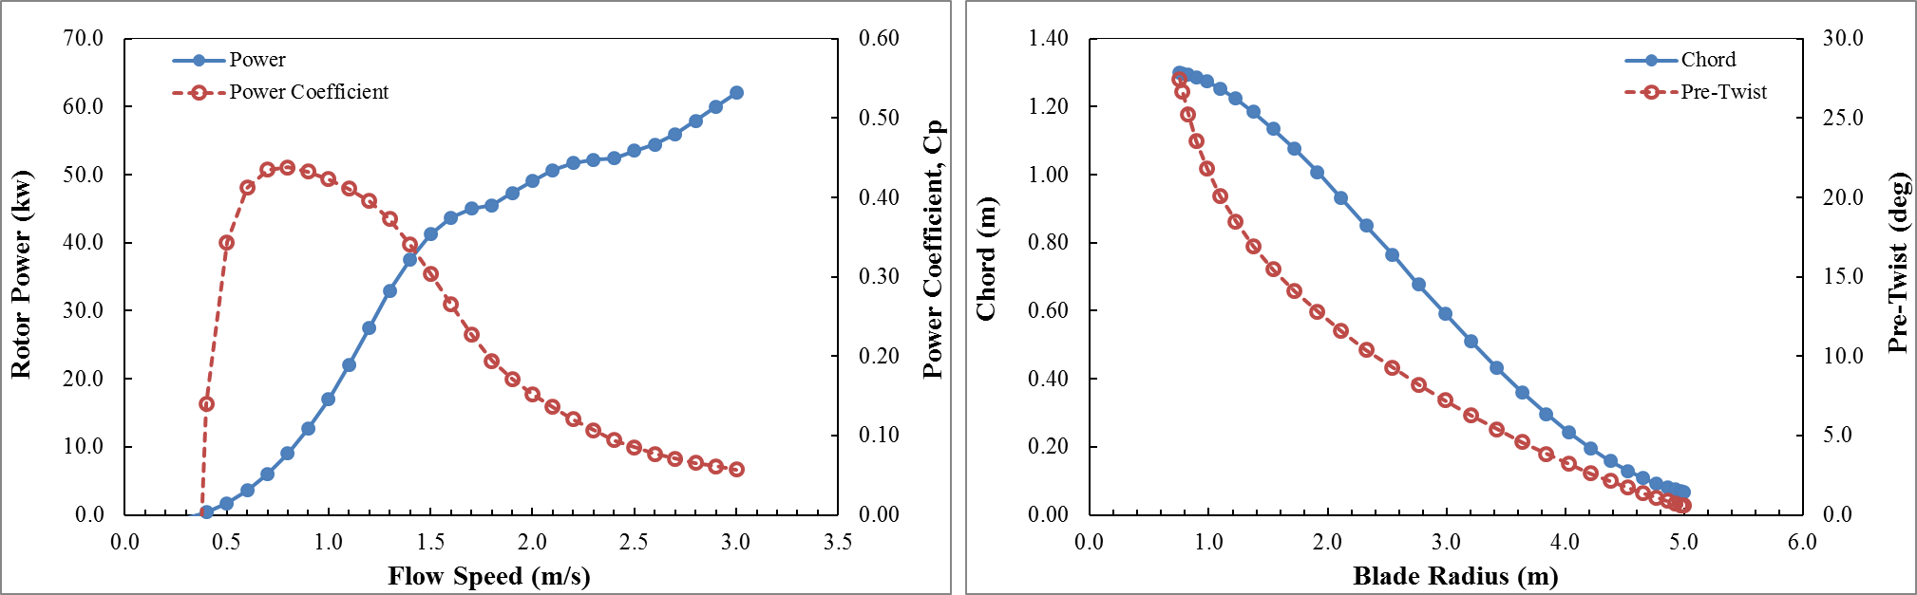
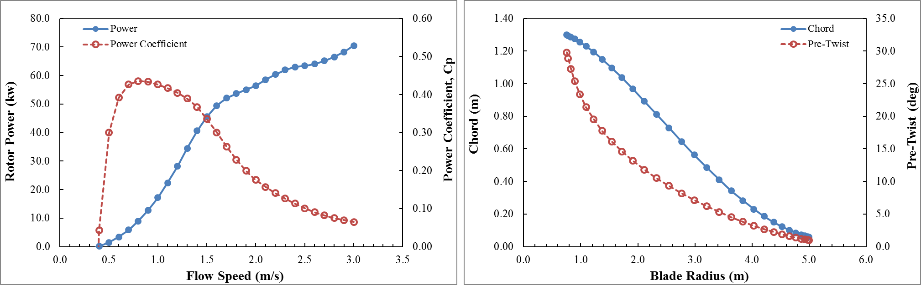
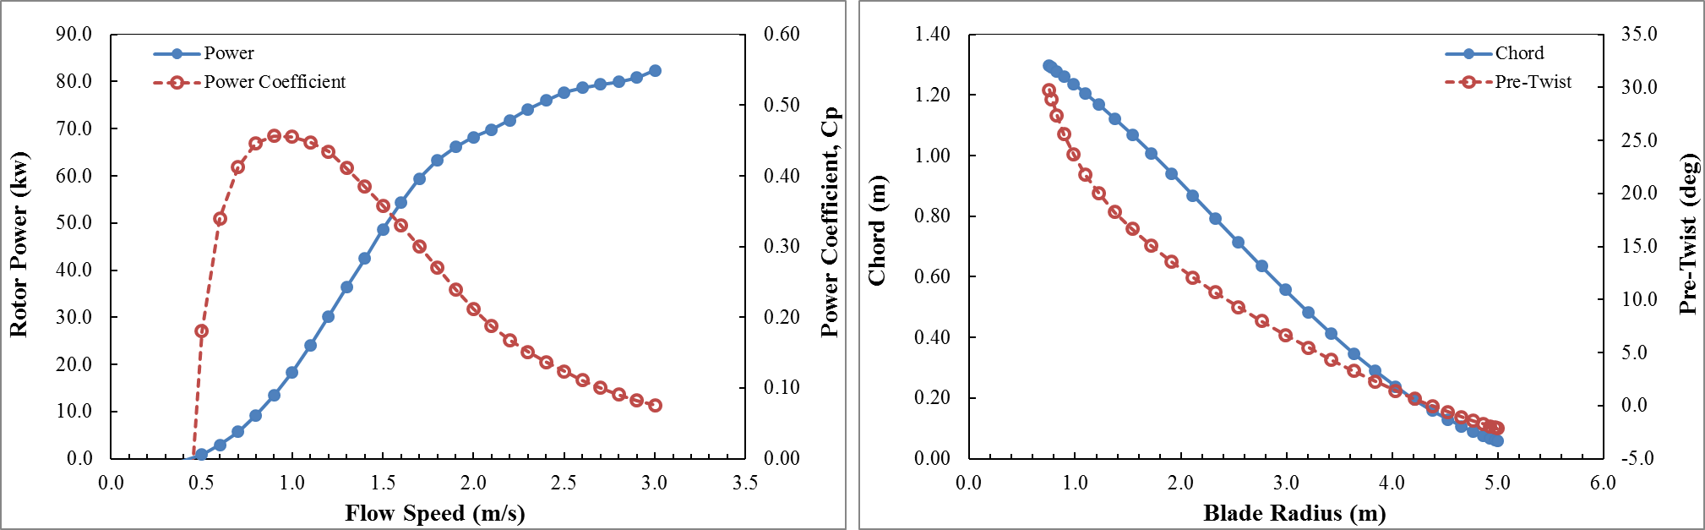
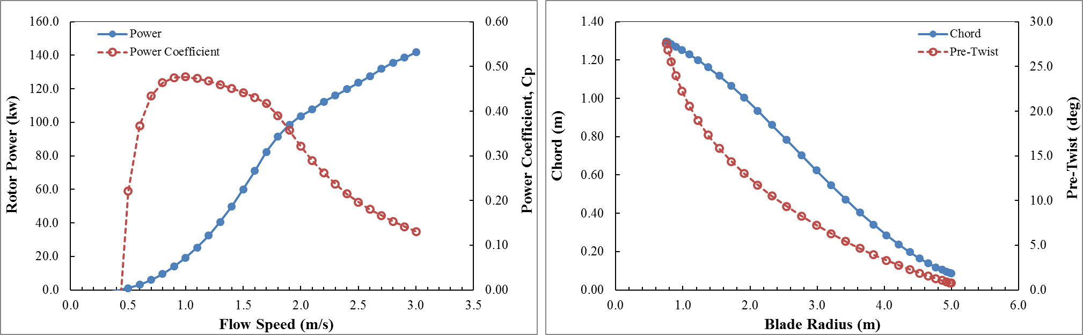
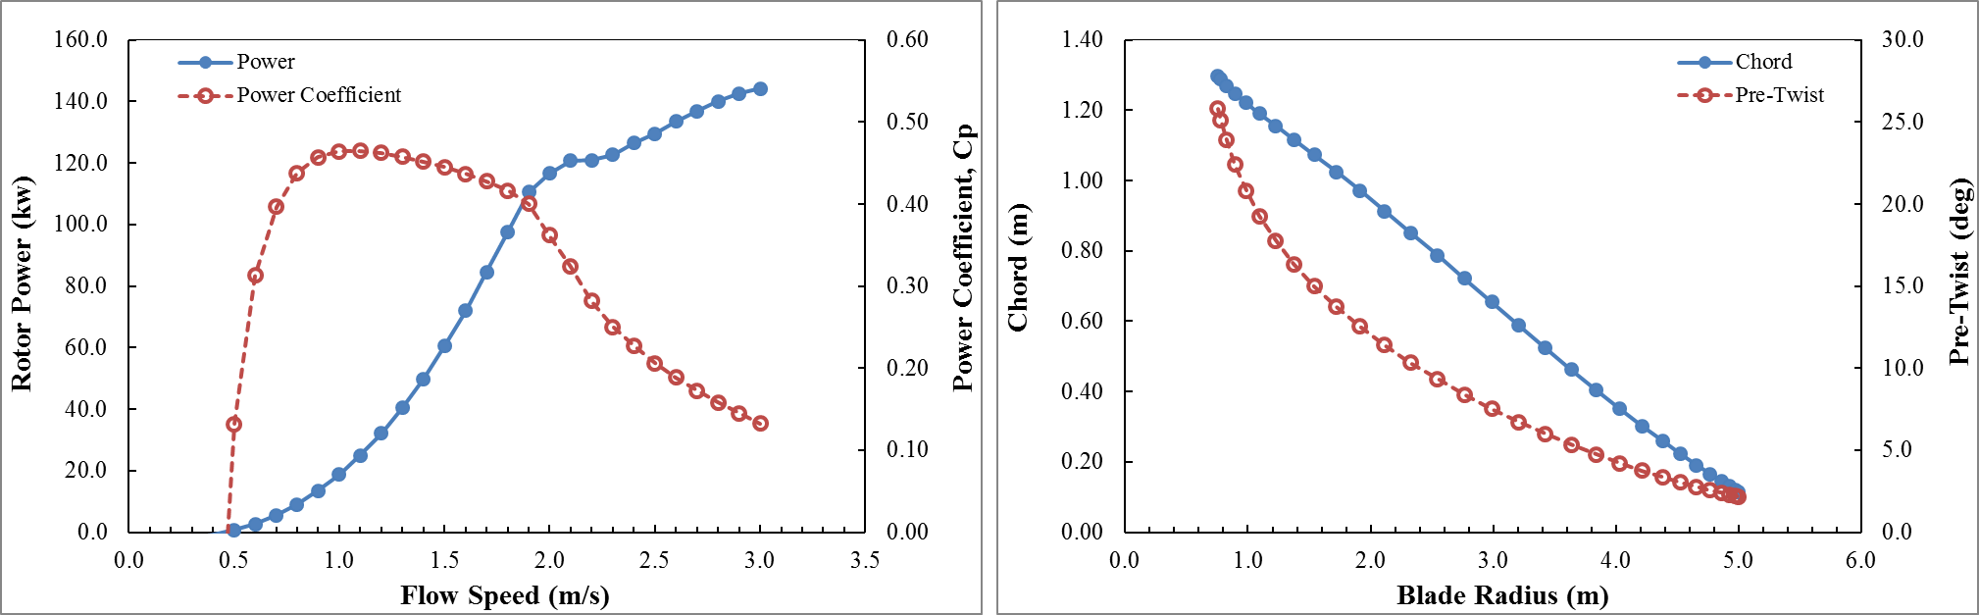
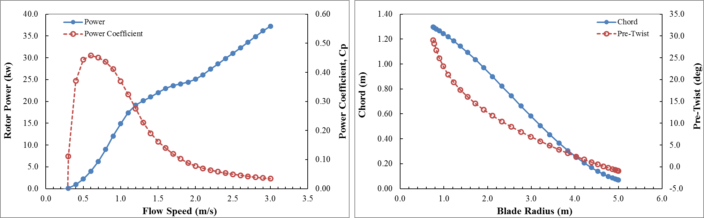
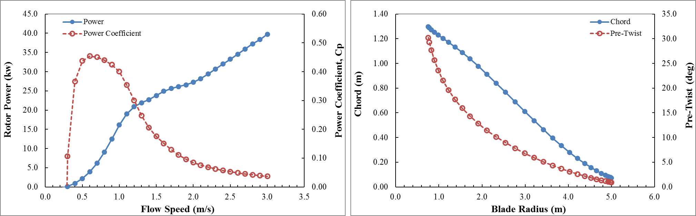
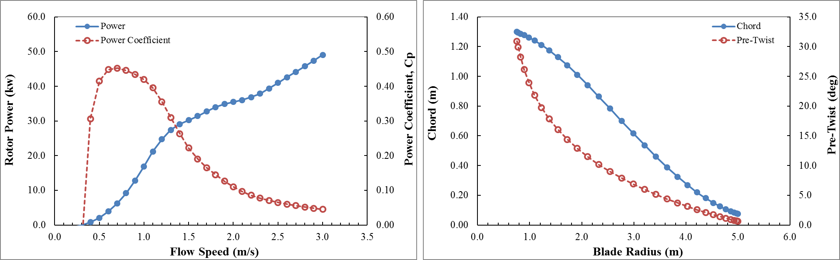
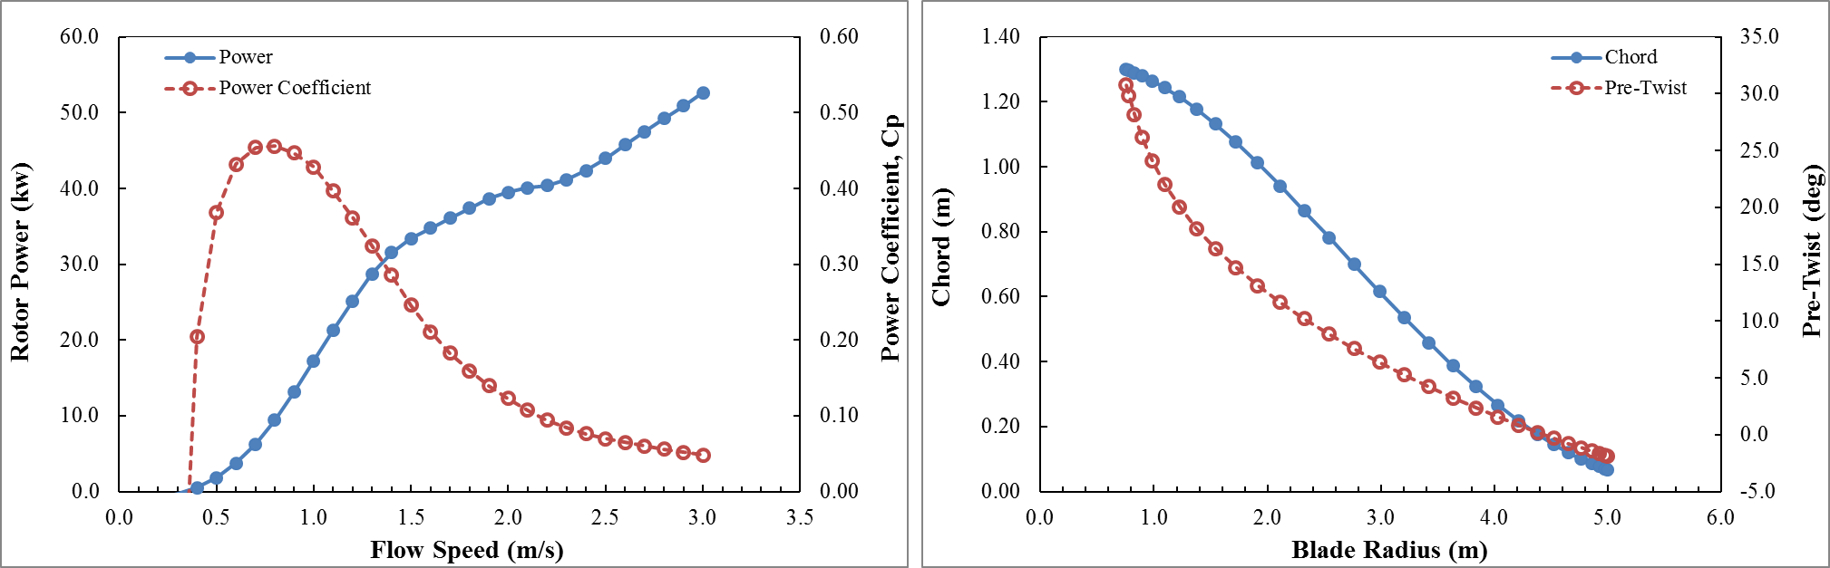
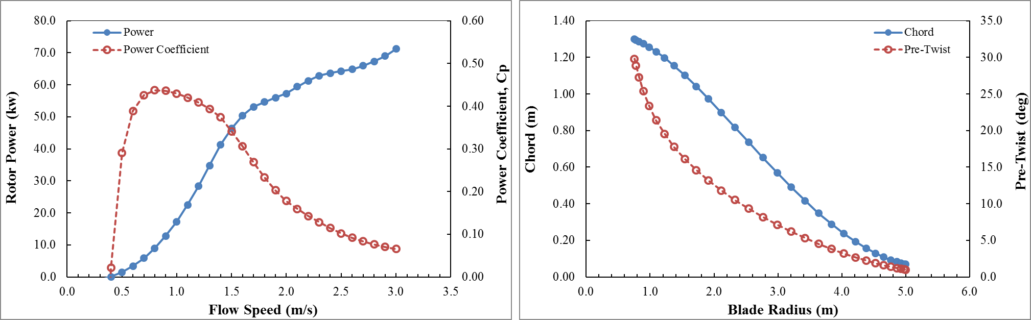
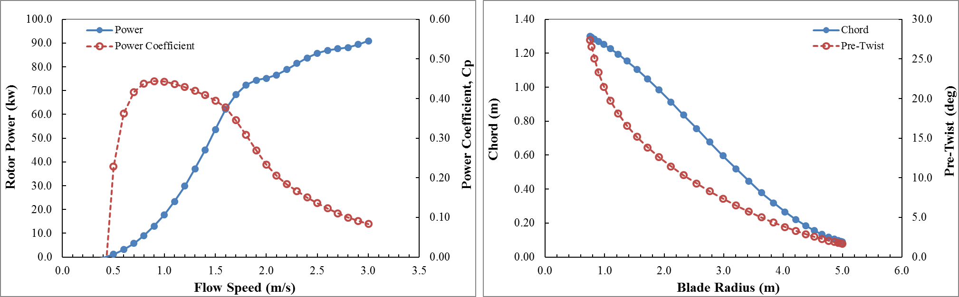
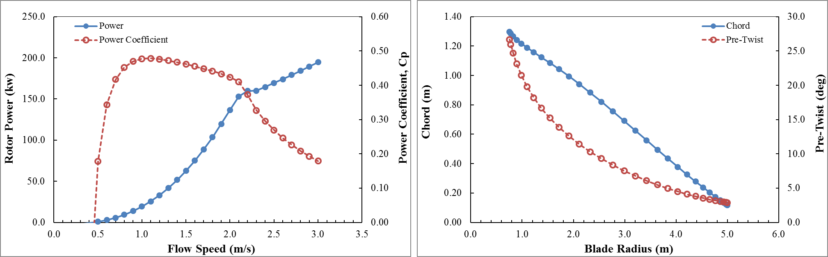
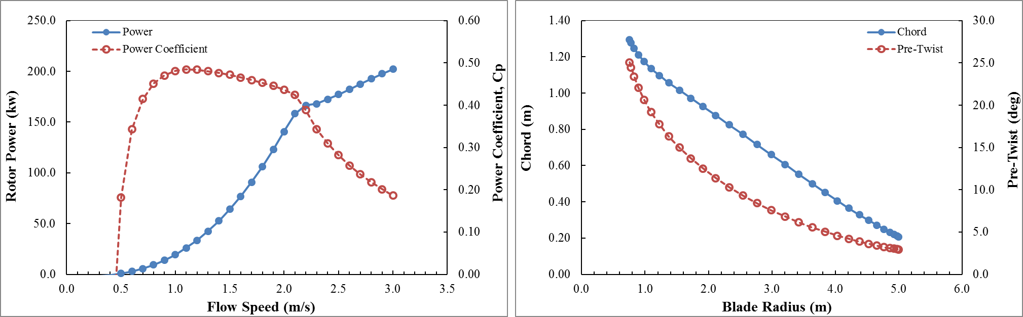
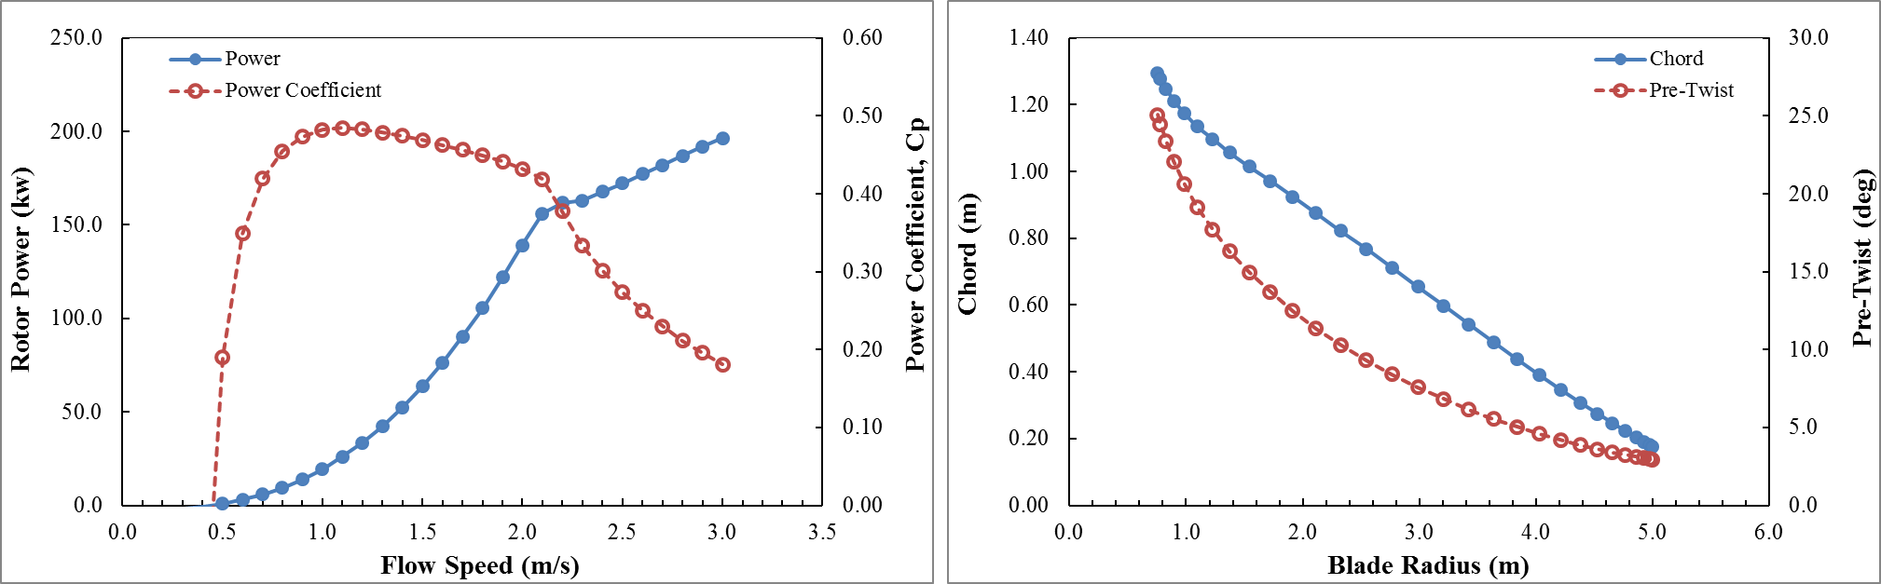
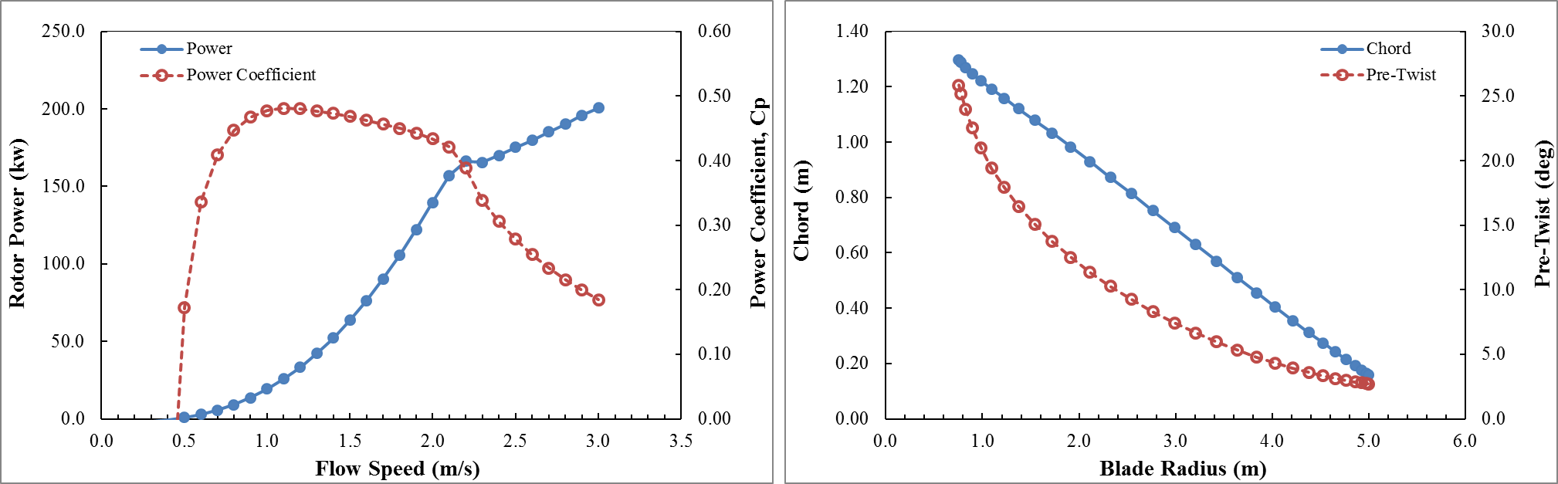
A Methodology for a Decision Support Tool for a Tidal Stream Device
A Decision Support Tool for the Resource, Performance and Survivability Analysis of Tidal Turbines
3
Blade Element Momentum Analysis Tool
Outputs
18
Introduction
Tool 1
Tool 2
Tool 3
Tool 4
Tool 5
Conclusion
14

Slide 20
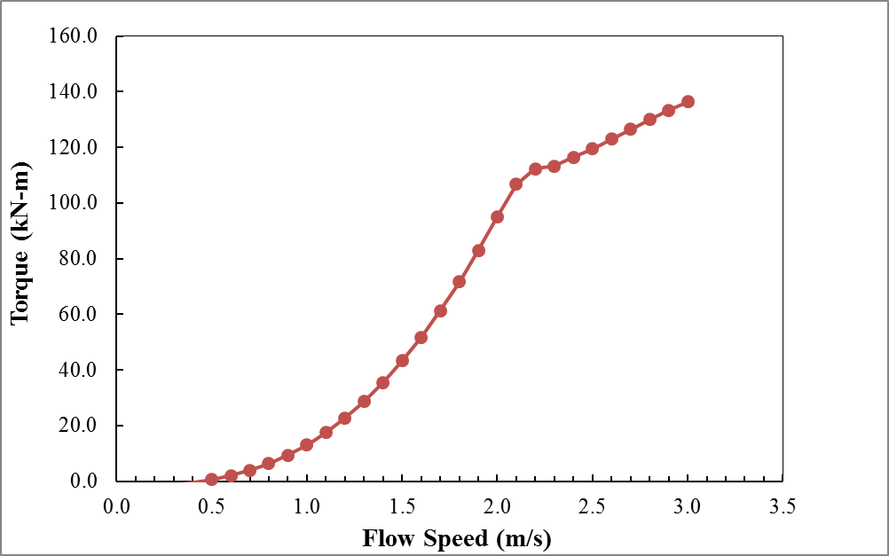
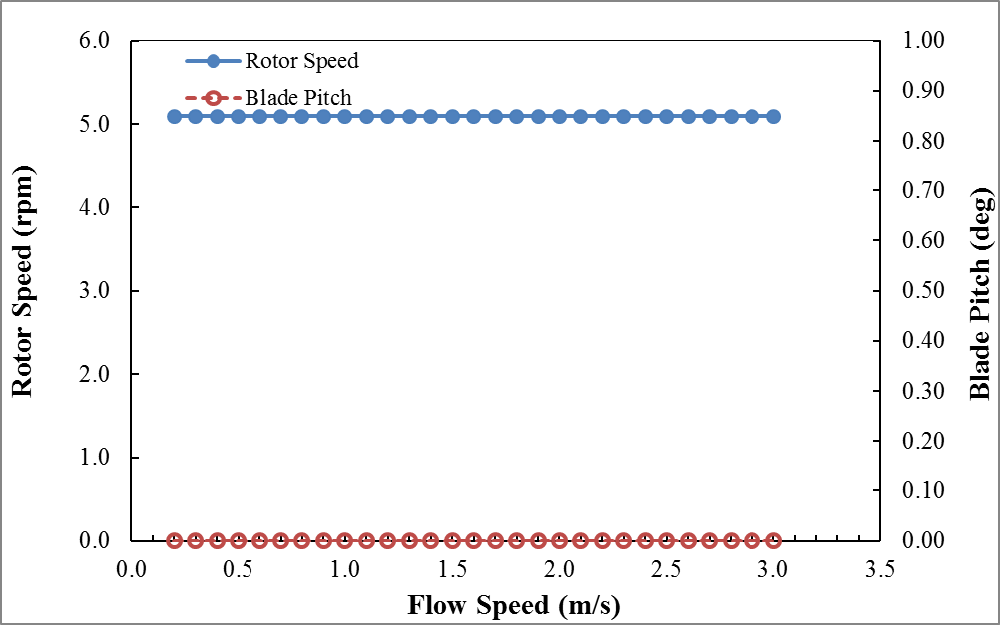
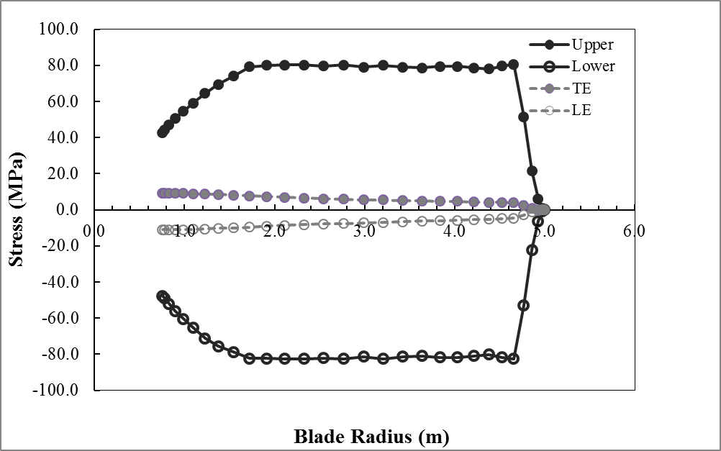
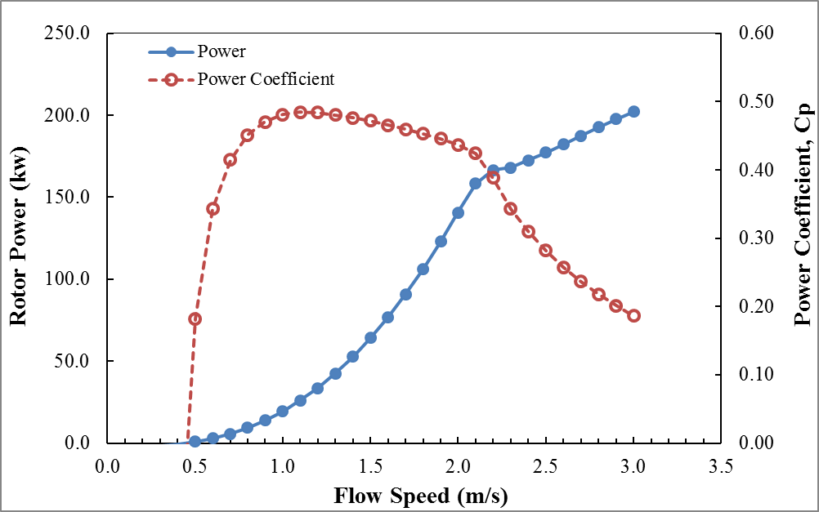
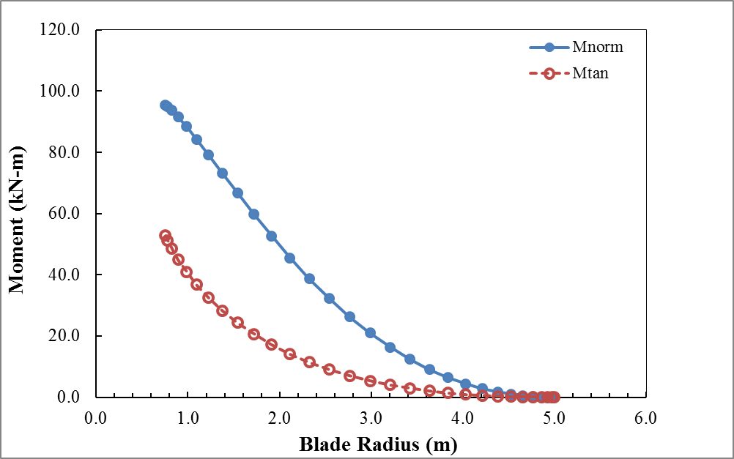
A Methodology for a Decision Support Tool for a Tidal Stream Device
A Decision Support Tool for the Resource, Performance and Survivability Analysis of Tidal Turbines
3
Blade Element Momentum Analysis Tool
Outputs
Stresses [MPa]
Fixed Rotor Speed [rpm] and Fixed Blade Pitch [deg]
Torque [kN-m]
Rotor Power [kW] and Power Coefficient [-]
Normal and Tangential Bending Moments [kN-m]
19
Introduction
Tool 1
Tool 2
Tool 3
Tool 4
Tool 5
Conclusion
15

Slide 21
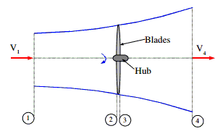
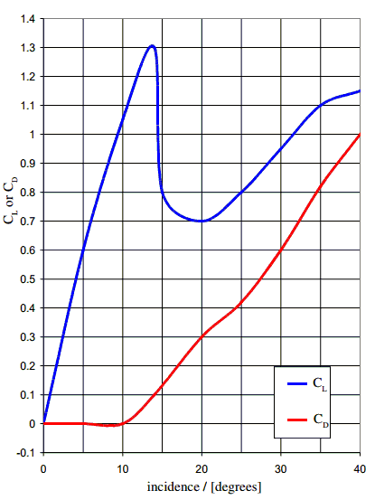
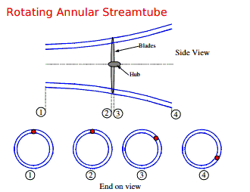
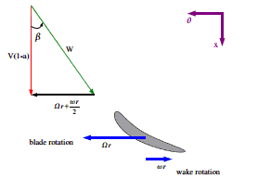
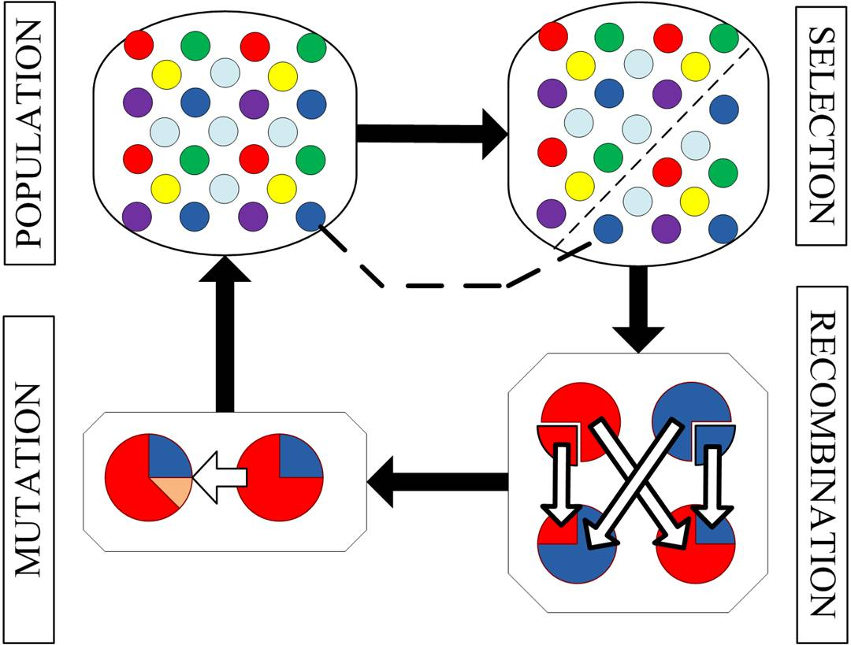
A Methodology for a Decision Support Tool for a Tidal Stream Device
3
Blade Element Momentum Analysis Tool
Methodology
Momentum Theory
1. Axial Force
2. Rotating Angular Stream Tube
Blade Element Theory
3. Relative Force
4. Blade Elements Drag and Lift
Genetic Algorithm
20
Introduction
Tool 1
Tool 2
Tool 3
Tool 4
Tool 5
Conclusion
11

Slide 22
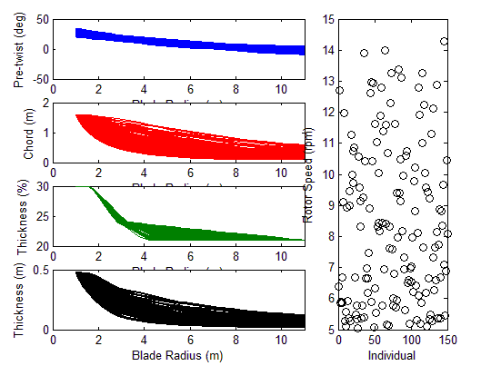
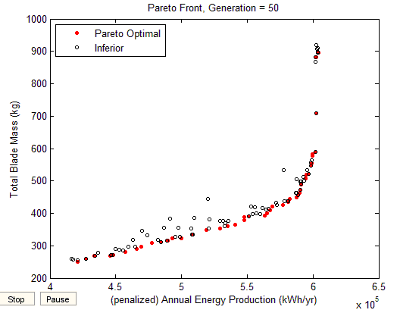
A Methodology for a Decision Support Tool for a Tidal Stream Device
3
Blade Element Momentum Analysis Tool
Methodology
Initial Population
45 Optimum Blades
21
Introduction
Tool 1
Tool 2
Tool 3
Tool 4
Tool 5
Conclusion
11

Slide 23
A Methodology for a Decision Support Tool for a Tidal Stream Device
4
Material Analysis Tool
Description
Quantify the effect of the varying loading profile during rotation of the blade on the design of the blade root
Damage Equivalent Load (DEL) method equates the damage by a spectrum of stress ranges over time to a single value alternating at a single frequency
22
Introduction
Tool 1
Tool 2
Tool 3
Tool 4
Tool 5
Conclusion

Slide 24
A Methodology for a Decision Support Tool for a Tidal Stream Device
4
Material Analysis Tool
Inputs
BEM
Tidal
SN Curve
Blade Root
Root bending moments & corresponding flow speed
Flow velocity behaviour at maximum and minimum depth of the blade root
Constants A & B from the equation of line
User-defined geometry & timeframe
Rotational speed of turbine
23
Introduction
Tool 1
Tool 2
Tool 3
Tool 4
Tool 5
Conclusion

Slide 25
A Methodology for a Decision Support Tool for a Tidal Stream Device
5
Material Analysis Tool
Outputs
Stress Margin
The design of the turbine root is operating within safe limits at positive values
Re-design of the turbine root segment is driven by damage accumulation as the margin approaches zero or reaches negative values.
24
Introduction
Tool 1
Tool 2
Tool 3
Tool 4
Tool 5
Conclusion

Slide 26
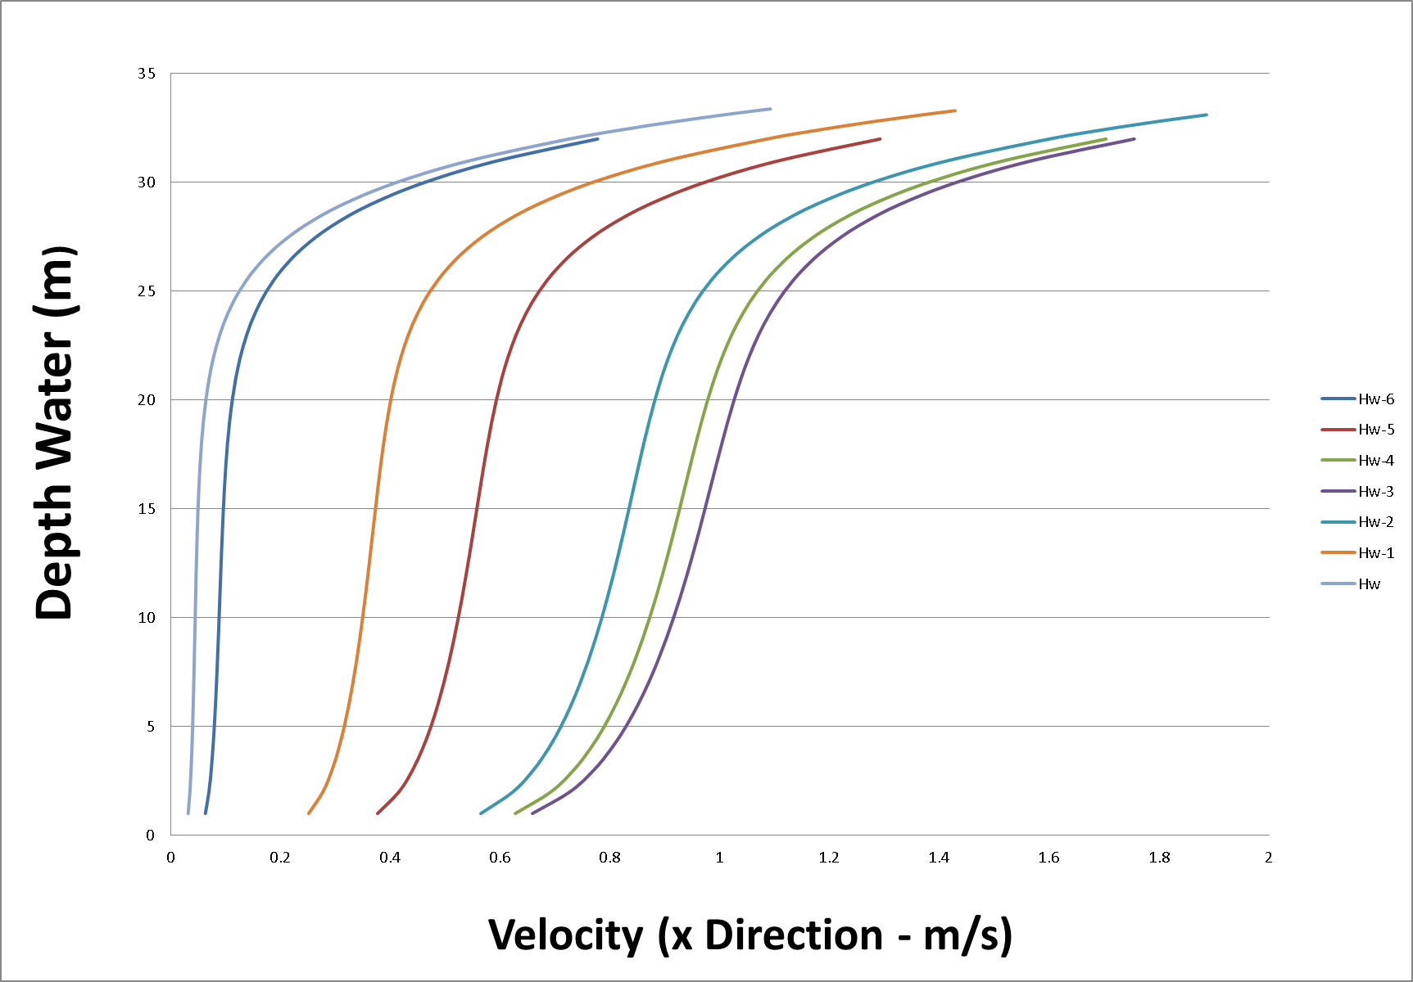
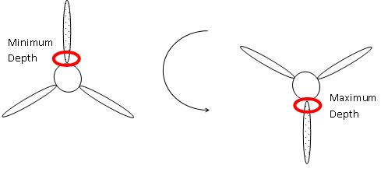
A Methodology for a Decision Support Tool for a Tidal Stream Device
5
Material Analysis Tool
Methodology
Root Bending Moments
Stress at Max and Min Depth of Root
Calculate Stress Range & Count Stress ‘Bins’
DEL
Stress Margin (%)
↑Velocity
↓Velocity
25
Introduction
Tool 1
Tool 2
Tool 3
Tool 4
Tool 5
Conclusion

Slide 27

A Methodology for a Decision Support Tool for a Tidal Stream Device
A Decision Support Tool for the Resource, Performance and Survivability Analysis of Tidal Turbines
5
Techno-Economic Analysis Tool
Description
↑Energy
↓LCoE ?
↓Mass
26
Introduction
Tool 1
Tool 2
Tool 3
Tool 4
Tool 5
Conclusion
11

Slide 28
A Methodology for a Decision Support Tool for a Tidal Stream Device
A Decision Support Tool for the Resource, Performance and Survivability Analysis of Tidal Turbines
5
Techno-Economic Analysis Tool
Inputs
Material Cost [₤/kg]
Turbine Diameter [m]
Rated Power [kW]
Availability [%]
Efficiency [%]
ROCs CfD Tariff [₤/MW-h]
Discount Rate [%]
27
Introduction
Tool 1
Tool 2
Tool 3
Tool 4
Tool 5
Conclusion
11
Notes:
Blade Element Momentum Theory equates two methods of examining how a wind turbine operates. The ﬁrst method MOMEMENTUM METHOD is to use a momentum balance on a rotating annular stream tube passing through a turbine. The second BLADE ELEMENT METHOD is to examine the forces generated by the aerofoil lift and drag coefﬁcients at various sections along the blade. These two methods then give a series of equations that can be solved iteratively.
a=(v1-v2)/v1 (AXIAL INDUCTION FACTOR)
Momentum method……………………………..
1. Axial Force
(Axial Stream tube around a Wind Turbine)
Bernouilli eq AND p1=p4, V2=v3 → AXIAL FORCE on the blade
2. Rotating Annular Stream tube
(Rotating Annular Stream tube)
Conservation of angular momentum in the annular stream tube FOR the 4 stations where, blade rotates at GAMMA mayus → TANGENTIAL FORCE on an annular element of fluid → Torque (T) = tangential force * radius
+Tip Lost Correction (At the tip of the turbine blade losses are introduced in a similar manner to those found in wind tip vorticies on turbine blades)
Blade element method…………………..
3. Relative Flow
(Forces on the turbine blade)
Lift and Drag available for multitude of profiles (Naca, Gottinger, FFA,…) so…NEED to relate the flow over the moving airfoil to that of the stationary tests → Relative velocity over the airfoil. → Induction factors
Beta → Angle Drag<->Axial Force and also → Angle Lift<->Tangential Force, since Drga and Lift are based in these factors.
4. Blade Elements
(Forces on the turbine blade)
Sigma prima=LOCAL SOLIDITY: number blades x thickness / (2*PI*r)

Slide 29

A Methodology for a Decision Support Tool for a Tidal Stream Device
A Decision Support Tool for the Resource, Performance and Survivability Analysis of Tidal Turbines
5
Techno-Economic Analysis Tool
Outputs
LCoE [₤/MW-h]
Capacity Factor [%]
CAPEX [₤]
Revenues [₤]
Discounted Profit [₤]
Payback [years]
Project Life [years]
↓LCoE
28
Introduction
Tool 1
Tool 2
Tool 3
Tool 4
Tool 5
Conclusion
11
Notes:
Blade Element Momentum Theory equates two methods of examining how a wind turbine operates. The ﬁrst method MOMEMENTUM METHOD is to use a momentum balance on a rotating annular stream tube passing through a turbine. The second BLADE ELEMENT METHOD is to examine the forces generated by the aerofoil lift and drag coefﬁcients at various sections along the blade. These two methods then give a series of equations that can be solved iteratively.
a=(v1-v2)/v1 (AXIAL INDUCTION FACTOR)
Momentum method……………………………..
1. Axial Force
(Axial Stream tube around a Wind Turbine)
Bernouilli eq AND p1=p4, V2=v3 → AXIAL FORCE on the blade
2. Rotating Annular Stream tube
(Rotating Annular Stream tube)
Conservation of angular momentum in the annular stream tube FOR the 4 stations where, blade rotates at GAMMA mayus → TANGENTIAL FORCE on an annular element of fluid → Torque (T) = tangential force * radius
+Tip Lost Correction (At the tip of the turbine blade losses are introduced in a similar manner to those found in wind tip vorticies on turbine blades)
Blade element method…………………..
3. Relative Flow
(Forces on the turbine blade)
Lift and Drag available for multitude of profiles (Naca, Gottinger, FFA,…) so…NEED to relate the flow over the moving airfoil to that of the stationary tests → Relative velocity over the airfoil. → Induction factors
Beta → Angle Drag<->Axial Force and also → Angle Lift<->Tangential Force, since Drga and Lift are based in these factors.
4. Blade Elements
(Forces on the turbine blade)
Sigma prima=LOCAL SOLIDITY: number blades x thickness / (2*PI*r)

Slide 30
A Methodology for a Decision Support Tool for a Tidal Stream Device
A Decision Support Tool for the Resource, Performance and Survivability Analysis of Tidal Turbines
5
Techno-Economic Analysis Tool
Outputs
Aluminium
Stainless Steel
29
Introduction
Tool 1
Tool 2
Tool 3
Tool 4
Tool 5
Conclusion
11

Slide 31


A Methodology for a Decision Support Tool for a Tidal Stream Device
A Decision Support Tool for the Resource, Performance and Survivability Analysis of Tidal Turbines
5
Techno-Economic Analysis Tool
Methodology
Sensitivity Analysis
(Cost Study for Large Wind Turbine Blades: WindPACT Blade System Design Studies)
(Issues and Opportunities for Advancing Technology, Expanding Renewable Generation and Reducing Emissions)
30
Introduction
Tool 1
Tool 2
Tool 3
Tool 4
Tool 5
Conclusion
11

Slide 32

A Methodology for a Decision Support Tool for a Tidal Stream Device
A Decision Support Tool for the Resource, Performance and Survivability Analysis of Tidal Turbines
Diagram
1
2
3
4
5
Flow Probabilities
Wave/Tidal Interaction
Exceedance Curve Calculator
BEM Analysis
Material Analysis
Techno-Economic Analysis
Aluminium Alloy
D_{rot} = 22 [m]
d_{HUB-SABED} = 15 [m]
45 Optimum Blades
LCoE = 192 [£/MW-h]
31
Introduction
Tool 1
Tool 2
Tool 3
Tool 4
Tool 5
Conclusion
11

Slide 33
A Methodology for a Decision Support Tool for a Tidal Stream Device
Conclusions
Reliable
Compact
Efficient
32
Introduction
Tool 1
Tool 2
Tool 3
Tool 4
Tool 5
Conclusion

Slide 34
A Methodology for a Decision Support Tool for a Tidal Stream Device
A Methodology for a Decision Support Tool for a Tidal Stream Device
?
?
Andrew Cooper
Julen Garcia-Ibanez
Ciaran Gilbert
Stuart Mack
Xabier Miquelez de Mendiluce
29/04/2014

